Slide 1
European Vocational Skills Week in Hungary
By David Rozványi
Notes:
Dear Organisers!
Hungary is one of the „top country”. What is our secret? There is no secret just a simple method. Today I’d like to introduce our method:

Slide 2
Our steps:
5. profit!
4. support
1. communication
3. motivation
2. strategy
Notes:
The „Hungarian method” means 5 simple steps:
Communication
Strategic thinking
Motiving the organisers
Support to organisers
Not last but not least: we must introduce the profit of the European Vocational Skills Week

Slide 3
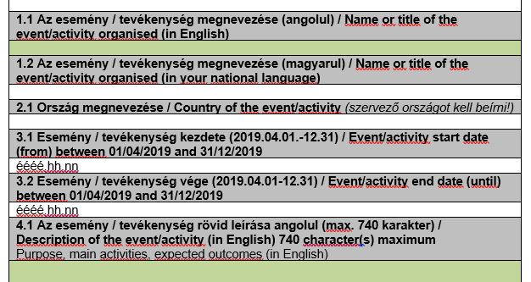
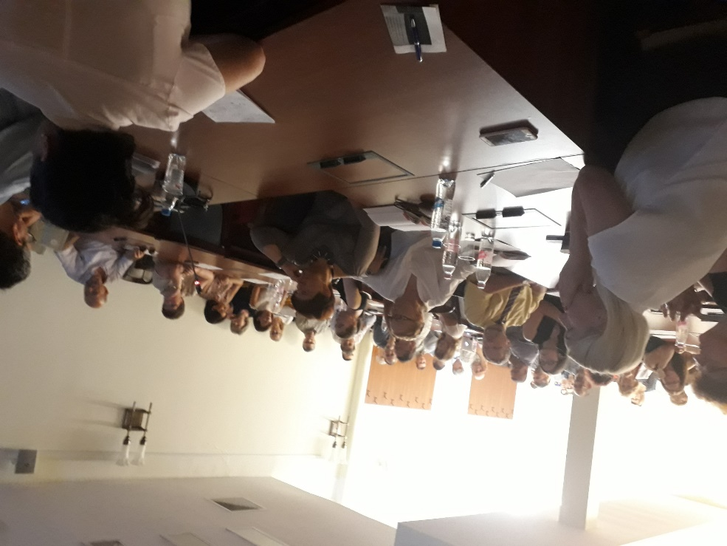
1. communication
Translating and dissemination of the official documents
Workshops for the affected organizations in every year:
Actual information
Best practices
Results
Notes:
The first step is the communication:
We translate the official documents (what you can’t find in Hungarian in the central webpage) – a.g. registration form. Here is not our friend the ‚Google translator’: we must pair the international terms with the Hungarian practice. A.g. the „Open doors event” is an „open day” in the Hungarian schools, and a visit in a company is „open doors” event too.
Every year we organise workshops to the organisers: we tell the actual information we share the actual information and our results.

Slide 4
2. strategy
Subsidiarity: Law cost and Local
The programs available throughout the country for the visitors
Flagship projects: great spectaculars programs:
What's up? Career guidance festival for technical professions
Build Your Future! Construction Career Day
Notes:
Our strategy has three levels:
The first, we encourage the organisers keeping local and law cost programs. They mustn’t thinking only the big, high-cost programs. So, every local VET schools can be successful.
We want to cover our country: every county and town must participate. And we have two „Flagship” project: by it we sell the Week in the media. Our two countrywide flagship program is the
What's up? Career guidance festival for technical professions
Build Your Future! Construction Career Day

Slide 5
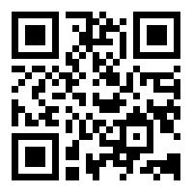
…but why it is worth joining?
3. motivation
The European Vocational Skills Week is a very good quality mark
The visual toolkit of the EVSW is very good!
Race among the counties and the organizations: who has more registered programs?
The registered programs are visible in the Hungarian website (https://szakkepzesihet.hu/)

Slide 6
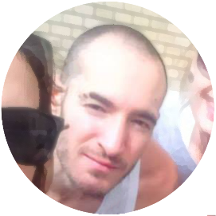
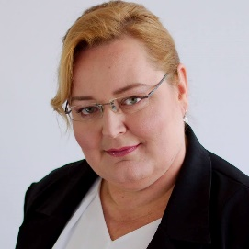
Our team support the Hungarian organizers
4. support
Quality assurance translate administration social media: David Rozványi
IT support Hungarian website: Gábor, Klement-Ugrin
Marketing and financial methods: Anikó, Angyalné Kovács

Slide 7
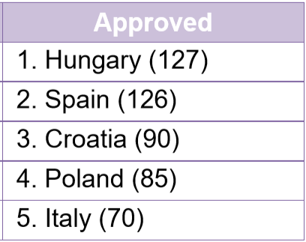
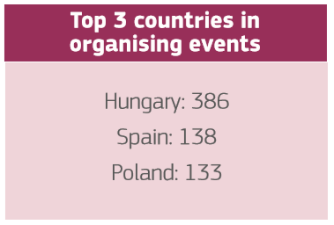
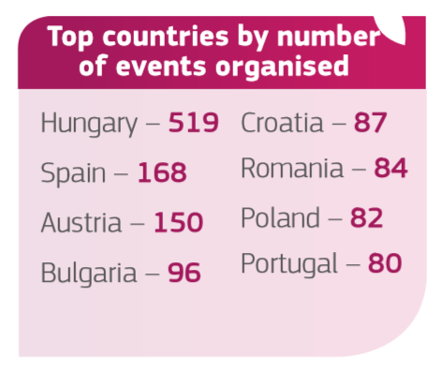
5. profit!
We are a „Top Country” – this is a good motivation, but not enough profit!
2016
2017
2018

Slide 8
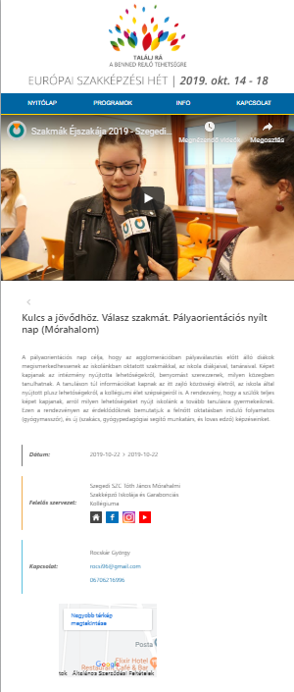
5. profit!
Our real profit:
Cooperation among the VET organizations
A new webpage is created for the parents and teachers where they can find the important Hungarian VET promotion programs (In Hungarian, with pictures, Youtube channels and GoogleMaps)
New mentality and methods in the VET promotion

Slide 9
Thank you for your attention! David Rozványi szakhet@gmail.com

