Slide 1
IMPLEMENTING INNOVATIVE VET IN FINLAND
Ville Heinonen, Senior Ministry Adviser
Tomi Kytölä, Special Adviser
Anna Mari Leinonen, Principal, Keuda Group

Slide 2
THE VET SYSTEM IN FINLAND
New legislation into effect 1.1.2018
About 280 000 students annually (5,5 million inhabitants, age cohort of 16-year-old ca. 58 000)
200 000 in IVET (Vocational qualifications, EQF 4)
80 000 in CVET (Further vocational qualifications, EQF 4, and specialist vocational qualifications, EQF 5)
VET is attractive: 44 % of comprehensive school-leavers continue in IVET
Continuous learning is reality: Over 50 % of students are 25-65 years

Slide 3
THE VET SYSTEM IN FINLAND
In 2019, total operating costs of vocational institutions amounted to 1.800 million € (average funding/student/year is approximately 9 500 €)
145 VET-providers:
municipalities, joint federations of municipalities and private organisations (non-profit organisations)
sizes ranging from 11 students to 14 500 students annually
the share of the 30 biggest VET-providers of all students is 75 %

Slide 4
THE VET SYSTEM IN FINLAND
Holistic approach: VET for young people (IVET) and adults (CVET) form a consistent whole from the lifelong learning perspective. Employment training is also integral part of VET system
Competence-based approach:
Learning outcomes matters – skills and competences needed in world of work and in society
Learner is the starting point, not the system
Focus on the skills and competences which individual is missing – recognition of prior learning
From supply-oriented to demand/need-oriented approach
Flexibility: customer segments, versatile learning environments (VET-institutions, workplaces, digital platforms), modular qualifications, pedagogical methods, applying in education, individual learning pathways
Cooperation and partnerships: world of work, other educational organisations, PES
Decision making-power largely shifted to VET providers

Slide 5
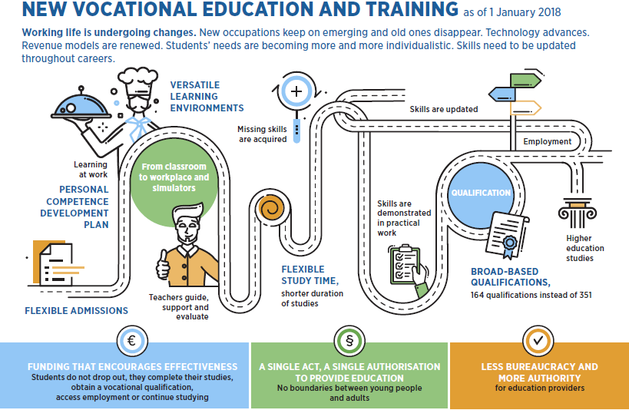

Slide 6
FLEXIBLE ADMISSIONS
There is rolling admissions throughout the year
For students completing their compulsory education there is a joint national application in the spring

Slide 7
Example: Rolling admission in Keuda
Keuda organizes a guidance day once a month
All applicants who apply during the month’s period are invited to a guidance day
During the guidance day, teachers will evaluate applicant’s eligibility to study. They make skills mapping
If applicants do not have the capacity to study for the degree sought, they will be offered another alternative
If the applicants have the capacity to study for the degree sought, they will be invited to study as soon as possible

Slide 8
INDIVIDUAL STUDY PATH FOR ALL
Objectives for competence development will be written down in a personal competence development plan.
The plan will include information on, for example, identification and recognition of prior learning, acquisition of missing skills, competence tests and other demonstration of skills, and the necessary guidance and support.
Duration of studies will be shortened through focusing on the acquisition of missing skills in a manner most suitable for the student.
Education providers will have an obligation to recognise prior learning.
Studies and the related guidance and support will correspond to the objectives, needs, life situation and skills of the student.

Slide 9
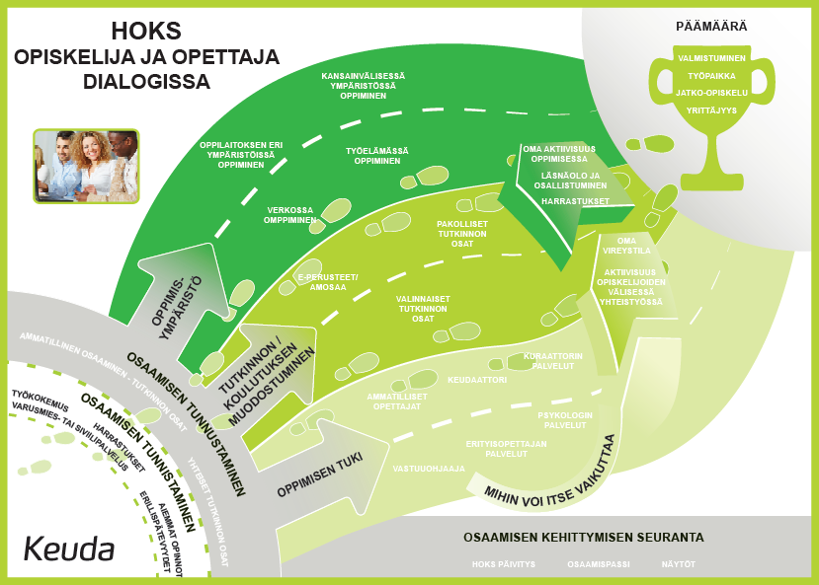
EXAMPLE: INDIVIDUAL STUDY PATH FOR ALL
Personal Competence Development Plan
Goal
Learning environment
Structure of education
How can I influence?
Learning support, special support
Existing competences
Continuous monitoring of competence development
Dialogue platform The discussion recorded in a digital student management system

Slide 10
MORE VERSATILE LEARNING ENVIROMENTS
Education providers will be responsible for and decide on the contents of education and the manner in which it is provided.
Education providers will have versatile possibilities to make use of different learning environments and pedagogical solutions (such as traditional contact teaching, simulators and other digital learning environments, and workplaces).
The contents of education must comply with the national qualification requirements or the core curriculum for preparatory education.
If a student pursuing vocational upper secondary qualification does not have any experience or competence in the practical work tasks related to the qualification, such training must be arranged at the workplace in connection with the practical work tasks.

Slide 11
MORE GUIDED LEARNING AT WORKPLACES
Training at workplaces in connection with the practical work tasks will be arranged as apprenticeship training or training based on a training agreement.
Apprenticeship training:
Based on a fixed-term employment relationship or public-service relationship (status: employed person)
Students are paid salary and employers are paid training compensation.
May apply to the entire qualification or to an individual module.
Training agreement:
Students are not in an employment relationship (status: student).
Students receive no salary and employers receive no training compensation.
Is made as per module.
A student may flexibly transfer from a training agreement to apprenticeship training, when the prerequisites for concluding an apprenticeship agreement are met.

Slide 12
EXAMPLE:
MORE VERSATILE LEARNING ENVIROMENTS
Everyday co-operation with the working life
Work-based learning is an integral part of every qualification
Work-based learning is planned in a personal competence development plan
There are two forms of WBL: Training agreement and apprenticeship – which may vary flexibly during the individual’s studies.
The teacher coaches students throughout the progress. And the student has his own trainer at the workplace
Teachers maintain their professional skills through WBL -periods
In addition to WBL there is a customer and student projects

Slide 13
EXAMPLE:
MORE VERSATILE LEARNING ENVIROMENTS
International mobility of students
All students can study abroad
Guidance and counselling has to take this into account
Use a lot of digitalization and robotization
In all diversified learning environments, students are coached and supported in every step of the way

Slide 14
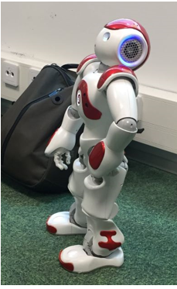
EXAMPLE: Digitalisation - Keuda digilabs
Keuda Digilabs are low-threshold workshops, where students and teachers can explore new tech together with an expert and colleagues. Afterwards participants will get, if they want, Keuda New Tech digital competency badges. Even physical ones!
Keuda Digilabs - Digital makerspaces offer easy accesses to new technologies such as:
Augmented Reality (AR),
Virtual Reality (VR),
3D modeling and printing (3D),
Robotics (ROBO), several robo"paths" possible,
new Digital Media (DM) possibilities like 360 cameras,
easy effective (even fun) applications for images, videos etc.
Artificial Intelligence (AI) examples to use yourself, and
even some more digital paths on the plate.
https://www.thinglink.com/video/1226492501720825861

Slide 15
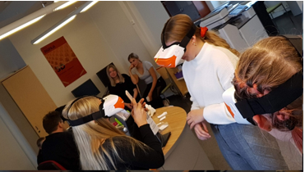
EXAMPLE: Digitalisation - Keuda digilabs
Three levels:
Level 1: Easy "digi shower" like What’s it about (You'll learn some basics and can try yourself)
Level 2: We go deeper.
Level 3: You are figuring yourself (together with your teacher) what this means in my field of studies.
Learn more Bit.ly/arkeuda (The Most Digital Act 2019) Not just theory, but actually putting things into practice. If you are interested in knowing more, you are welcome
to visit our Digilabs! More information:
Mr. Kari Honkonen kari.honkonen@keuda.fi

Slide 16
QUALIFICATIONS ARE COMPLETED THROUGH COMPETENCE DEMONSTRATIONS
Vocational skills are primarily demonstrated in practical work situations at workplaces (=competence demonstrations)
Competences are assessed as per module of a qualification or preparatory education.
In a competence demonstrations, the student's competence is assessed by a teacher and a representative of working life together.
Working and business life will be given a strong role in assuring the quality of skills: a representative of working life is one of the two assessors, and working life committees will ensure the quality of vocational skills at national level.

Slide 17
EXAMPLE: In-service training of personnel
Managerial Forums - Knowledge Management (4 times split morning / afternoon / year), HR for all supervisors Pedagogical program, Changed VET, Team Coaching (Team Academy)
Learning Cafes for Team Managers (4 times / year) Personal Competence Development Plan, Training Offerings, Competence Based, Partnership Team coaching
Pedagogical training for teachers (4 times / year) Working in a team Teaching and guidance in different learning environments Skills mapping themes, Competence based education

Slide 18
NATIONAL DIGITAL SOLUTIONS AS PART OF THE IMPLEMENTATION
National solutions that where developed further for example
Studyinfo.fi information about study programmes leading to a degree, joint applications etc.
eRequirements –service, includes for example qualification requirements for the vocational qualifications, basically cover everything from pre-primary to upper secondary
Arvo – Education Management Information Service, survey data
…
New solutions
eHOKS –service to support individual study paths
Open education resource service, to support the use of OER –materials produced in education
Programs to develop the capabilities of the education providers, from teacher training to information architecture

Slide 19
CHALLENGES FOR VET
Changes of work and technology.
Digitalisation, automation, robots, artificial intelligence are a great possibility to the working life and the economy, but they also bring challenges.
Dynamics in labour markets is rising
Ageing workforce
It is more and more important that everyone’s skills are up-to-date to stay employable.
Level of education
Those born in the 1970s are likely to be the age cohort with the highest level of education in Finland, leaving all others behind.
Despite an upper secondary qualification having been recognised as the minimum level of education for anybody to find work and participate in a modern society, 16 per cent of the age cohort fails to complete this educational level.
Need for new ways to ensure that our skills development professionals, educators, can boost learning at working places, not just inside educational institutions.

Slide 20
MORE INFORMATION
More information about Finnish VET: https://minedu.fi/en/vocational-education-and-training
More information about the Government Programme 2019: https://minedu.fi/en/vocational-education-and-training

Slide 21
Education and Training Services
Services for Working Life
Covers all vocational sectors:
Automotive and Transport
Wellness and Welfare
Business and Commerce
Naural Resources and Environment
Hospitality Services
Technology and Construction
Keuda is a consortium owned by 7 municipalities: Järvenpää, Kerava, Mäntsälä, Nurmijärvi, Pornainen, Tuusula and Sipoo
Population of the area over 220 000
About 6500 student years / over 10 000 students
Staff 620 (2/3 teaching staff)
Turn-over about 60 M€
11 training units

