Slide 1
Learning providers and the EU mobility:
reinforcing VET attractiveness through staff engagement (WG2)
CEDEFOP Jon Harding and all

Slide 2
Working group two – VET mobility
#DiscoverYourTalent

Slide 3
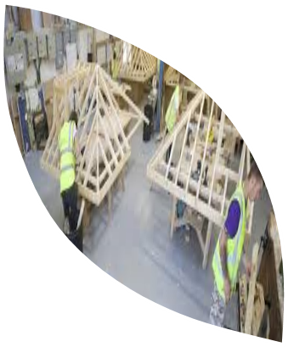
Part 1 - VET staff mobility: Current situation
VET Staff
VET-providers and institutions
Industry

Slide 4
VET staff mobility – What for?
improved competences, linked to their professional profiles;
broader understanding of practices, policies and systems in education, training or youth across countries;
increased capacity to trigger changes in terms of modernisation and international opening within their educational organisations;
greater understanding of interconnections between formal and non-formal education, vocational training and the labour market respectively;
better quality of their work and activities in favour of students, trainees, apprentices, pupils, adult learners, young people and volunteers;
greater understanding and responsiveness to social, linguistic and cultural diversity;
increased ability to address the needs of the disadvantaged;
increased support for and promotion of mobility activities for learners;
increased opportunities for professional and career development;
improved foreign language competences;
increased motivation and satisfaction in their daily work

Slide 5
VET staff mobility – Driver of Change
Pulling down barriers;
Mobility for all;
Peer learning for innovation;
Collective inspiration about pedagogy/methodology;
Personal & professional development;

Slide 6
VET staff mobility – Driver for Change (Opportunities)
Public policy strategy to embed internationalization in curricula;
Increase funding per mobility and administration support;
The possibility of running training courses, events, study visits and peer learning activities;
Europe-wide recognition of achievements of mobility as part of staff CPD;
Review and update EU Transparency Tools for mobility;
Improve digitalisation of mobility documentation and processes;
Engage staff from the VET stakeholders in mobility;

Slide 7
Thank you for your attention!
VET for the future

