Slide 1
The UNESCO Institute for Lifelong Learning
Werner Mauch
Team Leader, MALL
ET2020 Working Group
on Adult Learning 2018 - 2020
Vocational Skills as Part of
Adult Learning and Education (ALE)
Helsinki, European Vocational Skills Week 2019
15 October 2019
Notes:
Welcome

Slide 2
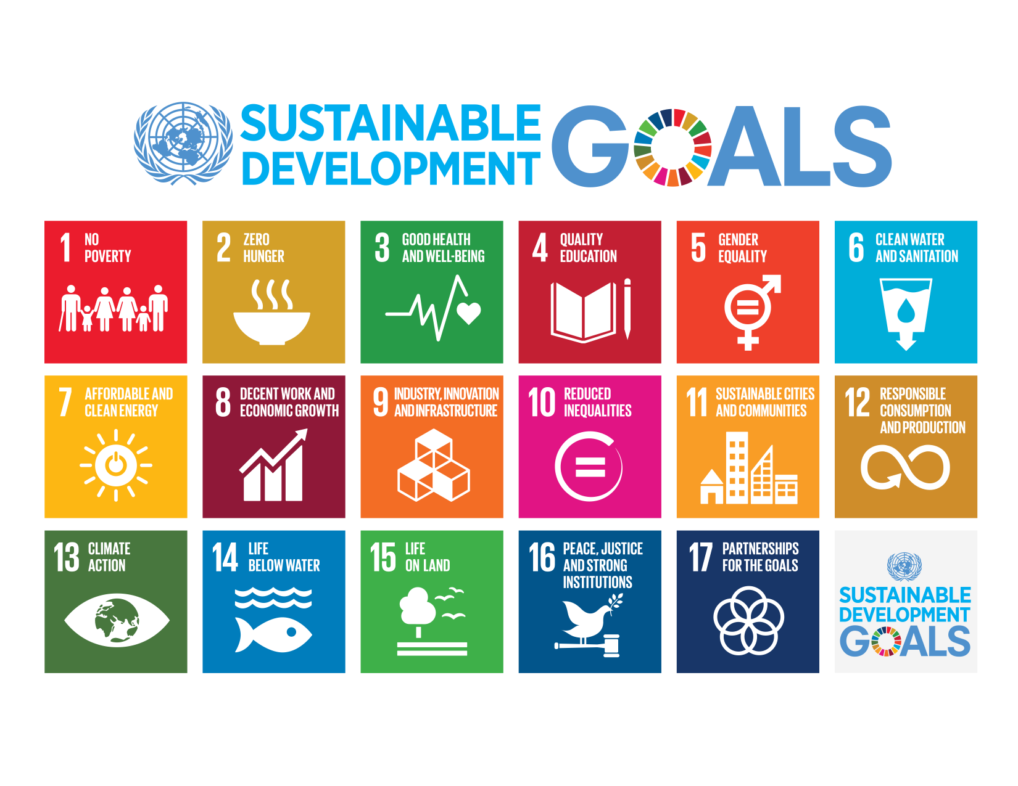
Notes:
Our plan for action is the UN Sustainable Development Agenda. And UNESCO has a particular role to play in this Agenda

Slide 3
Ensure inclusive and
equitable quality education and
promote lifelong learning
opportunities for all
Notes:
And UIL‘s mandate lies in the second part of this goal

Slide 4
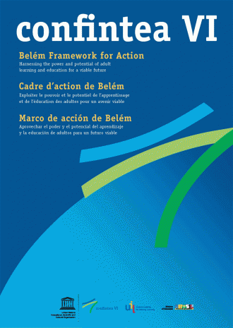
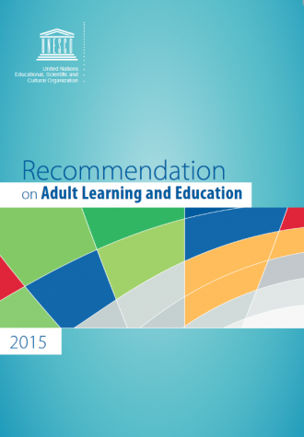
Two Frameworks
Belém Framework for Action (2009)
RALE (2015)

Slide 5
GCED for Youth and Adult Learners
ALE: Three key fields of learning
Literacy/Basic Skills
Professional Development/ Vocational Skills
Active Citizenship
Skills
Notes:
Literacy is a key component of adult learning and education. It involves a continuum of learning and proficiency levels which allows citizens to engage in lifelong learning and participate fully in community, workplace and wider society. It includes the ability to read and write, to identify, understand, interpret, create, communicate and compute, using printed and written materials, as well as the ability to solve problems in an increasingly technological and information-rich environment. Literacy is an essential means of building people’s knowledge, skills and competencies to cope with the evolving challenges and complexities of life, culture, economy and society.
Continuing training and professional development is a fundamental element in a continuum of learning that equips adults with the knowledge, skills and competencies to fully engage in rapidly-changing societal and working environments.
ALE also also includes education and learning opportunities for active citizenship, variously known as community, popular or liberal education. It empowers people
to actively engage with social issues such as poverty, gender, intergenerational solidarity, social mobility, justice, equity, exclusion, violence, unemployment, environmental protection and climate change. It also helps people to lead a decent life, in terms of health and well-being, culture, spirituality and in all other ways that contribute to personal development and dignity.

Slide 6
RALE: three key fields of learning
Policy
1) Literacy and Basic Skills
2) Continuing Training and Professional Development -> Vocational Skills | Equips adults with the knowledge, skills and competencies to fully engage in rapidly-changing societal and working environments
3) Community/Popular/Liberal Education -> Active Citzenship Skills
Governance
Financing
Participation, equity and inclusion
Quality

Slide 7
ALE Monitoring Frameworks
GRALE is a monitoring tool, much like a pair of glasses, with which we can look at the international scene of ALE through two lenses.
Recommendation on ALE (RALE)
Policy and decision-making framework
Belém Framework for Action ( BFA)
Five areas of action
Notes:
In future, international monitoring of ALE will be undertaken by addressing the two key frameworks at the same time, i.e. the Belém Framework for Action and the RALE. This concept will also be presented to the upcoming CONFINTEA Mid-Term Review (2017). The Mid-Term Review will take stock of achievements concerning implementatioon of the BFA and propose an overall strategy together with key activities to ensure implementation of tghe BFA until 2021. In 2021 CONFINTEA VII will take place, to adopt new guidelines for the international development of ALE up to CONFINTEA VIII.

Slide 8
GRALE 3 (2016): ALE benefits individuals, employers & societies
Healthy behaviours & attitudes
Longer life expectancy
A reduction in lifestyle diseases
Lower costs for acute healthcare
Skills & employability
Higher wages
Job satisfaction & commitment
Greater productivity & entrepreneurship
Tax revenues
Literacy & numeracy
Life skills such as resilience & self-confidence
Tolerance of diversity
Attention to the environment
Social cohesion
Political participation

Slide 9
GRALE 3 (2016): ALE benefits individuals, employers & societies
89% of countries agree that ALE contributes “a great deal” to personal health & wellbeing
More than 50% of countries agree that ALE has a positive effect on employability and labour markets
Two thirds of countries say that literacy programmes help develop democratic values, peaceful co-existence and community solidarity

Slide 10
Participation in ALE analysed and strengthened through GRALE 4 (2019)
Concepts of participation, measuring participation
Vocational skills (4.3, 4.4)
Basic skills (4.6)
Active and global citizenship (4.7)

Slide 11
Future trends:
Linking the three fields
TVET = genuine alternative to higher education
Vocational skills as part of global citizenship education (GCED)

Slide 12
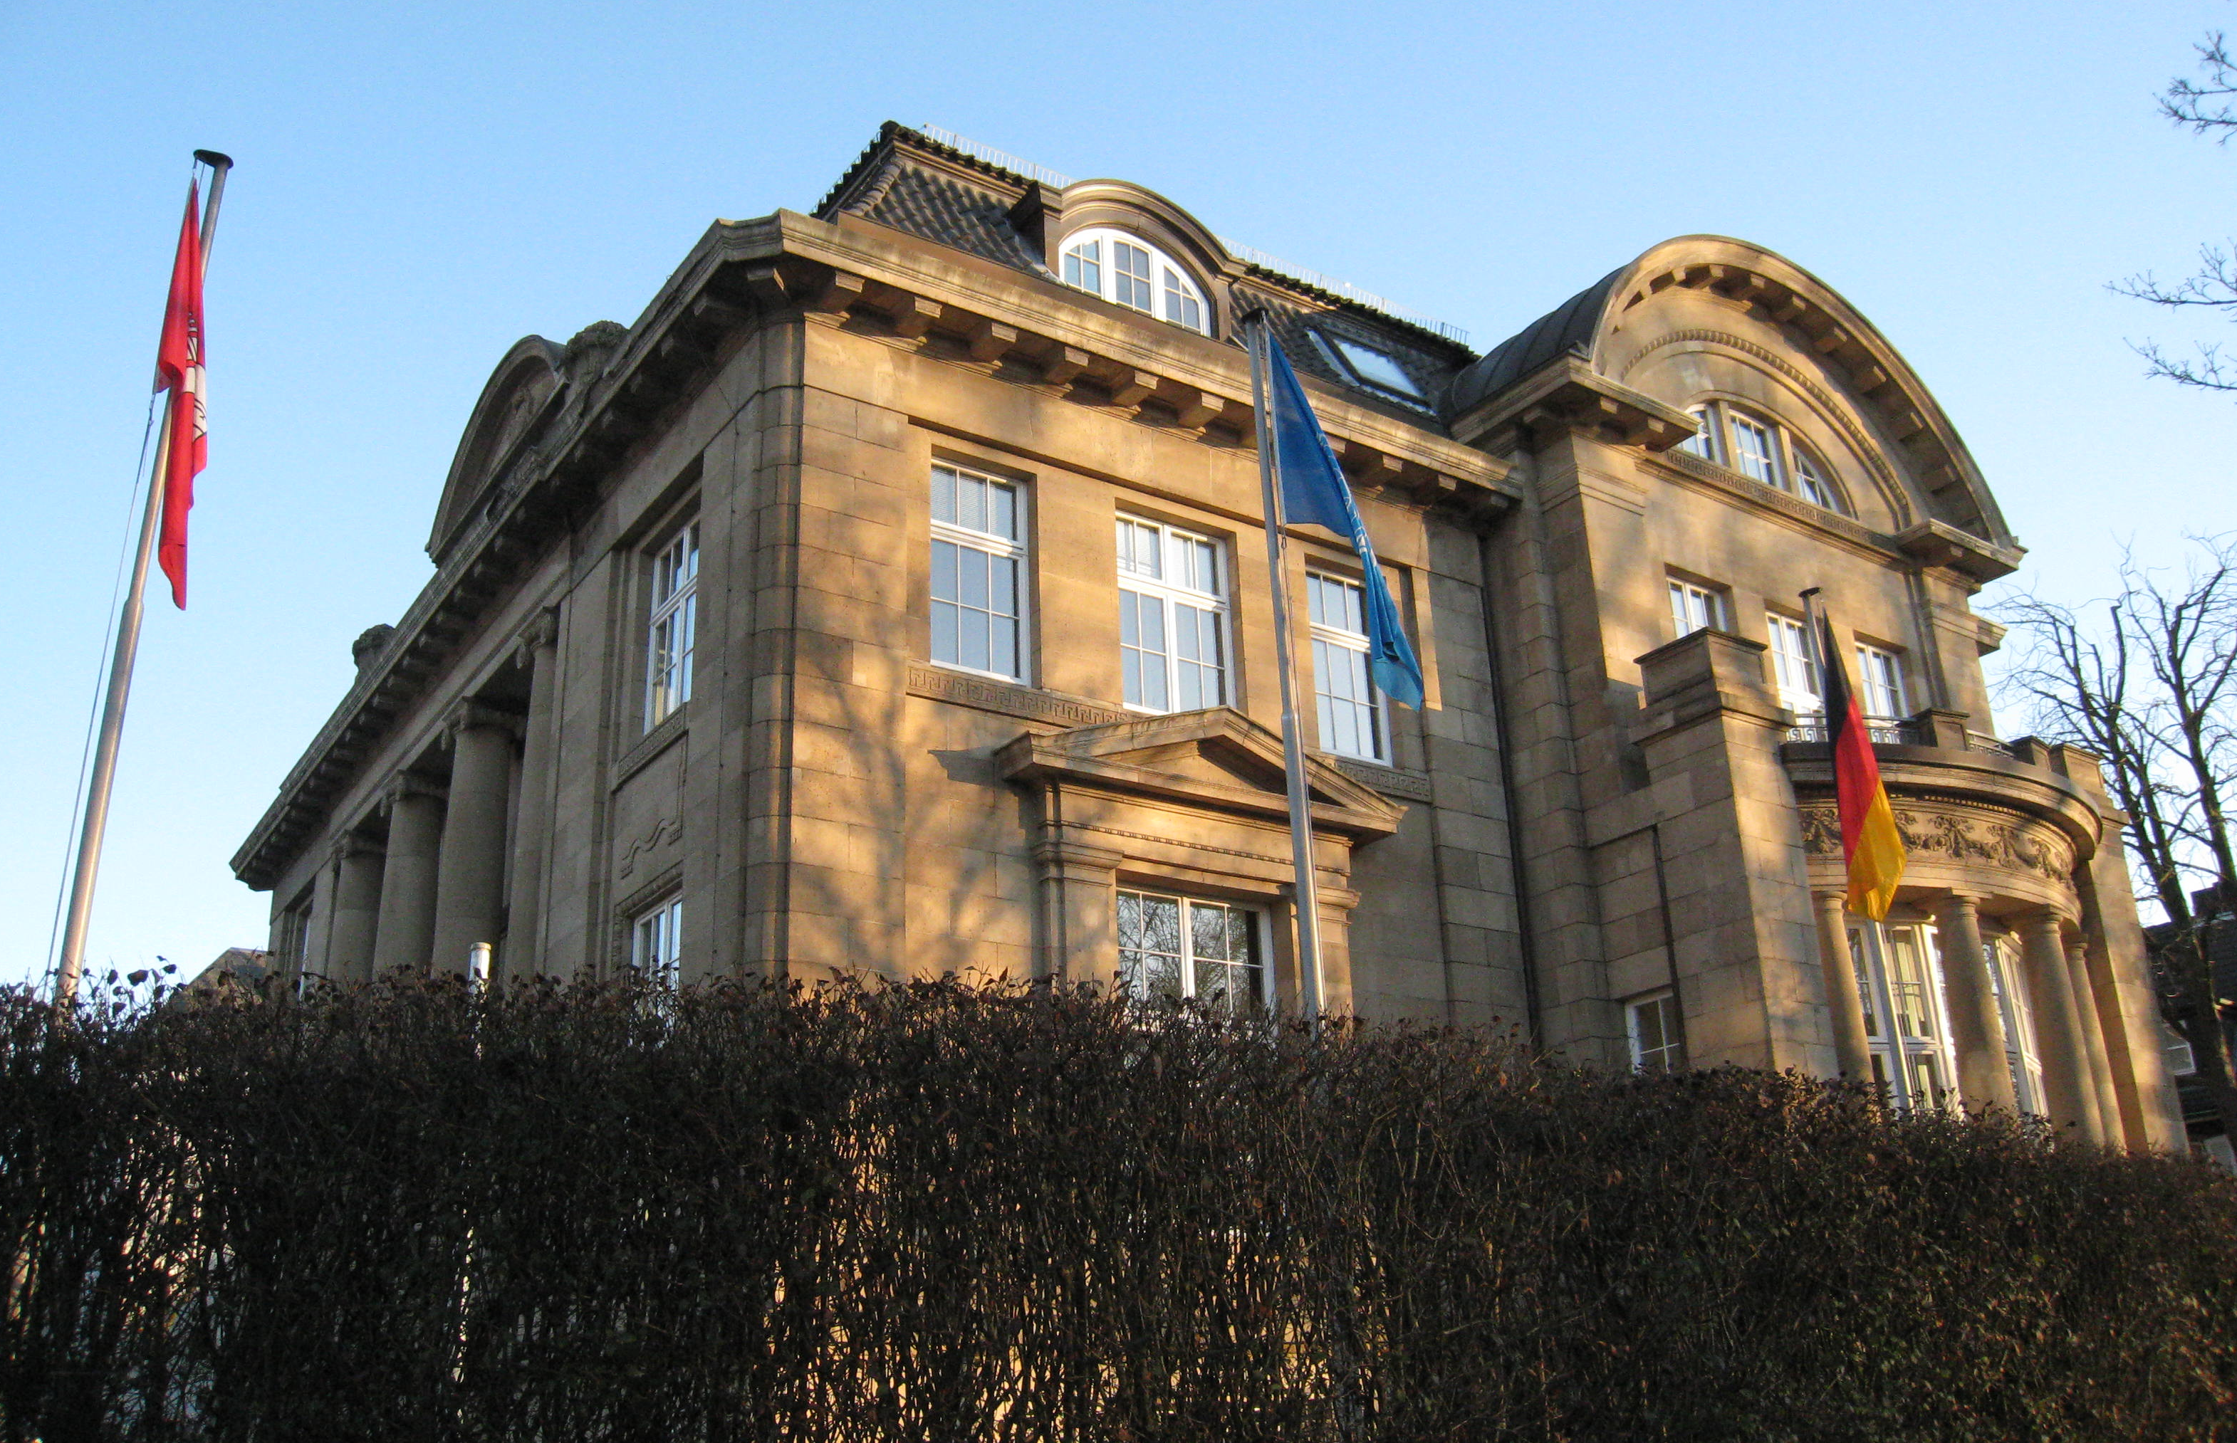
Thank you!
unesco.org/uil
@uil
@unesco.uil/
Michelle Diederichs, Public Relations Specialist m.diederichs@unesco.org

