Slide 1
EUROPEAN VOCATIONAL SKILLS WEEK
VET for ALL – Skills for Life conference
Vocational excellence
17 October 2019

Slide 2
Chamber of Skilled Crafts Handwerkskammer Freiburg Gewerbe Akademie Vocational Training Center
Notes:
Ladies and Gentlemen,
Thank you very much for the invitation and the opportunity to present a part of our work.
My name is Joachim Rapp.
I am a project manager for vocational education and training at the Chamber of Skilled Crafts Freiburg.
I am responsible for the development of initial vocational training and further education in our vocational training centers.
I would like to introduce you to a few projects that identify, analyze and evaluate changes in craft trades. And how we integrate these changes in our teaching.

Slide 3
Cooperation and partnerships of Vocational Training Centers
Notes:
... and I would like to share a few examples of our cooperations, partnerships and networks in our education centres.

Slide 4
53 Chambers of Skilled Crafts
Sovereign tasks – commissioned by the Federal Government
Registration und Monitoring
Handicraft businesses
Vocational Education and Training
Freiburg
source: www.ZDH.de
Notes:
In Germany there are 53 Chambers of Skilled Crafts.
They represent the interests of handicraft businesses in Germany.
For this purpose, the Chambers of Skilled Crafts have been given state monitoring tasks.
On the one hand, they take care of the registration and monitoring of the craft businesses
On the other hand, they take care of all matters of vocational education and training

Slide 5
Vocational Education and Training in Germany
governed by the Vocational Training Act The Dual System of Vocational Education and Training
Professional School ~ 30%
In-company Training ~ 70%
123 trades in the handicraft business
Duration of vocational training 3 – 3,5 years
Notes:
Vocational training in Germany is regulated by the Vocational Training Act.
We train according to the dual VET-System.
About 30% of the apprenticeship time trainees learn at the professional school
Around 70% of the training period they learn and work in their training company.
There are 123 apprenticeship trades in the handicraft businesses.
Every apprentice concludes a training contract with his or her training company.
Depending on the profession, training lasts between 3 and 3.5 years in Germany.

Slide 6
The DUAL VET with Inter-company Training
Notes:
But in fact, the dual system actually has three parts.
Part No. I is the professional school
… and Part No. II is the In-company training
… the third part is the inter-company training.
Inter-company training supports the training companies, especially SMEs. The practical training courses in VET centers guarantee that all important training content is systematically covered.
For each trade special practice courses were developed. They always last one week and take place in the workshops of the VET Centers.

Slide 7
Vocational Training Centers in Germany > 1.000
Notes:
Today there are over 1,000 vocational training centers in Germany
At first the training centers were founded just for inter-company training.
But vocational education and training offers more than just initial education

Slide 8
Career in Crafts Chamber of Skilled Crafts Freiburg Gewerbe Akademie Vocational Training Centers
Bachelor of Arts (B.A.) in Business Admini-stration
Business Ad-ministration of crafts
Education to Master of Skilled Crafts
Further Vocational
Education
Initial
Vocational Education and Training
Professional Orientation
Notes:
That is the reason why the Freiburg Chamber of Skilled Crafts has developed a concept for vocational education and training that takes many aspects of lifelong learning into account.
So you find
clicking
Professional orientation
clicking
Initial Vocational Education and Training
clicking
Further education
clicking
Education to Master of Skilled Crafts - Handwerksmeister
clicking
Studies of Business Administration of Skilled Crafts
clicking
Studies of Bachelor of Arts in Business Administration
For each level our VET Centers offer special programs and projects.

Slide 9
Cooperations and Partnerships in VET Training Centers
BMBF – Federal Ministry of Education and Research
BMWI – Federal Ministry of Economics and Energy
BIBB – Federal Institute for Vocational Education and Training
EU-institutions
our handicraft companies
general secondary schools
professional schools
industry and producers
research institutions
institutes and universities
Our common goal: Vocational Excellence
by cooperations, partnerships and learning venues
Notes:
We work with more than 50 permanent coaches. But to cover the wide range of professions and topics, we need the support of VET experts and partners.
There are
our handicraft companies
General secondary schools
Professional schools
Industry and producers
Research institutions
Institutes and universities
…..click
on the other side there are the state institutions, they support us in financing the vocational training. And they help us to develop new VET learning contents.
BMBF – Federal Ministry of Education and Research
BMWI – Federal Ministry of Economics and Energy
BIBB – Federal Institute for Vocational Education and Training
Ministries of the state Baden-Württemberg
And of course various EU-institutions
klick
We all have one common goal: Vocational Excellence.
We will only achieve this if we work together with all partners in vocational education.

Slide 10
Chamber of Skilled Crafts Freiburg Gewerbe Akademie Vocational Training Centers
Bachelor of Arts (B.A.) in Business Admini-stration
Vocational Training Centers with special tasks
Business Ad-ministration of crafts
Education to Master of Skilled Crafts
Initial
Vocational Education and Training
Further Education
Professional Orientation
Notes:
Today, I would like to focus on initial education and training. Click
And I would like to present special tasks of our VET center.

Slide 11
Centers of Competence VET
Notes:
The BIBB plays a special role here:
The BIBB has many tasks. But this is not the topic of today.
A major task of BIBB is to constantly update vocational training and adapt it to changing developments.
Click
The VET Centers have the opportunity to participate in this development.
click
If they want to cooperate with the BIBB, they must first qualify as a Center of competence.

Slide 12
Centers of Competence VET
Centers of Competence VET
act as innovation promoting vocational training centers
implement modern vocational educational concepts for vocational training centers
develop practical and business-oriented qualification offers for SMEs in a specialist focus
> 50 Competence of Centers in Germany
Notes:
The Centers of Competence VET have the task of further developing the practical, the theoretical and the educational aspects of vocational education and training. They act as innovation lighthouses.
To become a center of excellence, it must complete a three-year project phase with a final examination. Only then it will receive the certificate: "Center of Competence VET".
They prove
that they are able and willing to develop VET in their business with extraordinary services
that they publicly transfer the results
that they continue to work as a Center of Competence after the project phase

Slide 13
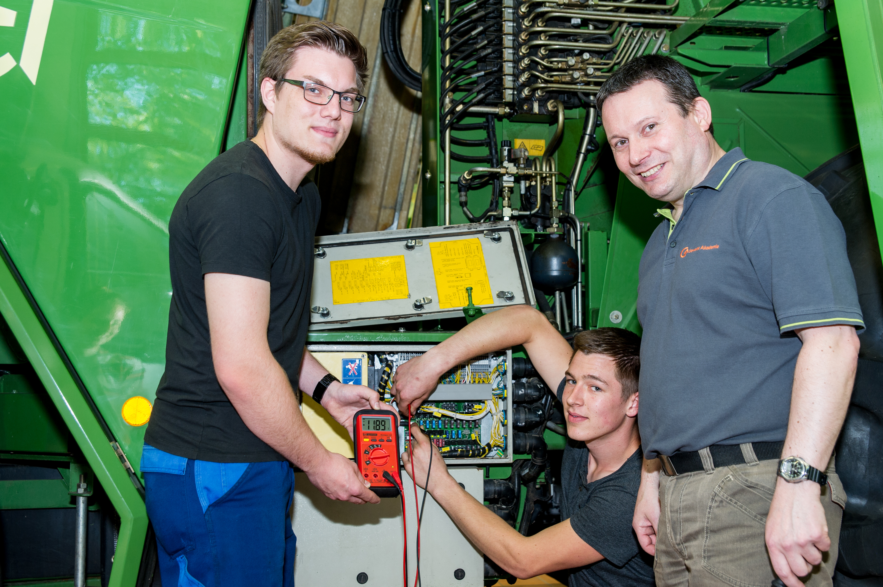
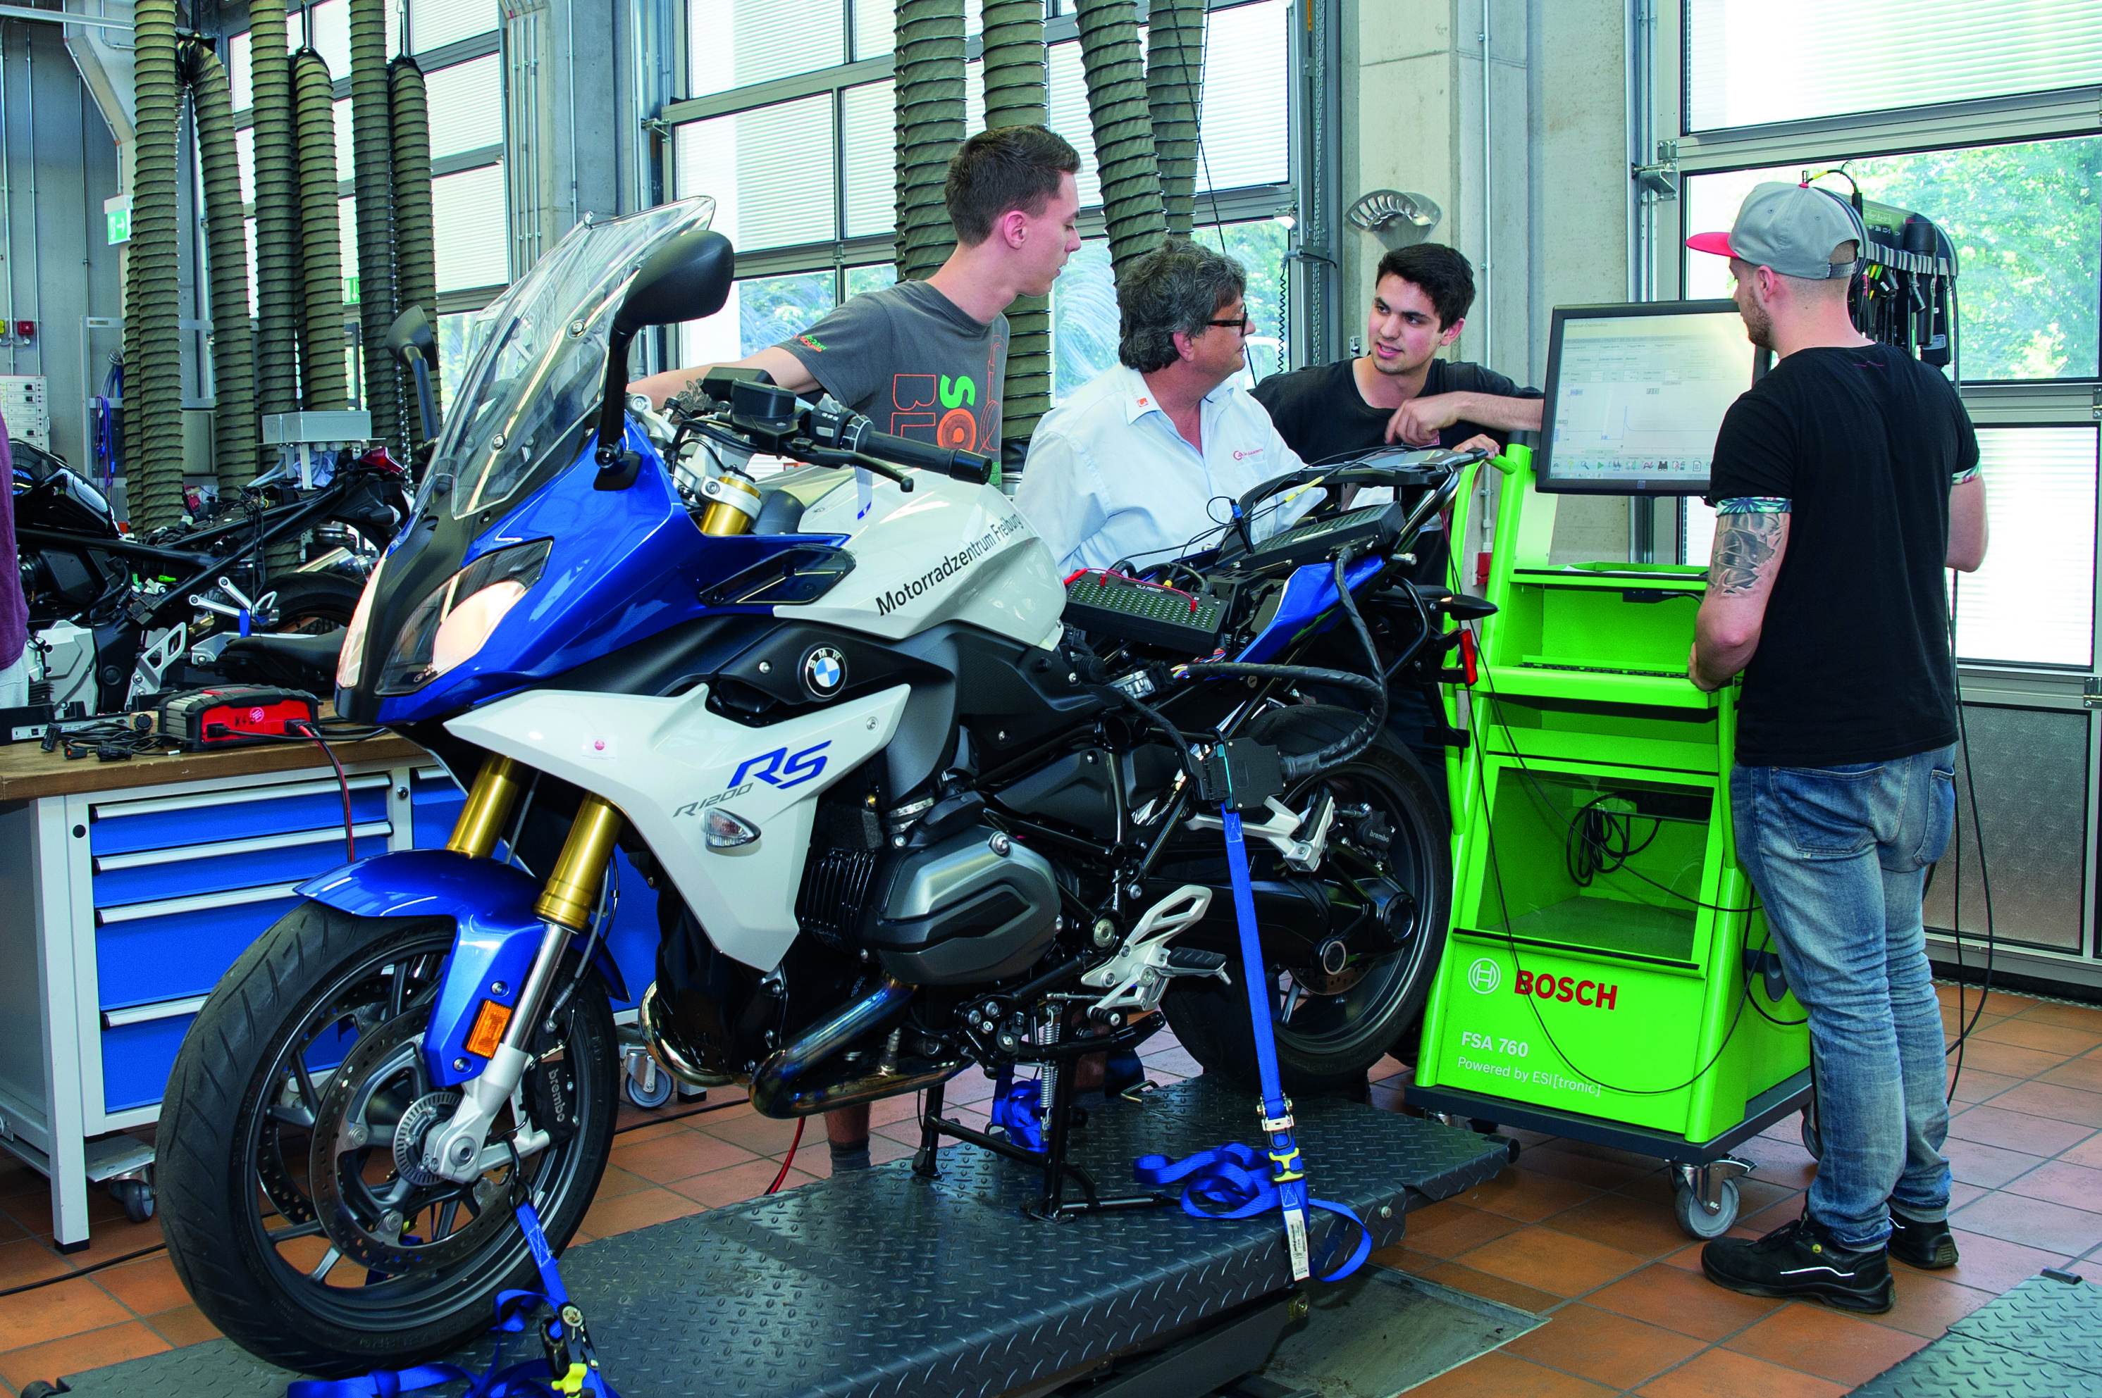
Centers of Competence VET Chamber of Skilled Crafts Freiburg
Center of Competence VET for Automotive Engineering
Notes:
The Chamber of Skilled Crafts Freiburg is certified for 2 centers of competence:
…. click Bild 1 Bild 2 Bild 3 Bild 4
One is the Center of Competence VET for Automotive Engineering

Slide 14
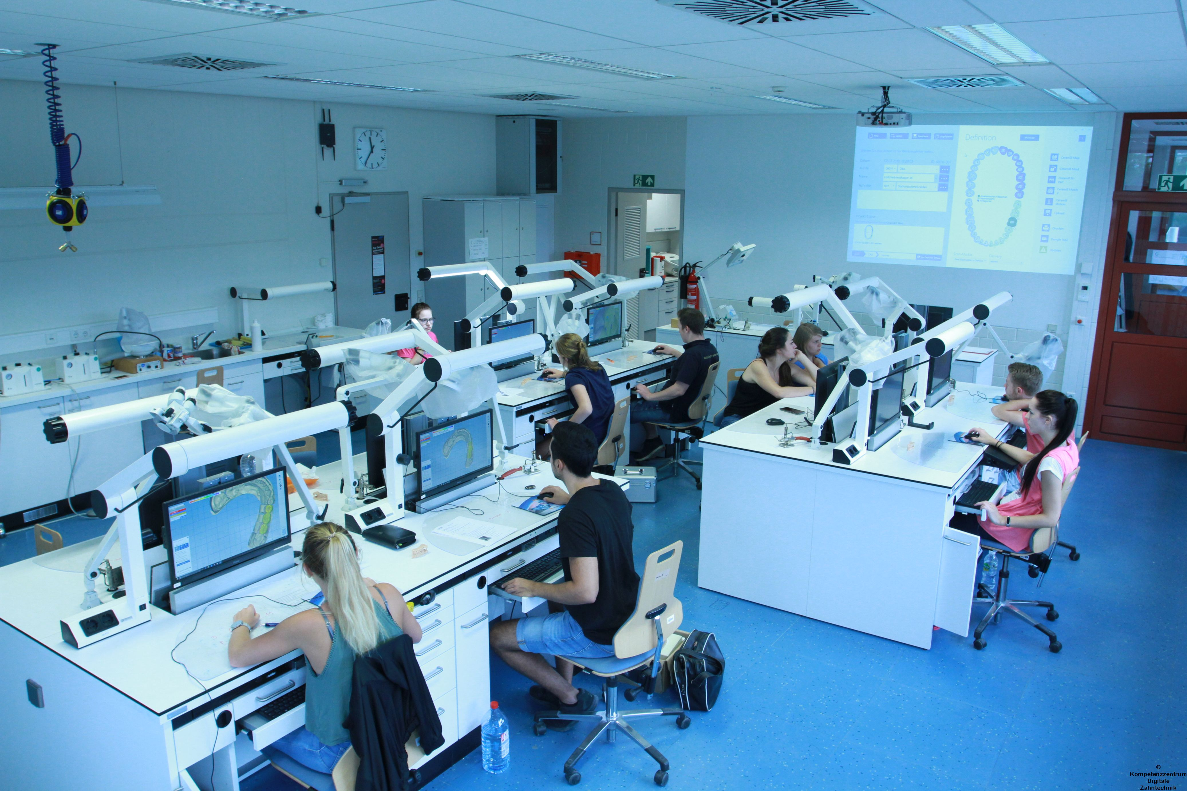
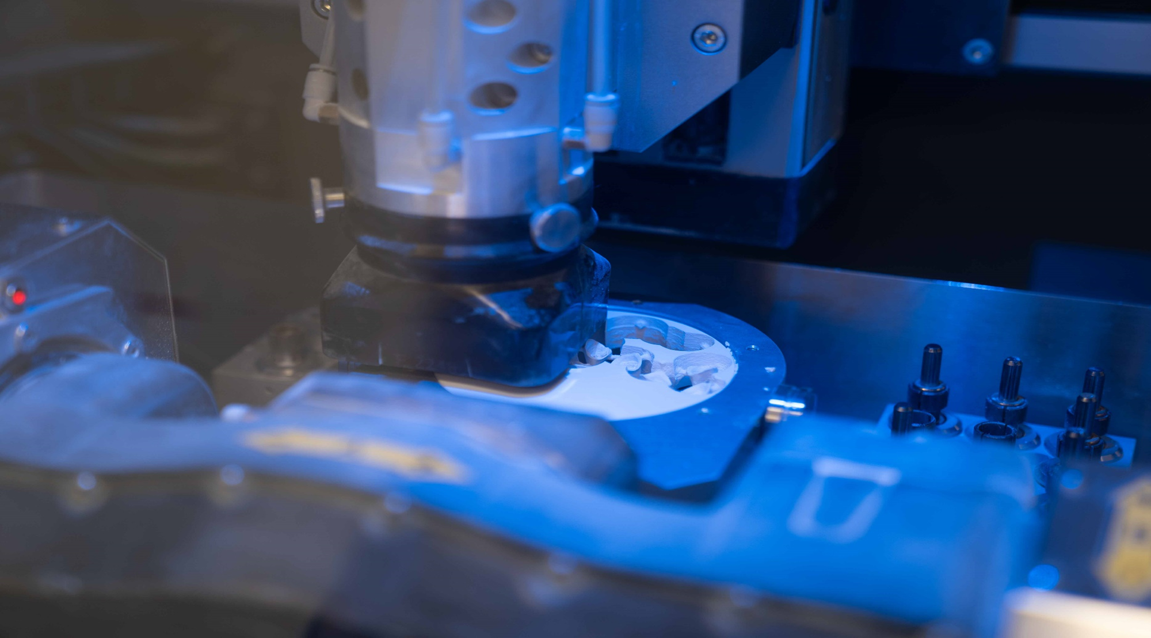
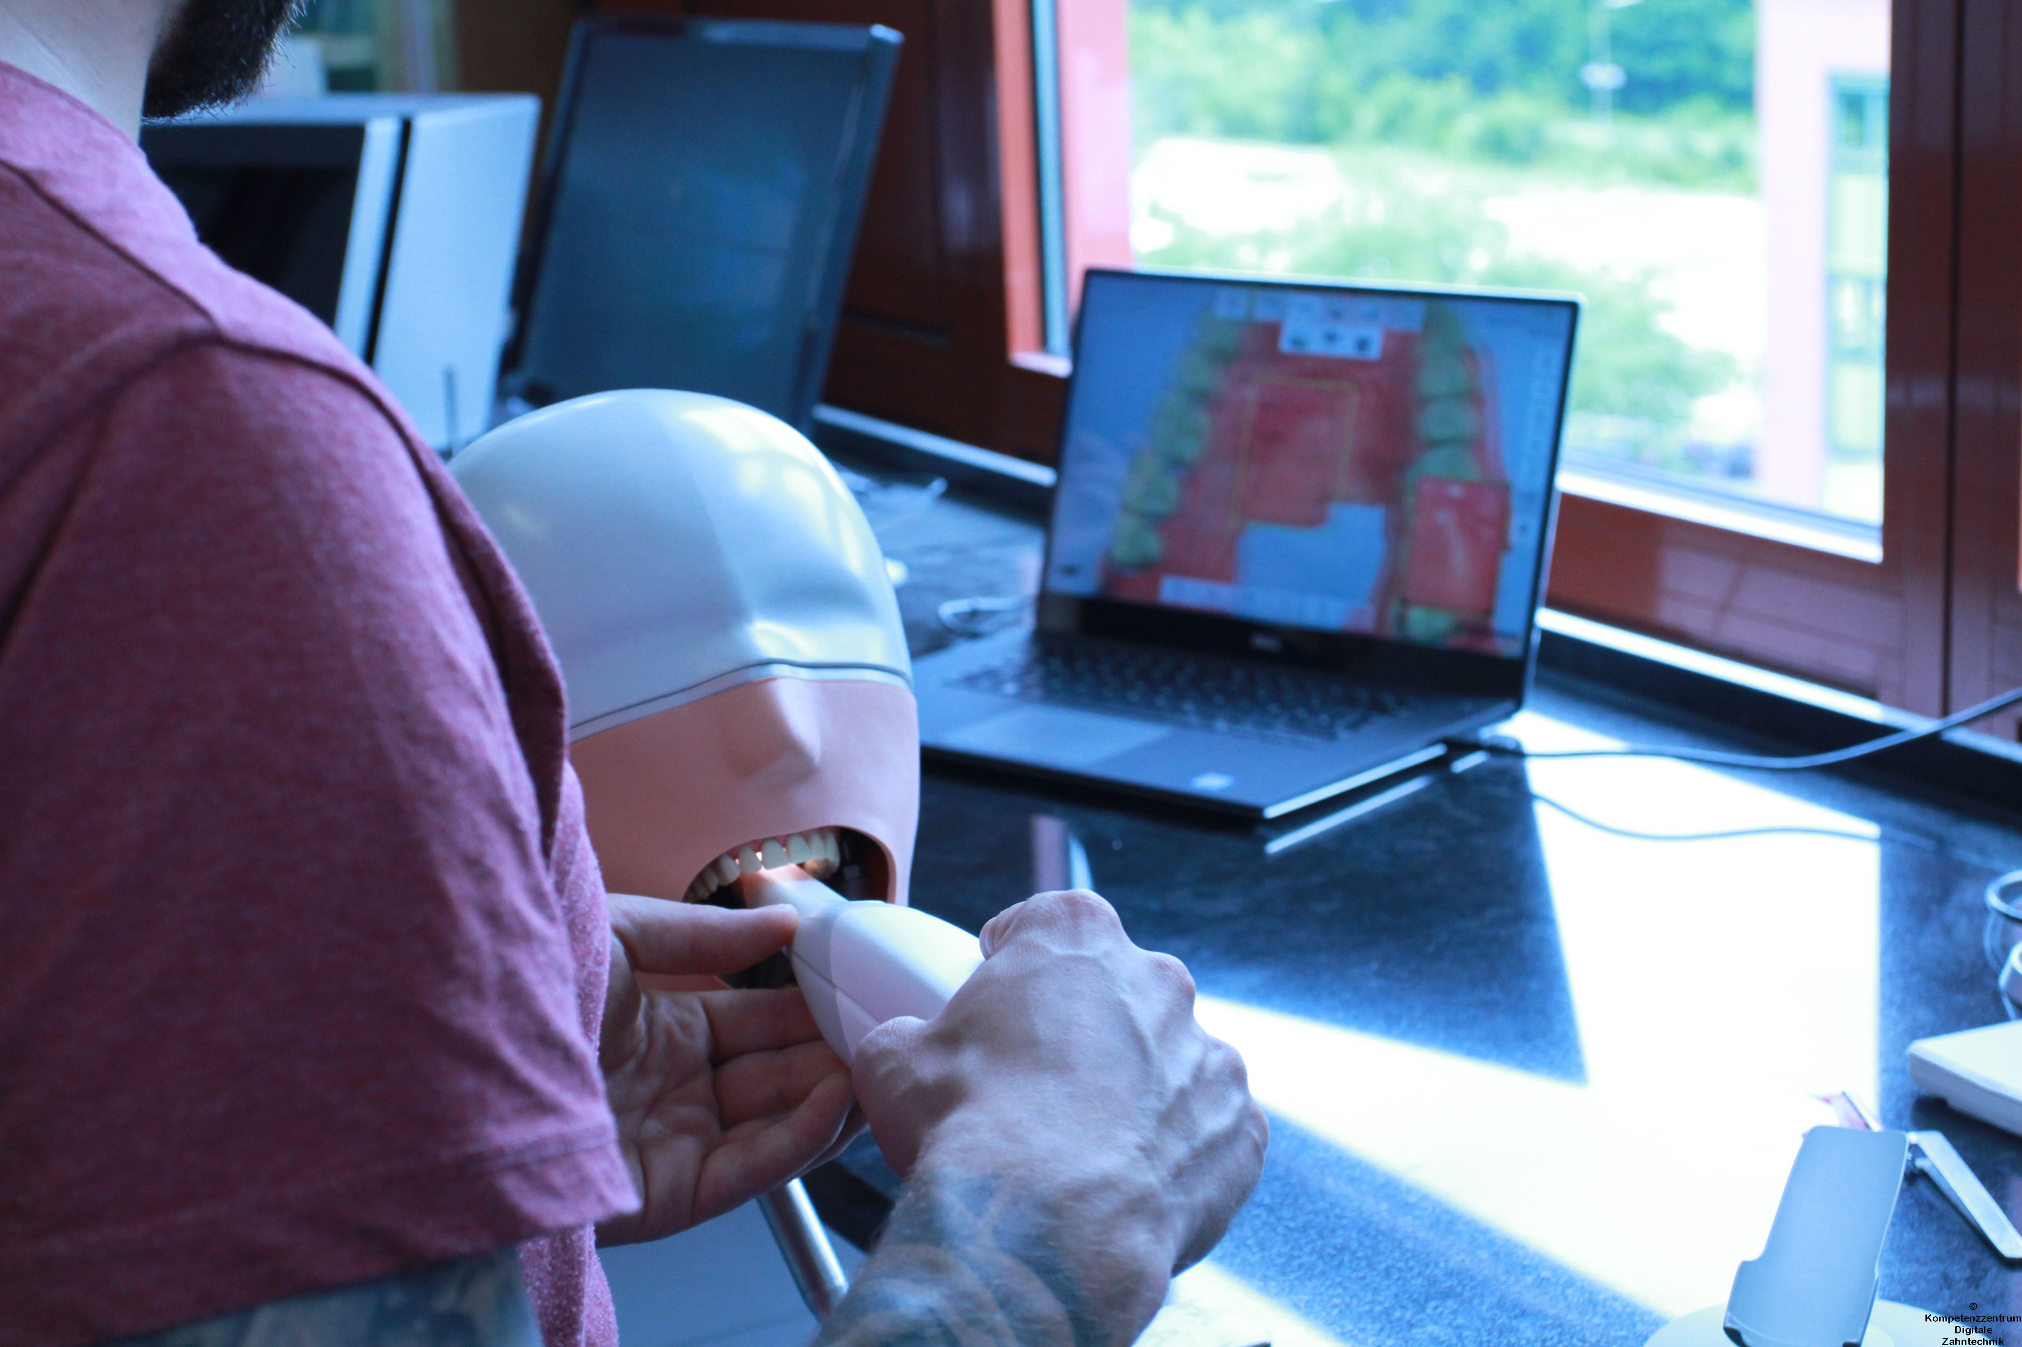
Centers of Competence VET Chamber of Skilled Craft Freiburg
Center of Competence VET for Digital Dental Technology
Notes:
and the second is
the Center of Competence VET for Digital Dental Technology
Klick Bild 1 Bild 2 Bild 3

Slide 15
Special program for Digitation in Vocational Training Centers
integrating new technical, digital innovations into the inter-company training - both materially and conceptually. In this way they help to ensure a modern and future-oriented education.
Notes:
BMBF and BIBB started with the „Special Program for Digitation in Vocational Training Centers“ a three-year project. It took place from 2016 to 2019.
Among other things, the following topics were to be investigated and answered:
what effects does the advancing digitization have on the vocational education and training?
Which digital technology and knowledge needs to be included?
How can we teach and learn with the support of digital techniques.
How can we develop vocational didactics.

Slide 16
Special program for Digitation in Vocational Training Centers
8 Centers of Competence VET in Germany started the “Special Program for Digitation”
one of them “Center of Competence for Digital Dental Technology” Chamber of Skilled Crafts Freiburg, Gewerbe Akademie
Notes:
The BIBB selected 8 centers of competence VET for this program

Slide 17
Special program for Digitation in Vocational Training Centers
Osnabrück Sanitary- / Heating Technology
Berlin Joiner and Painter
Kassel Carpentry
Erfurt Technology and Security
Dresden Smart Home Technology
Dresden Building Information Modeling
Stuttgart Electrical Engineering and Automation
Freiburg Digital Dental Technology
Notes:
This is how a nationwide network was created
Osnabrück Sanitary- / Heating Technology
Berlin Joiner and Painter
Kassel Carpentry
Erfurt Technology and Security
Dresden Smart Home Technology
Dresden Building Information Modeling
Stuttgart Electrical Engineering and Automation
Freiburg Digital Dental Technology
Close cooperation, joint subprojects, regular meetings and the publication of the results on a common platform has given rise to a nationwide network that focuses on the impact of digitization on initial training.

Slide 18
Special program for Digitation in Vocational Training Centers
Teamwork – Common Success
1 Network – results for 8 professions
regular meetings
definition of common goals
development of digital learning units
Use of same Softwares, exchange of equipment and knowledge
Exchange of results ‘for free use’
Train the trainer workshops inside / outside Network
Notes:
The success of our network lies in
• 1 network provides results for 8 professions
• A 2 days meeting at each network partner
• Workshops at BIBB and BMBF
• teams deliver results for the group
• Identification and definition of common goals to make projects comparable.
• We learn from each other as each project works with different approaches.
• Development of a common structure for the creation of digital learning units.
• Use of identical software for creating e-learning modules
• Exchange of digital learning units in the network
• Sharing learning platforms
• Train the trainer seminars

Slide 19
Special program for Digitation in Vocational Training Centers
Center of Competence Digital Dental Technology Freiburg
Our Results in the Project “Dental Digital3”
Notes:
Finally, I would like to introduce some of the results from our project:

Slide 20
Identifying digital needs in VET
Notes:
Surveys have identified the digital need for vocational training.

Slide 21
Pilot course CAD/CAM I Basics for CAD-/CAM-/CNC-Technology
Notes:
According to our surveys we developed, conducted and evaluated new courses: A new one week course for inter-company-Training: Basics for C-Technologies

Slide 22
Pilot course CAD/CAM II Implant Technology
Notes:
a further course contains „Implant Technology“

Slide 23
New Dental Laboratory
Notes:
We were able to set up a new lab

Slide 24
Workshops Digital Dental Tecnology for Trainers of Vocational Training Centers
Notes:
we organized workshops
for Trainers of Vocational Training Centers

Slide 25
Workshops Digital Dental Tecnology for Teachers of Professional Schools
Notes:
… and for Teachers of Professional Schools

Slide 26
E-Learning
Notes:
Creating e-learning sessions is an imense task. We are still at the beginning

Slide 27
Development Ausbildungsordnung Training Regulations and Framework Curricula
Notes:
Most recently, we made suggestions on how the Training Regulations and Framework Curricula could be updated. Hereby, we are partners of the committees that actually decide on these new regulations. For example, the BIBB and the Federal Association of German Zahtechniker-Guilds.

Slide 28
Special program for Digitation in Vocational Training Centers
The new special program for Digitation in Vocational Training Centers Part II: 2019 - 2023
Notes:
The „Special program for Digitaization in Vocational Training Centers will continue with
Part II: 2019 until 2023

Slide 29
Invitation
… you are welcome Chamber of Skilled Craft General Manager Handwerkskammer Freiburg Wolfram Seitz-Schuele Bismarckalle 6 wolfram.seitz-schuele@hwk-Freiburg.de 79098 Freiburg +49 761 218 00 0 Vocational Training Center Joachim Rapp Gewerbe Akademie Joachim.rapp@hwk-Freiburg.de Wirthstrasse 28 +49 761 15250 84 79110 Freiburg
Notes:
Ladies and gentlemen,
we would like to invite you to Freiburg.
May be we can organize a cooperation or partnership with you where we can learn from each other.
We could work together and come closer to our common goal: „Vocational Excellence“.

Slide 30
Summary of Links
https://www.hwk-freiburg.de/de
https://www.gewerbeakademie.de
https://www.gewerbeakademie.de/digitale-zahntechnik/kompetenzzentrum-digitale-zahntechnik/
Special program Digitation in Vocational Training Centers Informations and videos of the 8 Centers of Competence VET https://www.foraus.de/html/foraus_digitale-prozesse-in-ausbildungsberufe-integrieren-auswirkungen-der-digitalisierung-in-der-uberbetrieblichen-ausbildung-11120.php
BIBB – Federal Institute for Vocational Education and Training https://www.bibb.de/de/36926.php#module98960
Federal Ministry of Education an Research (BMBF): Inter-company Vocational Training https://www.bmbf.de/de/ueberbetriebliche-berufsbildungsstaetten-1078.html
Notes:
If you are interested – you can find here a Summary of Links

Slide 31
Thank you for your attention

