Slide 1
Nestlé’s journey for YOUth in Europe (2013-2019)
Dame Fiona Kendrick

Slide 2
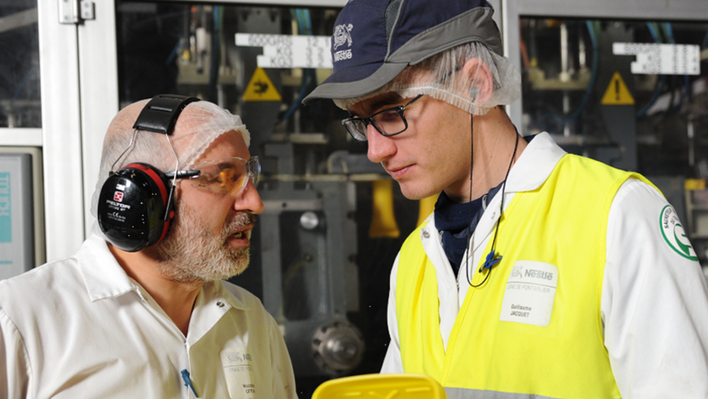
Nestlé’s journey for YOUth in Europe (2013-2019)
10,500 apprentices hired across Europe
1,100
apprenticeship schemes set up in 20 countries
4,000
readiness for work activities organized
310,000 jobs and training opportunities offered
Proud member of the European Alliance for Apprenticeships

