Slide 1
Michiel Kernkamp
CEO Nestlé Nordic

Slide 2
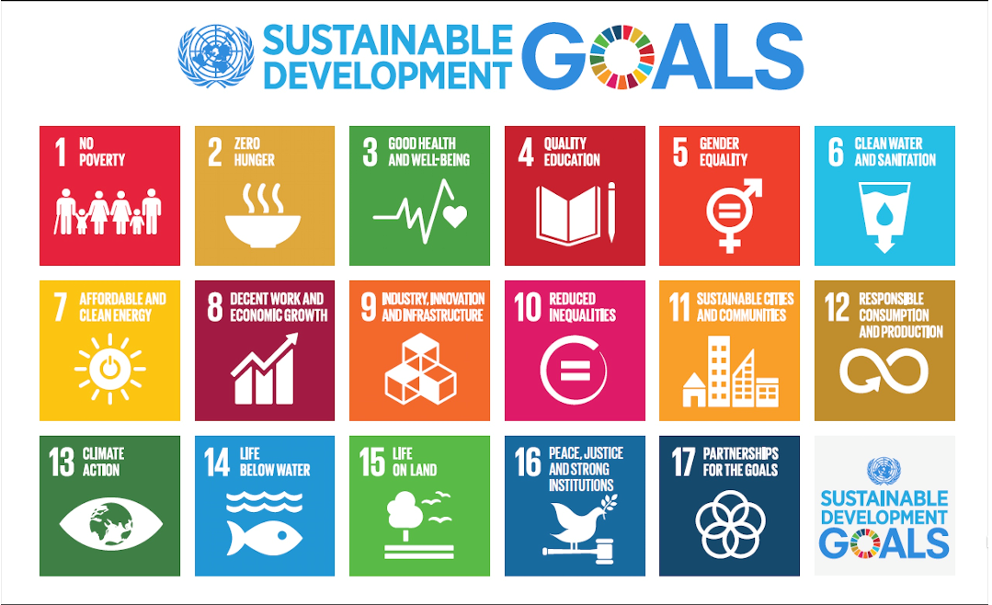

Slide 3
WE AIM TO CONNECT A HEALTHIER PLATE TO
A MORE INCLUSIVE ND SUSTAINABLE PLANET

Slide 4
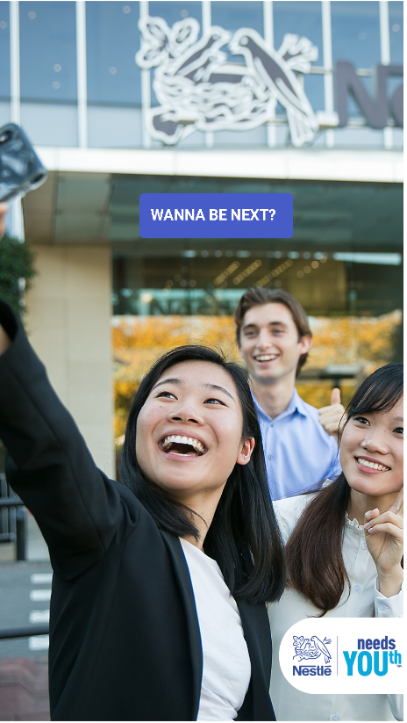
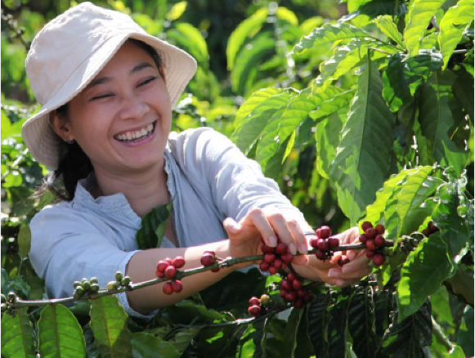
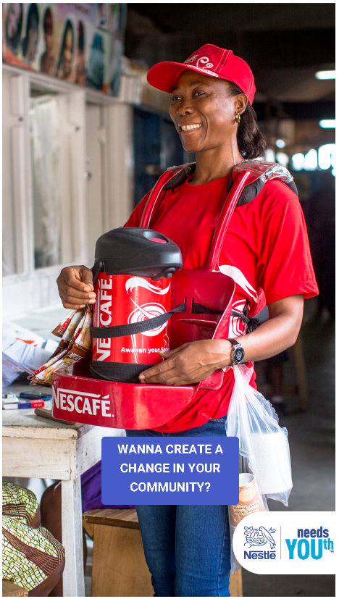
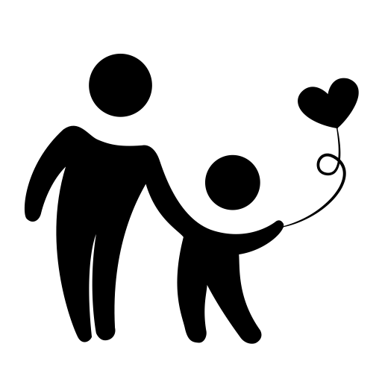
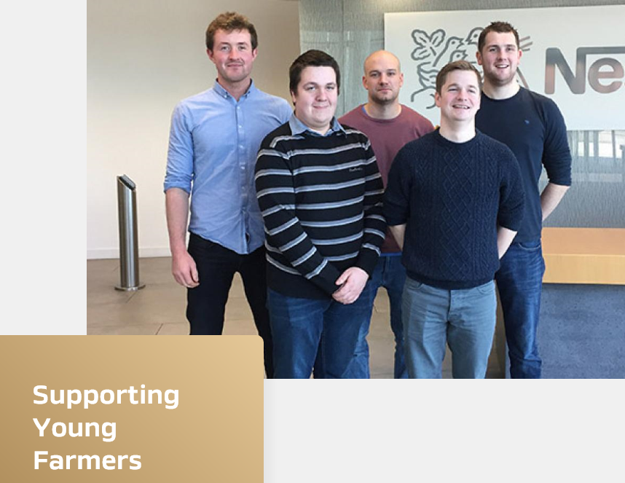
INCLUSIVENESS
EMPLOYMENT &
EMPLOYABILITY
AGRIPRENEURSHIP
ENTREPRENEURSHIP
Helping 10 million young people access economic opportunities
by 2030
◾ 45,000 to 50,000 apprentice-ship and traineeships
◾ 20,000 to 25,000 job opportunities
◾ ‘readiness for work’ events
◾ Extend External partnerships
◾ 5% farmers < 35 yrs old
◾ ‘Farmers Connect’
◾ Skilling Young farmers
◾ Helping gender diversity
◾ Nurturing business talent
◾ MYOWBU
◾ SWISS Social investment accelerator
2014

Slide 5
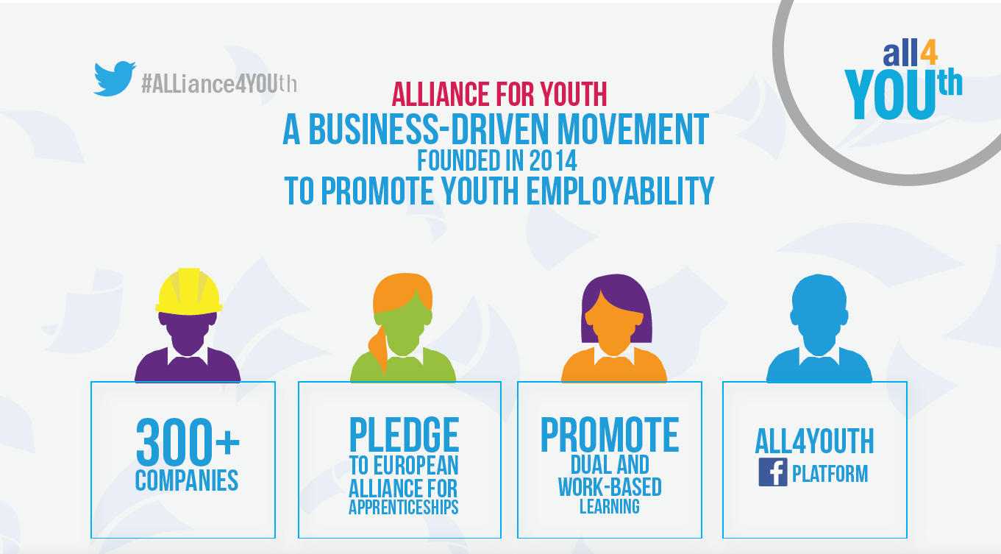

Slide 7
Michiel Kernkamp
CEO Nestlé Nordic

