Slide 1
Artificial Intelligence: actions in education
Simona Petkova
DG EAC, European Commission
Simona.PETKOVA@ext.ec.europa.eu

Slide 2
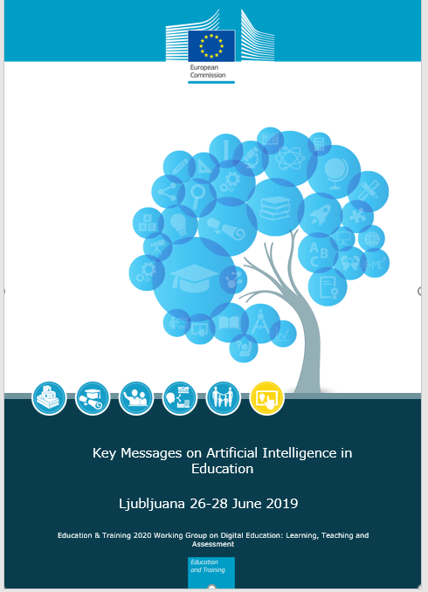
Key messages on Artificial Intelligence in Education
Education for AI:
AI not for elite groups, but for everyone
What to teach on AI– no consensus
Lifelong learning approach -upskilling and reskilling
AI for education:
AI used to solve education problems
Involvement of teachers/educators is central
Ethical implications are central

Slide 3
Digital Education Action Plan
Priority 1
Priority 2
Priority 3
Making better use of digital technology for teaching and learning
Developing relevant digital competences and skills for the digital transformation
Improving education through better data analysis and foresight
Action 10: Artificial Intelligence and analytics pilot actions
Action 11: Strategic foresight

Slide 4
Action 10: Artificial Intelligence and analytics pilot actions
Pilot on skill gap analysis to identify trending skills and match individuals with jobs and educational courses for upskilling
DG EAC
+
DIGIT
Pilot 1: Linking skills and labour market needs
Pilot 2: What aspects of AI should be part of broader educational programmes

Slide 5
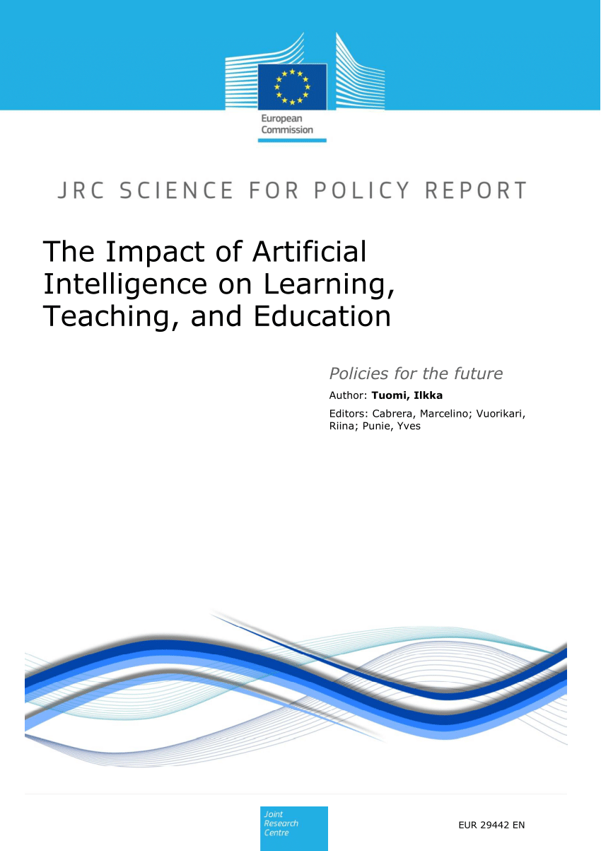
Action 11: Strategic foresight
A series of policy, research and guidance papers on the impact and potential of digital technologies…
Notes:
A series of policy, research and guidance papers on the impact and potential of digital technologies

Slide 6
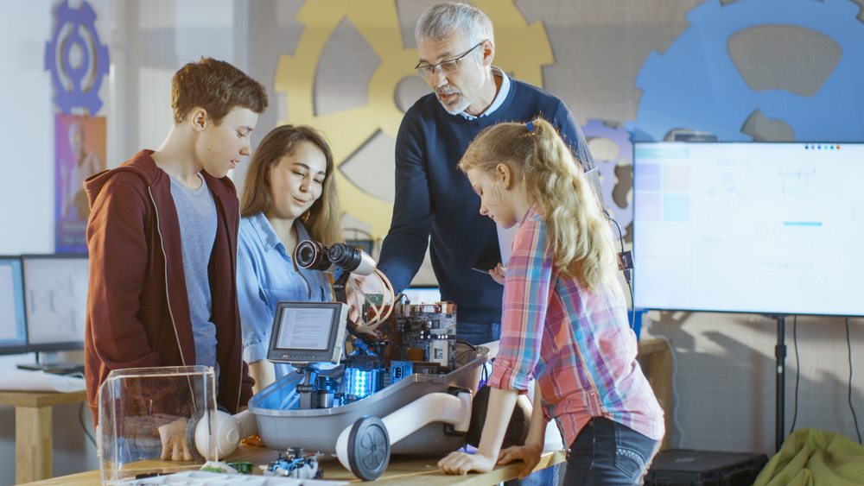
Thank you!
Simona.PETKOVA@ext.ec.europa.eu
@EUDigitalEdu
#EUDigitalEducation
Notes:
=

