Slide 1
OECD’s work on Adult apprenticeships
Shinyoung Jeon, Policy Analyst
VET and Adult Learning Team, OECD Centre for Skills
EAfA, 15 October 2019

Slide 2
Adult shares in apprenticeships (all levels)
Young under 25
Adults 25+
Source: National statistics and Muehlemann, S. (forthcoming), “The Economics of Apprenticeships for Adults”, OECD Publishing
Note: Adults refer 25+ except Austria (21+) and Germany (24+)

Slide 3
Are adult apprenticeships becoming more common?
2009
2017
2013
2017
1999
2013
2016
2018
2008
2009
2016
1993
Note: Canada counts total number of apprenticeship registration records and not individual apprentices, including non-completed ones from the previous year plus apprentices newly registered during the current year.

Slide 4
Possible drivers
1. Demographic changes
2. Labour market changes
3. Strengths of apprenticeships

Slide 5
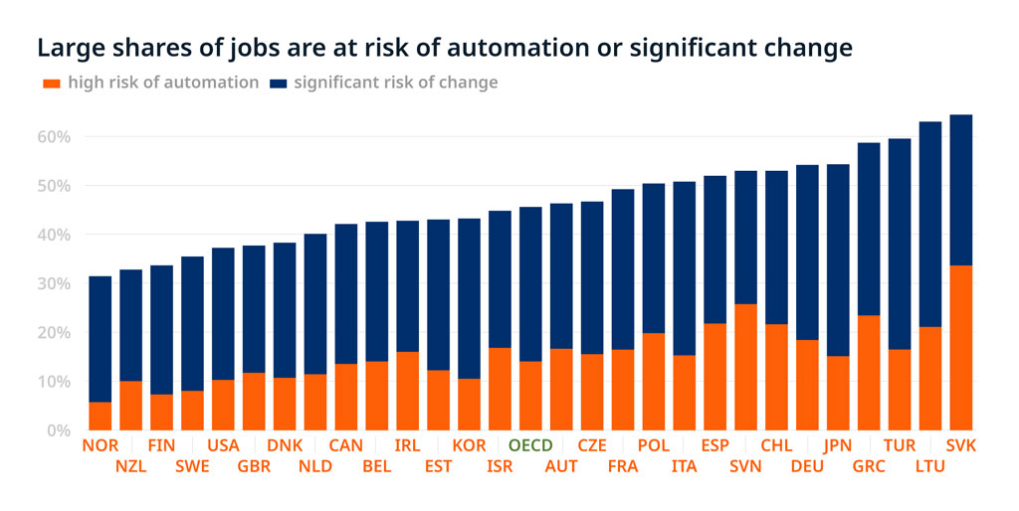
Possible drivers
1. Demographic changes
2. Labour market changes
3. Strengths of apprenticeships

Slide 6
Possible drivers
1. Demographic changes
2. Labour market changes
3. Strengths of apprenticeships

Slide 7
Characteristics of adult apprenticeships
Compared to youth apprenticeships…
Higher wages (but expected higher productivity)
Lower expected tenure but lower mobility costs
Higher foregone earning
Higher financial obligation of adult apprentices
Could be shorter for adults with work experience and relevant skills
Compared to on-the-job training…
Higher training costs (e.g. wage for longer duration)
Some occupations have no (or not many) alternative training but apprenticeships

Slide 8
How to make adult apprenticeships attractive and effective
Incentives
Flexibility
Basic skills
Career guidance
Teachers and trainers

Slide 9
How to make adult apprenticeships attractive and effective
Incentives
Flexibility
Basic skills
Career guidance
Teachers and trainers

Slide 10
Different routes to obtain apprenticeship qualifications
How adult apprentices obtained apprenticeship qualifications
in Switzerland in 2012

Slide 11
How to make adult apprenticeships attractive and effective
Incentives
Flexibility
Basic skills
Career guidance
Teachers and trainers

Slide 12
How to make adult apprenticeships attractive and effective
Incentives
Flexibility
Basic skills
Career guidance
Teachers and trainers

Slide 13
How to make adult apprenticeships attractive and effective
Incentives
Flexibility
Basic skills
Career guidance
Teachers and trainers

Slide 14
Recent OECD work on apprenticeships
6 working papers on work-based learning and a synthesis report (Seven Questions about Apprenticeships)
Country review of apprenticeship system: England and Israel
Apprenticeships for Adults: Muehlemann, S. (forthcoming), “The Economics of Apprenticeships for Adults”, OECD Publishing

Slide 15
Further work is needed
Build comparable database
No agreed definition for comparative data collection
Diversity in use of terms
Only partial mapping of apprenticeship schemes across OECD countries, particularly when compared to Europe
A forthcoming OECD publication will suggest proposals on how to improve apprenticeship data
Expand research on:
Diverse forms of adult apprenticeships and their effectiveness/efficiencies
Difference across sectors and levels

Slide 16
Contact: Shinyoung.Jeon@oecd.org
Recent OECD publications relevant to apprenticeships:
OECD (2018), Seven Questions about Apprenticeships: Answers from International Experience, OECD Reviews of VET.
Muehlemann, S. (forthcoming), “The Economics of Apprenticeships for Adults”, OECD Publishing
Mühlemann, S. (2016), "The Cost and Benefits of Work-based Learning", OECD Education Working Papers, No. 143, OECD Publishing.
Kuczera, M. (2017), "Incentives for apprenticeship", OECD Education Working Papers, No. 152
Kis, V. and H. Windisch (2018), "Making skills transparent: Recognising vocational skills acquired through work-based learning", OECD Edu WP
Musset, P. and L. Mytna Kurekova (2018), "Working it out: Career Guidance and Employer Engagement", OECD Education Working Papers.
Kuczera, M. (2017), "Striking the right balance: Costs and benefits of apprenticeship", OECD Education Working Papers, No. 153, OECD Publishing Kuczera, M. (2017), "Incentives for apprenticeship", OECD Education Working Papers, No. 152, OECD Publishing.
Kis, V. (2016), "Work-based Learning for Youth at Risk: Getting Employers on Board", OECD Education Working Papers.
Kis, V. (2016), "Work, train, win: work-based learning design and management for productivity gains", OECD Education Working Papers.
Kuczera, M. and S. Jeon (2019), Vocational Education and Training in Sweden, OECD Reviews of VET.
Kuczera, M. and S. Field (2018), Apprenticeship in England, United Kingdom, OECD Reviews of VET, OECD Publishing.
Kuczera, M., T. Bastianić and S. Field (2018), Apprenticeship and Vocational Education and Training in Israel, OECD Publishing.

