Slide 1
A NEXT STEP FOR THE EU
TOURISM SECTOR
Silvia Barbone
Federturismo Confindustria
VET for ALL – Skills for Life conference
Session – Services 4.0: innovation for workforce upskilling and reskilling
17 October 2019

Slide 2
THE NEXT GENERATION TOURISM SKILLS ALLIANCE

Slide 3
TOPICS
DIGITAL, SOCIAL & GREEN
SKILLS
DEVELOPMENT
FUTURE OF TOURISM AND TRAVEL
EDUCATION
&
INDUSTRY

Slide 4
THREE CHALLENGES
On global, European, national, regional level
DIGITAL
SOCIAL
GREEN
Notes:
‘’When it comes to skills development in general, three main challenges are involved on global, European, national and regional, a single country cannot fix it. I speak of the threat of climate change and technological disruption, especially the rise of artificial intelligence, robotics and building a better society, a viable environment for the human being and all living beings and a better future for those who will come, we will find a laudable sense for everything we do.
We need to give up what was important in our past for our future.
Technological progress and globalization offer almost endless opportunities for innovation, growth and jobs. These developments require skilled and adaptable people who are able to drive and support change. In order to address skills gaps that may prevent the tourism industry from growing, the project NTG focusing on a Blueprint for Sectoral Cooperation on Skills was launched as part of the New Skills Agenda from the European Commission.’’

Slide 6
NTG PROJECT APPROACH

Slide 7
THE FUTURE OF SKILLS SETS
DEPENDS ON WHAT WE DO TODAY
NTG’s
Skills gap analysis (primary, secondary)
Skills assessment method
Industry led skills groups
NTG Skills Matrix
New European NTG Modules
NTG Skills Development Tools & toolkit
Guidelines for HR | Education
Quality framework
Collection of best practices
Secondary data
(infographic + report)
B) Fieldresearch
Primary data
Survey report
Interview report

Slide 8
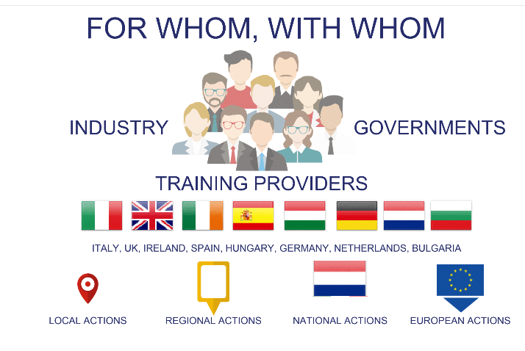

Slide 9
5 SUBSECTORS IN THE TOURISM ECOSYSTEM
TRAVEL AGENTS & TOUR OPERATORS
VISITOR
ATTRACTIONS
DESTINATION
MANAGEMENT
FOOD &
BEVERAGE
OPERATIONS
ACCOMMODATION

Slide 10
5 NTG PILLARS
STRATEGIC: POLICIES and ECOSYSTEM
OPERATIONAL:
Action Plans
COOPERATIVE:
Partnerships
SUSTAINABLE: PM4SD
INNOVATION

Slide 12
Digital skills need to go hand in hand with soft skills such as adaptability, flexibility, openness to innovation and self-learning skills.

Slide 13
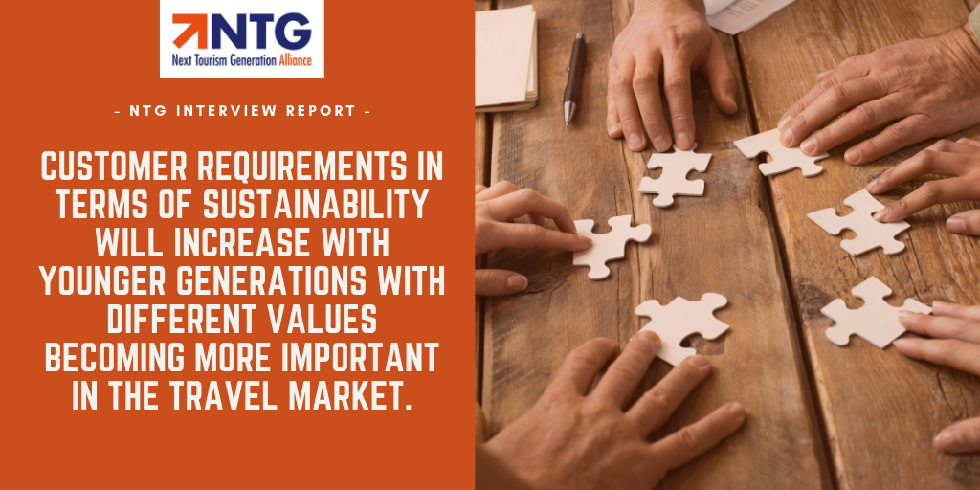

Slide 14
Life-long learning and self-learning skills are important to understand and cope with the ongoing changes in society.

Slide 15
Insights
Future skills gaps in EU
Artificial Intelligence (AI) and robotics skills
Skills related to applying digital hardware technologies, such as Augmented and Virtual Reality
Promotion of sustainable forms of transport (e.g. public transport)
Promotion of environmentally friendly activities and products
‘’WILLINGNESS TO CHANGE’’
Involvement: ILSG, Skills Matrix Validation (Sector Expert Groups),
Join public NTG events (EU scope), participate in NTG activities, share knowledge and visibility on NTG platforms.

Slide 16
S
Silvia Barbone
NTG Project Coordinator
s.barbone@federturismo.it

