Slide 1
4 years of Employers’ Days at the European Vocational Skills Week
Marja-Riitta Pihlman
Director General
Ministry of Economic Affairs and Employment
Helsinki 18.10.2019

Slide 2
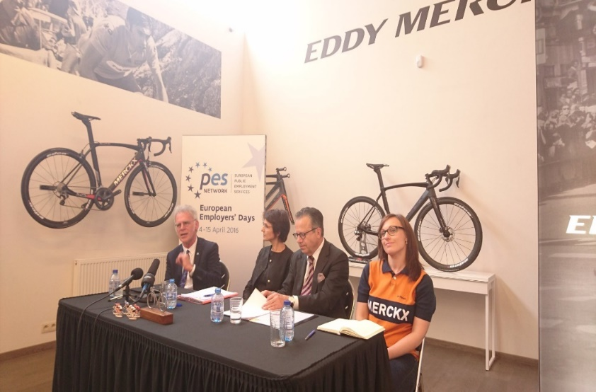
Background
First EED in 2016
Employers’ role crucial in job matching in PES
Aimed at raising awareness of the services provided by PES
EED highlights the cooperation with employers within the PES network
Official launch of the first EED with Commissioner Thyssen
Notes:
The original idea to organise an Employers’ Day is from the Flemish PES (VDAB). In January 2015 VDAB closed the employment offices and all the employees went out on the street and visited 26 606 small and medium-sized enterprises. The results exceeded all expectations: in 1 day VDAB successfully challenged the public opinion about its position for employers and presented itself as a problem solver, bringing solutions as an employment expert. As result, some 1 428 extra leads were gathered.

Slide 3
Positive outputs
Main results of the first EED
The relationship between PES and employers was strengthened
Employers' knowledge of public employment services and support systems was enhanced
Useful inputs from employers on how to improve the public employment services were received
An increase in contacts from employers and submitted vacancies was noticed
Altogether some 150 000 employers were contacted across Europe

Slide 4
Skills Week – new focus of EED
Since 2017, EED is organized in cooperation with the European Vocational Skills Week
With growing labour shortages, investments in human resources and skills are of utmost importance
In 2017 and 2018 more than 200 EED events were organized
In 2019 more than 300 EED events will be organized across Europe → altogether thousands of employers have been and will be contacted
Focus of the events on promoting training, detecting vacancies, making company visits, offering services to employers and attracting people to traineeships for jobs in shortage

Slide 5
Building bridges for the future
Common goal=boosting the matching
In the future, along with the transformation of working life, continuous learning becomes an essential element of individual careers
PES in close cooperation with other stakeholders must build bridges across career transitions – and develop lifelong guidance strategies
Good career guidance services are crucial for job seekers to ensure they have relevant skills for the future labour market
Enterprises, especially SMEs, need often more support in recruiting skilled workers or training persons for future skills
Skills Week & EED can showcase benefits of vocational skills and investments in human resources in order to achieve our common goal - boost the matching in the labour market

Slide 6
Thank you!
Wishing you a nice stay in Helsinki!

