Slide 1
European Vocational Skills Week in Hungary
By David Rozványi
Notes:
Dear Organisers!
Hungary is one of the „top country” in the European Vocational Skills Week. What is our secret? There is no secret, just a simple method. Today I’d like to introduce our method:

Slide 2
Our steps:
5. profit!
4. support
1. communication
3. motivation
2. strategy
Notes:
The „Hungarian method” means 5 simple steps:
Communication
Strategic thinking
Motivating the organisers
Support to organisers
Visible profit of the European Vocational Skills Week

Slide 3
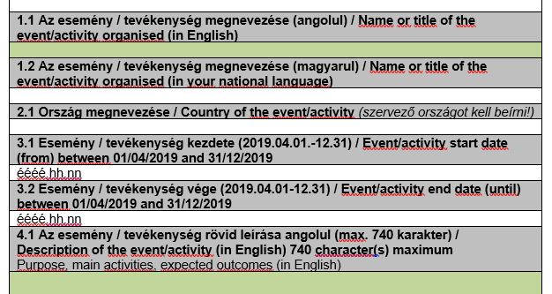
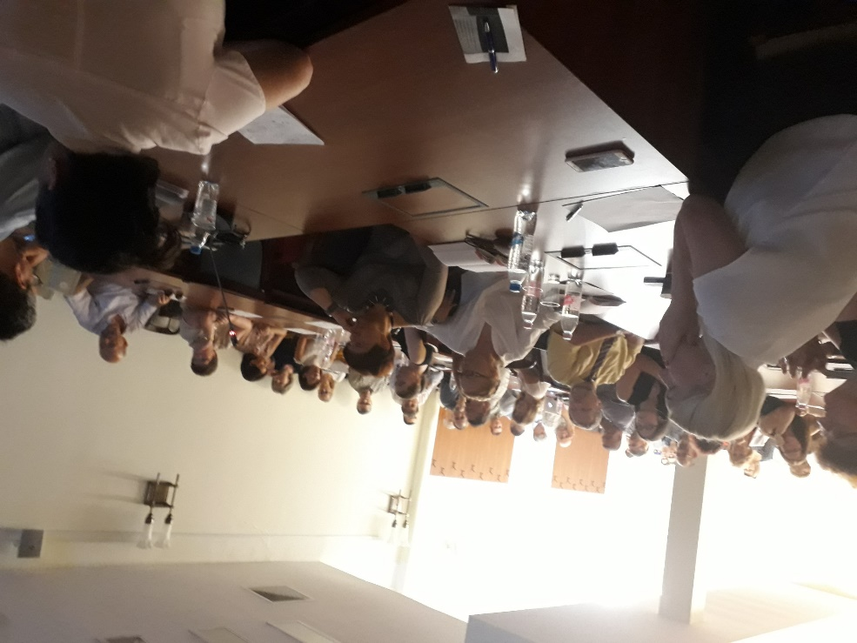
1. communication
Translating and dissemination of the official documents
Workshops for the affected organizations in every year:
Actual information
Best practices
Results
Notes:
The first step is the communication:
We translate the official documents (what you can’t find in Hungarian in the central webpage) – a.g. registration form. Here is not our friend the ‚Google translator’: we must pair the international terms with the Hungarian practice. A.g. the „Open doors event” is an „open day” in the Hungarian schools, and a visit in a company is „open doors” event too.
Every year we organise workshops to the organisers: we tell the actual informations, we share the best practices and our results.
(az aláhúzott részeket csak akkor mondom el, ha rákérdeznek)

Slide 4
2. strategy
Subsidiarity: Low cost and Local
The programs available throughout the country for the visitors
Great flagship programs:
What's up? Career guidance festival for technical professions
Build Your Future! Construction Career Day
Notes:
Our strategy has three levels:
The first, we encourage the organisers keeping local and low cost programs. They do not have to think in big, high-cost programs. So, every local VET schools can be successful.
Easy access all over the country
And we have two „Flagship” programs: to sell the Week in the media. Our two countrywide flagship programs are the
What's up? Career guidance festival for technical professions
Build Your Future! Construction Career Day

Slide 5
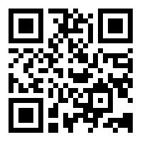
… why it is worth joining?
3. motivation
The European Vocational Skills Week is a very good quality mark
The visual toolkit of the EVSW is very good!
Friendly competition among the 19 counties and the organizations: who has more registered programs?
The registered programs are visible in the Hungarian website https://szakkepzesihet.hu/
Notes:
The first two points are obvious.
The 3rd: we, Hungarians, have a competitive spirit, so the Vocational Week has became a friendly competition in Hungary: the goal is which organisation can register more interesting programs?

Slide 6
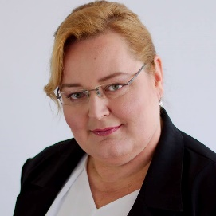
Our support team
4. support
Quality assurance, translation, administration, social media: David Rozványi
IT support, Hungarian website: Gábor, Klement-Ugrin
Marketing and financial methods: Anikó, Angyalné Kovács
Notes:
This group is our Marvel heroes: we support the Hungarian organisers in different ways.

Slide 7
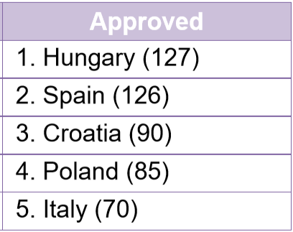
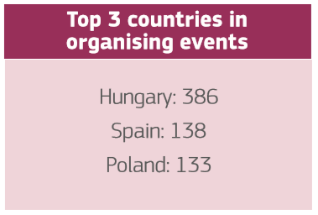
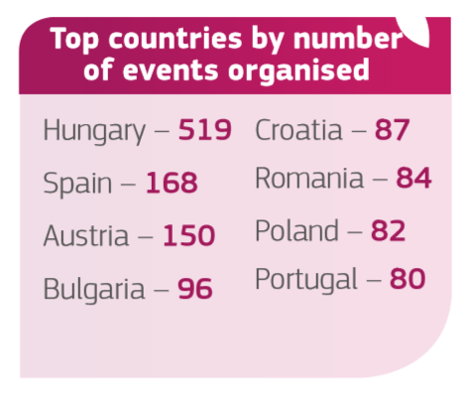
5. profit!
We are a „Top Country” – this is a good motivation, but we want more!
2016
2017
2018
Notes:
Being the Top Country is a good motivation, but here are the short term profit:

Slide 8
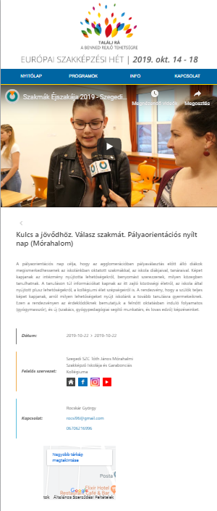
5. profit!
Our real profits:
Cooperation among the VET organizations
A new webpage is created for the parents and teachers where they can find the important Hungarian VET promotion programs (In Hungarian, with pictures, Youtube channels and GoogleMaps)
New mentality and methods in the VET promotion
Notes:
Our main goals are
Cooperation among the VET organizations
Promotion all VET programs in one webpage
a new way of thinking in the Hungarian VET system.

Slide 9
Thank you for your attention! David Rozványi szakhet@gmail.com https://szakkepzesihet.hu/ https://www.facebook.com/szakkepzesihet/

