Slide 1
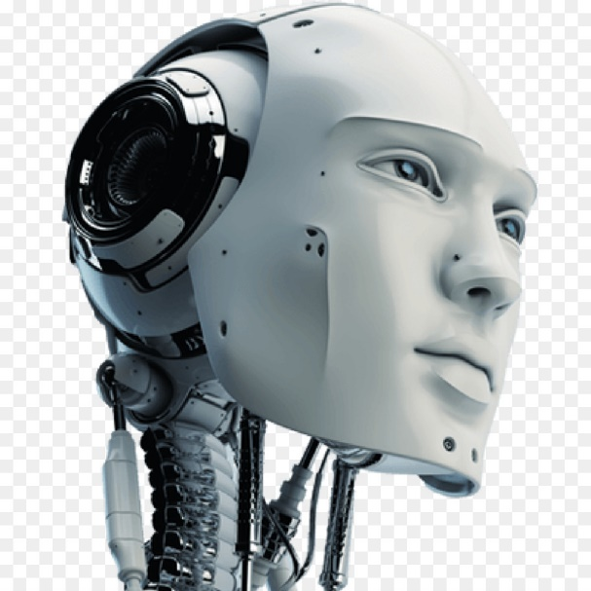
Joint Session on Artificial Intelligence, 15 October 2019, Helsinki,
11.00-12.30

Slide 2
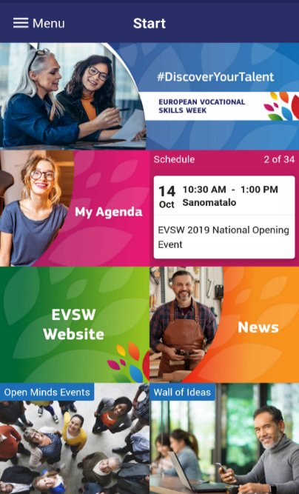
EVSW 2019 APP
To download the app:
Search ‘EVSW 2019’ on:
Apple App Store
Google Play Store
To login to the app:
Username: email address used to register for the Week
Password: helsinki
You can also login to the app:
as a guest
by creating a new account

Slide 3
WELCOME
ARTIFICIAL INTELLIGENCE AND HUMAN EDUCATION

Slide 4
Agenda
11:00-11:05 Welcome and introduction
Moderator: René van Schalwijk, Coordinator, Cedefop Community of Learning Providers
11:10-11:50 Keynote speeches
Silvia Merisio, Policy Officer, European Commission, DG CNECT
Ilkka Tuomi, Chief Scientist, Meaning Processing Ltd, Finland
Harri Ketamo, Chairman, Hedai Ltd,Finland
11:50-12:20 Interactive discussion and ‘elevator pitches’ including by
Margarida Segard, EVBB, Portugal
Simona Petkova, European Commission, DG EAC
12:20-12:30 Synthesis of key messages
12:30-14:00 Lunch

Slide 5
WELCOME
Aim of Session
Inform about EU Communication on Artificial
Intelligence (AI) in Europe + Coordinated
Plan on Artificial Intelligence
Share and increase knowledge and understanding of Artificial Intelligence in VET and Adult Learning
Create networks and identify good practices
on both national and EU level
Contribute to VET and Adult Learning aspects
for EU report on Artificial Intelligence due early 2020

Slide 6
WHAT IS ARTIFICIAL INTELLIGENCE?
Artificial intelligence is intelligence demonstrated by machines a system’s ability to correctly interpret external data, to learn from such data, and to use those learnings to achieve specific goals and tasks through flexible adaptation.”(Wikipedia)
Artificial intelligence refers to machines or algorithms that are capable of observing their environment, learning from it and, based on the knowledge and experience gained, take intelligent action or propose decisions.(EU commission factsheet)

Slide 7
What is intelligence?
Intelligence is the capacity for logic, understanding, self-awareness, learning, emotional knowledge, reasoning, planning, creativity, critical thinking, and problem solving.
More generally, it can be described as the ability to perceive or infer information, and to retain it as knowledge to be applied towards adaptive behaviors within an environment or context. (Wikipedia)

Slide 8
Great!!!!
This is about our day to day core business in education
But things are developing…
Some examples

Slide 9
HAL 9000
"I'm sorry Dave, I'm afraid I can't do that“
(1968)

Slide 10
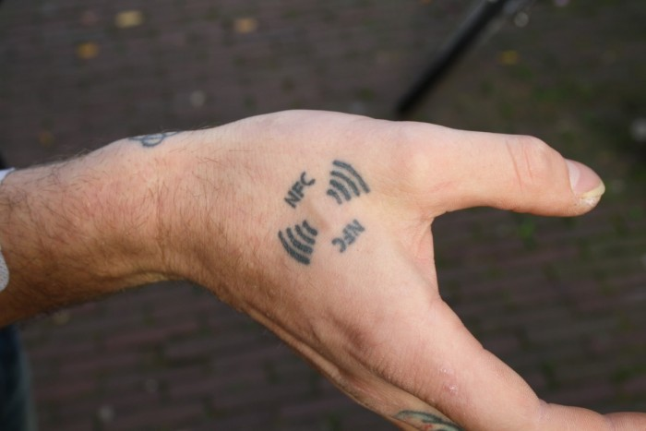

Slide 11
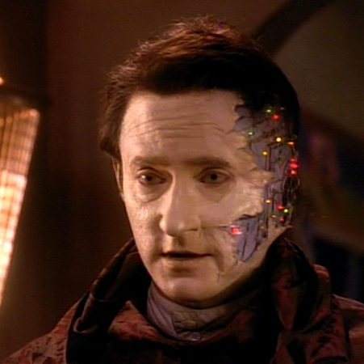

Slide 12
APP Question 1
Q: Are you involved in your country in the following activities (multiple choices possible):
a) Using VET and Adult learning to better educate about AI?
b) Using AI to improve VET and Adult learning teaching and training practices?
c) Integrating AI into curricula for VET and/or Adult learning?
d) None of the above

Slide 13
APP Question 2
Q: What are your views on how to best use AI in VET and Adult Learning? Please rank the following 3 issues according to the order of importance
(1 is most important; 3 is least important):
1. For accomplishing certain tasks instead of being done by people (teachers, learners etc), for example in the area of bureaucracy.
2. For personalising the pedagogical processes, adapting and choosing the best for the learner (more learner centered, deeper and meaningful teaching and learning, rather than ‘transmissive’ teaching).
3. For quick feedback about progress in work and/or learning, and giving directions/prognosis for students and teachers individually.

Slide 14
Questions for debate
1. Digitalisation and industry 4.0 are high on the
EU agenda, however, many VET schools (from IVET to HVET) do not even manage to apply and teach 2.0. Are we going to "jump" into Artificial Intelligence without completing this path?

Slide 15
Questions for debate
2. Artificial Intelligence is applicable to and valuable for many domains and labour market sectors, but how can we ensure an inclusive approach allowing all kinds of qualifications and VET-levels to learn about, implement and benefit from Artificial Intelligence, not only limited to higher level qualifications?

Slide 16
Questions for debate
3. How can the EU can best support Member States on Artificial Intelligence in order to make progress on implementing the EU’s Coordinated Plan on Artificial Intelligence?

Slide 17
Questions for debate
4. What should be the role of learners and teachers/trainers in Artificial Intelligence?
How can we best make use of the knowledge and experience of learners given that they are often aware of new trends and technologies before teachers?
How can we best involve teachers and trainers in research and practices on Artificial Intelligence ?

Slide 18
Questions for debate
5. How do we achieve the right balance between key competences in VET, notably digital competences, compared to more specialist skills for Artificial Intelligence?

Slide 19
Conclusions
Thank you!
Please continue to share contributions on the wall of ideas

