Slide 1
SHOWCASING VET PROVIDERS’ ERASMUS+ MOBILITY AND STRATEGIC INTERNATIONALISATION
Pirjo Kauhanen
Principal

Slide 2
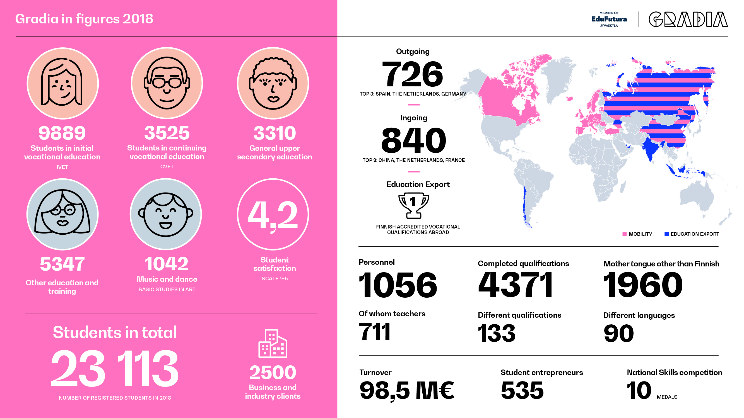

Slide 3
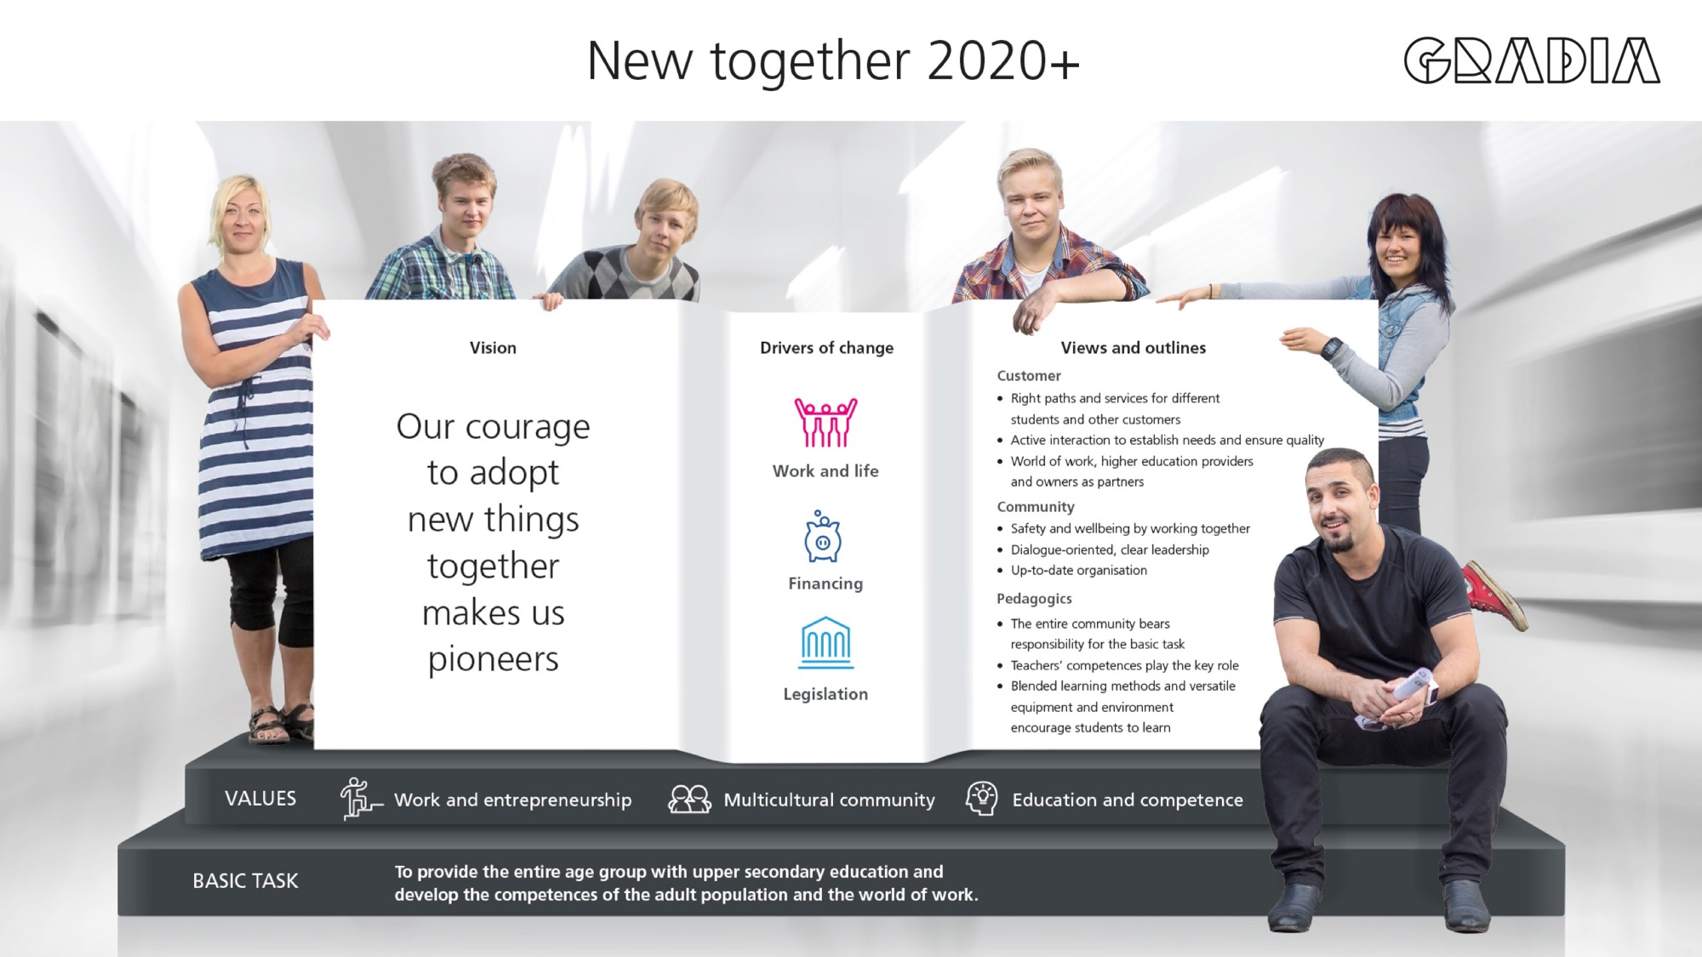

Slide 5

INTERNATIONAL DEVELOPMENT
PLAN 2019-2023
1. Indicative, annual development goals for the strategy period (students, staff, partnerships and networks, QA)
2. General, annual development goals decided by Gradia management board
3. Annual operational plans drawn on college level at the same time as the budget plan for the following fiscal year

Slide 6

GRADIA INTERNATIONAL STRATEGY
Key success factors
Strongly linked to the general strategy and operational plan (since 2009)
Management support
Diversified funding
Equity & equality
Transparency & Mainstreaming
Flexibility & modularisation
Strong, sustainable networks
Support services
Impact analysis & dissemination
Continous improvement

Slide 7

IMPACT
LEARNERS
- Transversal competences
- International/ European perspective
- Networks and friendships
STAFF
- Linguistic and cultural competence
- New ideas, methods, technology
- Benchmarking
ORGANISATION
- More open and tolerant culture
- Sustainable networks; multilevel and multisectoral cooperation
- Co-development and co-delivery of education with partners

Slide 8

Gradia renews learning and working life.
www.gradia.fi – Keep upgrading
FB: @gradiafi, Twitter: @gradia_fi, Instagram: @gradiafi, YouTube: Gradia.fi
pirjo.kauhanen@gradia.fi

