Slide 1
Future-proof adult learning
ET2020 Working Group on Adult Learning
15.10.2019, Helsinki
Anja Meierkord
Labour Market Economist
Directorate for Employment, Labour and Social Affairs
OECD

Slide 2

Adult learning systems are under pressure.
Technological change
Changing skill demand and supply.
Population ageing
Increased need for up- and reskilling
Globalisation
Notes:
Premise of the research project: megatrends such as technological change, population ageing and globalisation are changing the types of jobs that are available and how we do them.
For example, the number of manufacturing jobs has decreased in advanced economies in the past decades, and an increasing number of the remaining jobs in this sector now require the ability to operate, monitor and maintain advanced industrial robots. At the same time, new jobs requiring new combinations of skills have emerged, such as data scientists, web developer or social media manager.
[Data on job polarisation shows that the share of middle skilled jobs, such as secretaries, plumbers and train drivers, have decreased in all advanced economies (UK:10% between 1995 and 2015). In the UK, they have primarily been replaced by high-skilled jobs (up 9%), such as software engineers, environmental scientists and nurse practitioners, but also a small number of low-skilled jobs, including call centre salespersons and office cleaners (up 1%).]

Slide 3
Most countries have seen increases in employment rates in the last decades…
Employment-to-population ratio across countries, age 15-64
Note: 2007 data refers to 2001 for Japan and 2000 for France, Hungary and Israel
Source: OECD Labour Force Statistics Database (data here)

Slide 4
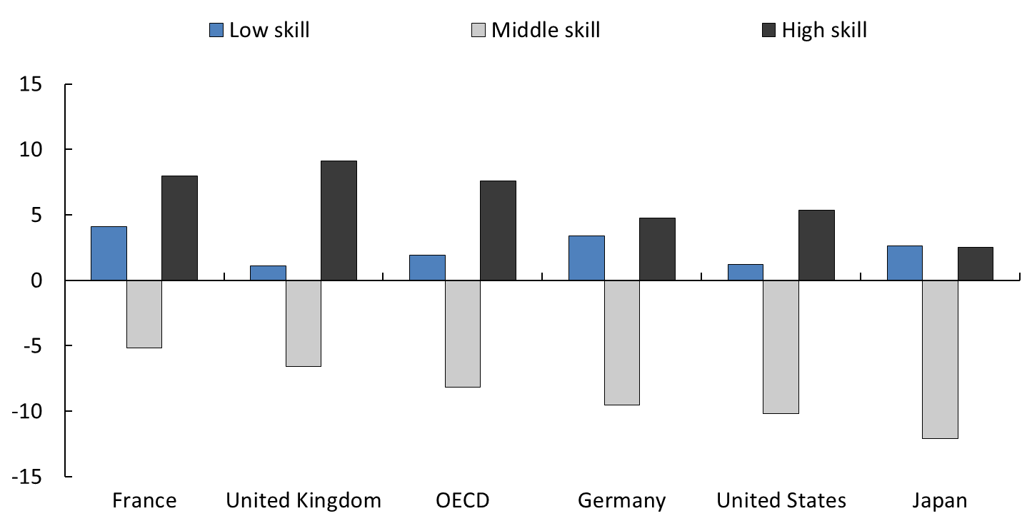
…but the jobs created are not the same as those disappearing.
Percentage point change in share of total employment
(OECD average), 1995 to 2015
Note: High, medium and low skilled occupations are ISCO occupational groups 1 to 3, 4 to 8 and 9 respectively.
Source: OECD (2017), OECD Employment Outlook 2017, (available here)

Slide 5
Skill imbalances in the labour market are intensifying…
Share of employment in high demand by skill level
Note: High, medium and low skilled occupations are ISCO occupational groups 1 to 3, 4 to 8 and 9 respectively. Shares of employment in each skill tier are computed as the corresponding employment in each group over the total number of workers in shortage in each country. Data refer to the latest year for which information is available
Source: Elaborations based on the OECD Skills for Jobs database (2018).

Slide 6

…and many more jobs will be affected by change in the future.
Jobs likely to change or be automated across countries, % of jobs
Note: High risk – more than 70% probability of automation; risk of significant change – between 50 and 70% probability.
Source: Nedelkoska and Quintini, 2018, based on PIAAC data (2012)

Slide 7





Are we ready for these challenges?
OECD project on future-ready
adult learning systems:
Priorities for Adult Learning dashboard
Accompanying report: Future-ready adult learning systems
Booklets for non-technical audiences on specific themes:
  Engaging low-skilled adults in learning
  Making adult learning work in social partnership
  Creating responsive adult learning systems
Country reviews - ongoing

Slide 8
The OECD PAL dashboard…
Urgency | Coverage | Inclusiveness | Flexi-guidance | Alignment | Perceived impact | Financing
Population ageing Automation & structural change Adult skills Globalisation | Employers Individuals | Socio-demographic characteristics Employment and contract status | Flexibility of training provision Use of career guidance services | Labour market imbalances Assessment of skill needs Training for future skills | Usefulness and effectiveness | Government Employers Individuals
Data basis:
Continuing Vocational Training Survey (CVTS), the European Adult Education Survey (AES), Eurostat and OECD data on Active Labour Market Policies, Survey of Adult Skills (PIAAC) data, UN world population prospects data, a number of country level surveys

Slide 9
… reveals that no AL system is perfect.

Slide 10
Many adults do not train, …
Participation and willingness to train across countries, % of adults
Note: The average refers to the unweighted average of OECD countries participating in PIAAC; formal and non-formal job-related education and training; data for England and Northern Ireland only
Source: PIAAC data (2012, 2015).

Slide 11
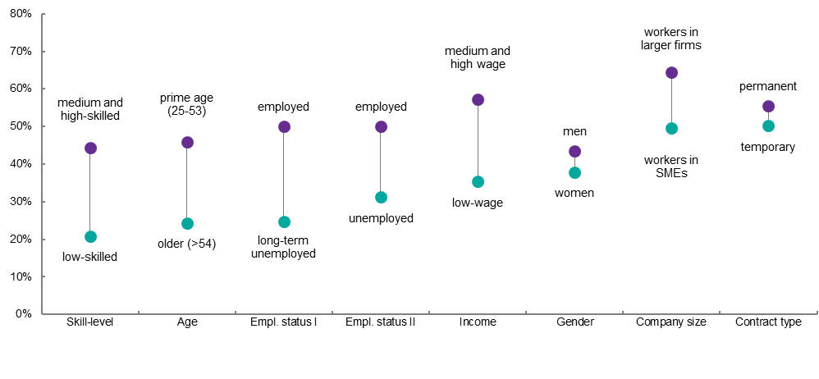
…certain groups of individuals don’t participate…
Participation gaps of disadvantaged groups, % of adult participating in training
Note: formal and non-formal job-related education and training; some data refers to all adults, others to workers only; data for England and Northern Ireland only
Source: PIAAC data (2012, 2015).

Slide 12
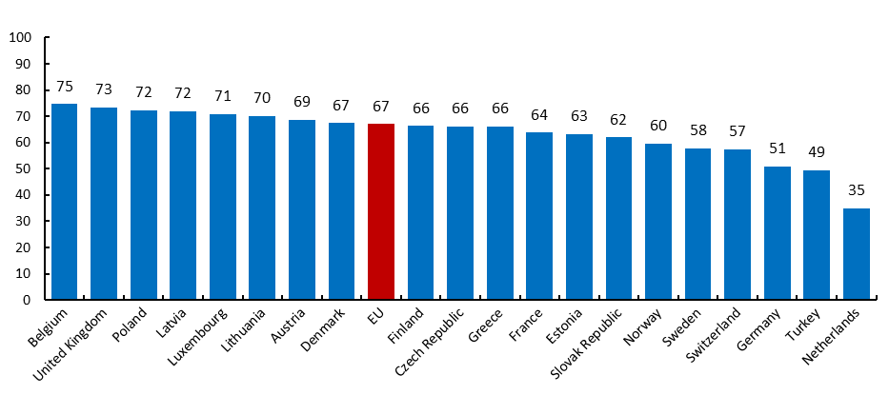
…and many don’t perceive training to be useful for the labour market.
Experience of positive employment outcomes following training, % of learners
Note: Data refers to non-formal learning only; Positive employment outcomes are defined as getting a (new) job, higher salary/wages, promotion in the job, new task, better performance in the present job.
Source: AES (2016)

Slide 13





There are five key areas of action for policy-makers.
Improving the coverage and inclusiveness of adult learning
Aligning the training content more strongly with the skills needs of the labour market
Improving the quality and impact of training provision
Putting in place adequate and sustainable financing
Strengthening governance mechanisms

Slide 14
Follow-up questions
What are the key AL issues in your country?
Where is more research needed so you can make better policy?
Notes:
[

Slide 15

Thank you!
Anja.Meierkord@oecd.org
Find us on:
Website - http://www.oecd.org/employment/skills-and-work.htm
Blog - https://oecdskillsandwork.wordpress.com/
Find out what the future holds for your job:

