Slide 1
ESREA, the ENLIVEN project, and the Upskilling Pathways
MARCELLA MILANA
15 October 2019
Helsinki

Slide 2
Outline
  The European Society for Research on the Education of Adults
    The ESREA Network on Policy Studies in Adult Education
  Encouraging Lifelong Learning for an Inclusive and Vibrant Europe
  (The ENLIVEN project – an EU’s Horizon 2020 funded project)
  The Upskilling Pathways
    Cases from Italy, the United Kingdom and Slovakia

Slide 3


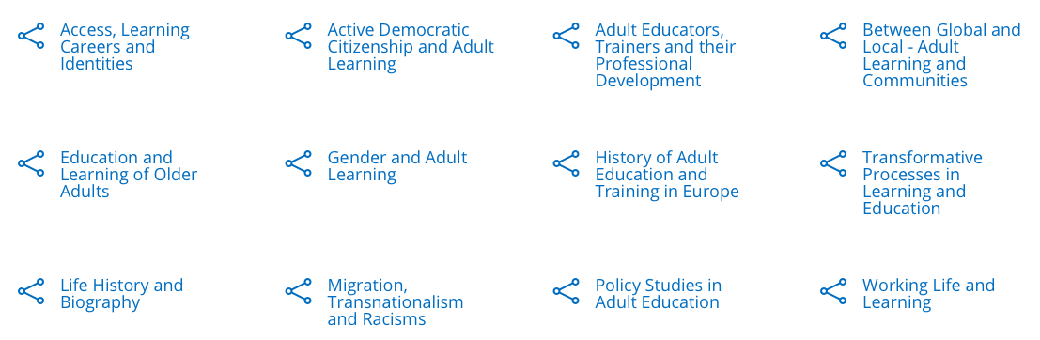

ESREA (www.esrea.org)
Promotes and disseminate research on the education of adults and adult learning in Europe, through:
  12 thematic research networks
  Annual, biannual and triennial conferences
  Open Access publications:
    Book series (Brill | Sense)
    RELA journal

Slide 4

Policy Studies in Adult Education
An ESREA thematic network
  Committed to on-going dialogue, development & impact of AE policies & research of AE policy
  Welcomes discussion from different perspectives & traditions
  Supports theory developments for studying AE-relevant policy issues
  Meets on biannual basis & engages in “policy dialogues”
  Sponsor publications of academic books & journal’s special issues

Slide 5
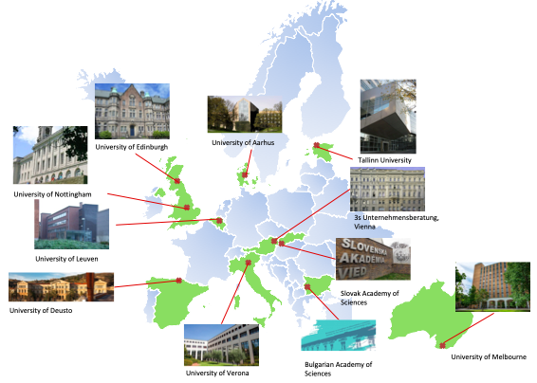
The ENLIVEN project
How can policy interventions in adult education markets become more effective?
ENLIVEN examined…
  Programmes, governance and policies in EU adult learning
  System characteristics to explain country/region-level variation in lifelong learning participation rates
  The operation and effectiveness of young adults’ learning at and for work
  …and DEVELOPED and TRIALED an Intelligent Data Support System for evidence-based policy-making and debate

Slide 6
Italy: “The Floor is Yours!”
Need to support inclusion policies in the Campania Region (Southern Italy)
  22 months (Nov 2016-Apr 2018)
  Co-funded under the Asylum, Migration and Integration Fund (AMIF)
  Legally resident Third Country Nationals in Italy
    Providing a tailored and flexible teaching offer for learning Italian as 2L
    Encouraging the participation of migrants (women, illiterate people, vulnerable people, refugees and applicants for international and humanitarian protection)
    Improving teaching methods on Italian language and civic education
  25 different kinds of activities (e.g. language courses, theatre workshops, artisanal training, citizens meetings)

Slide 7
UK: Talent Match D2N2
Need to support ‘Inclusive Learning Pathways’ (in Derby city, Derbyshire, Nottingham city and Nottinghamshire)
  5-year programme (2014 – 2019)
  Funded by the Big Lottery (awarding community-orientated grants), much of the funding comes from the ERDF and the ESF
  Young adults with the most complex and entrenched barriers to employment (i.e. low skills and educational attainment, in geographical areas with pockets of significant deprivation)
    Match people’s needs with their broader ambitions
  One-to-one mentoring relationships focusing on taking time to establish trust and rapport to help the person address barriers and make progress towards the labour market.

Slide 8
Slovakia: REPAS+
Need to provide the opportunity for young adults to re-qualify to meet new labour market requirements
  Delivered across Slovakia (except the Bratislava region) via regional labour offices
  Administered by the Central Office of Labour and Social Affairs
  Included as part of the UP initiative (!)
  Young people defined as NEET up to 29 years old
    Support the re-qualification of young registered job seekers who face problems in finding a job placement
  The length of the training is defined by the participants and the main activities of the programme are vocational training provided by external providers

Slide 9
Lessons learned
Deep differences between national and regional contexts
  People in predominantly low skilled, disadvantaged regions are the least able to take advantage of skills development opportunities –unless programmes are targeted at their particular needs in terms of access, support and outreach
    Importance of communication – between government, policy makers, providers and institutions – in tackling disadvantage, inequality and social exclusion
    “Asset-based approach” that involves trust building over a period of time and careful planning to find out what skills and abilities a person has and what he/she may aspire to do
    In regions with weak labour demand and limited job opportunities, financial contributions for job creation makes a significant difference

Slide 10
Invisible barriers to adult learning
Individual and group level
Structural level
What limits participation in existing learning opportunities
  Linguistic
  Digital
  Biographical
What limits implementation and effectiveness of learning opportunities
  Historical-cultural
  Legislative-administrative
      Lack of professional preparedness

Slide 11
Aknowledgements
The presentation is based on the following work from the ENLIVEN project:
  Boeren, E., Whittaker, S., & Riddell, S. (2017). Provision of seven types of education for (disadvantaged) adults in ten countries: overview and cross-country comparison (ENLIVEN Report, Deliverable No. 2.1). https://h2020enliven.files.wordpress.com/2017/09/enliven-d2-1.pdf
  Milana, M., Klatt, G., & Vatrella, S. (Eds.) (forthcoming). Europe’s Lifelong Learning Markets, Governance and Policy. Using an Instruments Approach. New York, London: Palgrave Macmillan

Slide 12
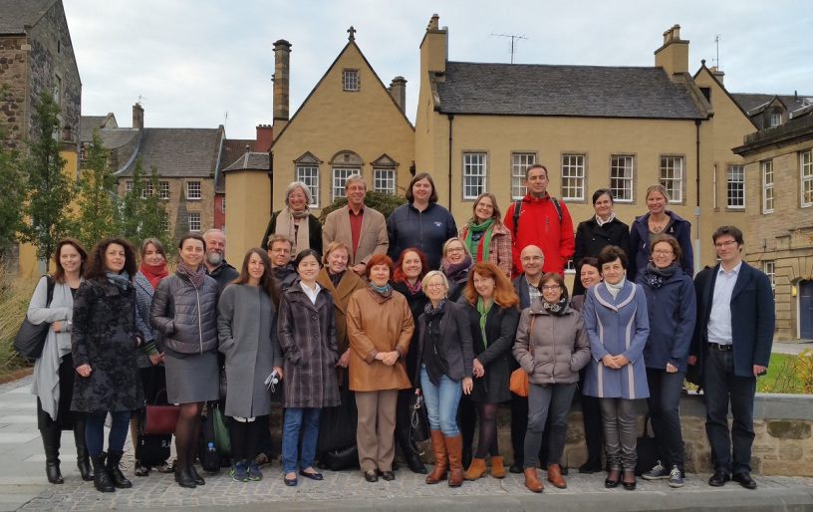

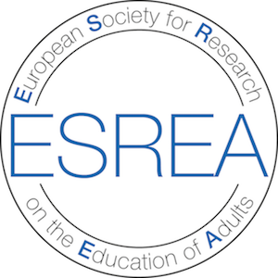
Contact:
marcella.milana@univr.it
#DiscoverYourTalent

