Slide 1


Unlocking the potential of migrants through Vocational Education and Training (VET)
Cross-country Analysis
Shinyoung Jeon, Policy Analyst
VET and Adult Learning Team, OECD Centre for Skills
Cedefop community of learning providers (WG3),14 October 2019

Slide 2
About the project
Policy advice for VET systems and VET stakeholders who are seeking to integrate young migrants and refugees into the host-country labour market.
With a particular focus on :
  Young humanitarian migrants (15-34) and their integration into upper-secondary VET
  Germany, Italy, Sweden and Switzerland

Slide 3
Context
Across the OECD in 2017, 27% of people aged 15-34,
or 59 million people had a migrant background.
With an increase of 4 percentage points over the previous decade.
Between 2014 and 2017, more than 5.3 million asylum seekers arrived in OECD countries and over 50% of those arriving in Europe were aged 18-34.
Of these, many – though not all – have obtained some form of international protection and are therefore classified as humanitarian migrants.

Slide 4
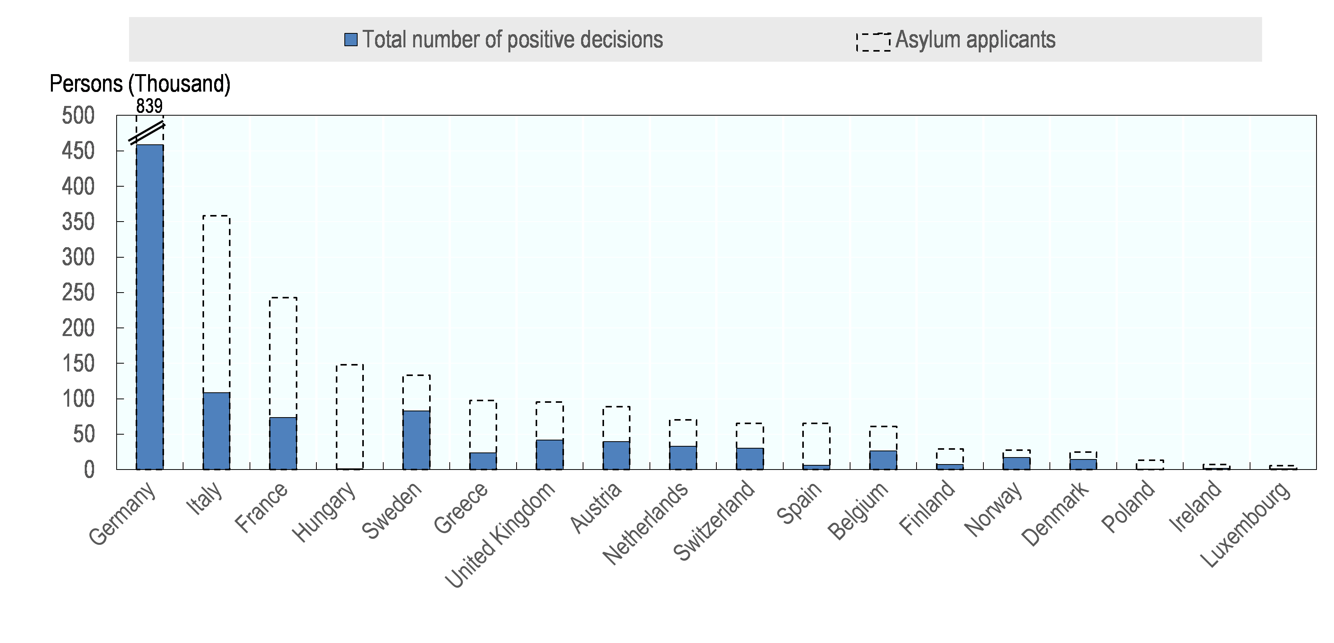
Recently, many young people came to seek asylum in EU countries
Cumulative sum of asylum seekers among young people (18-34) in selected EU countries and decisions (2014-18)

Slide 5
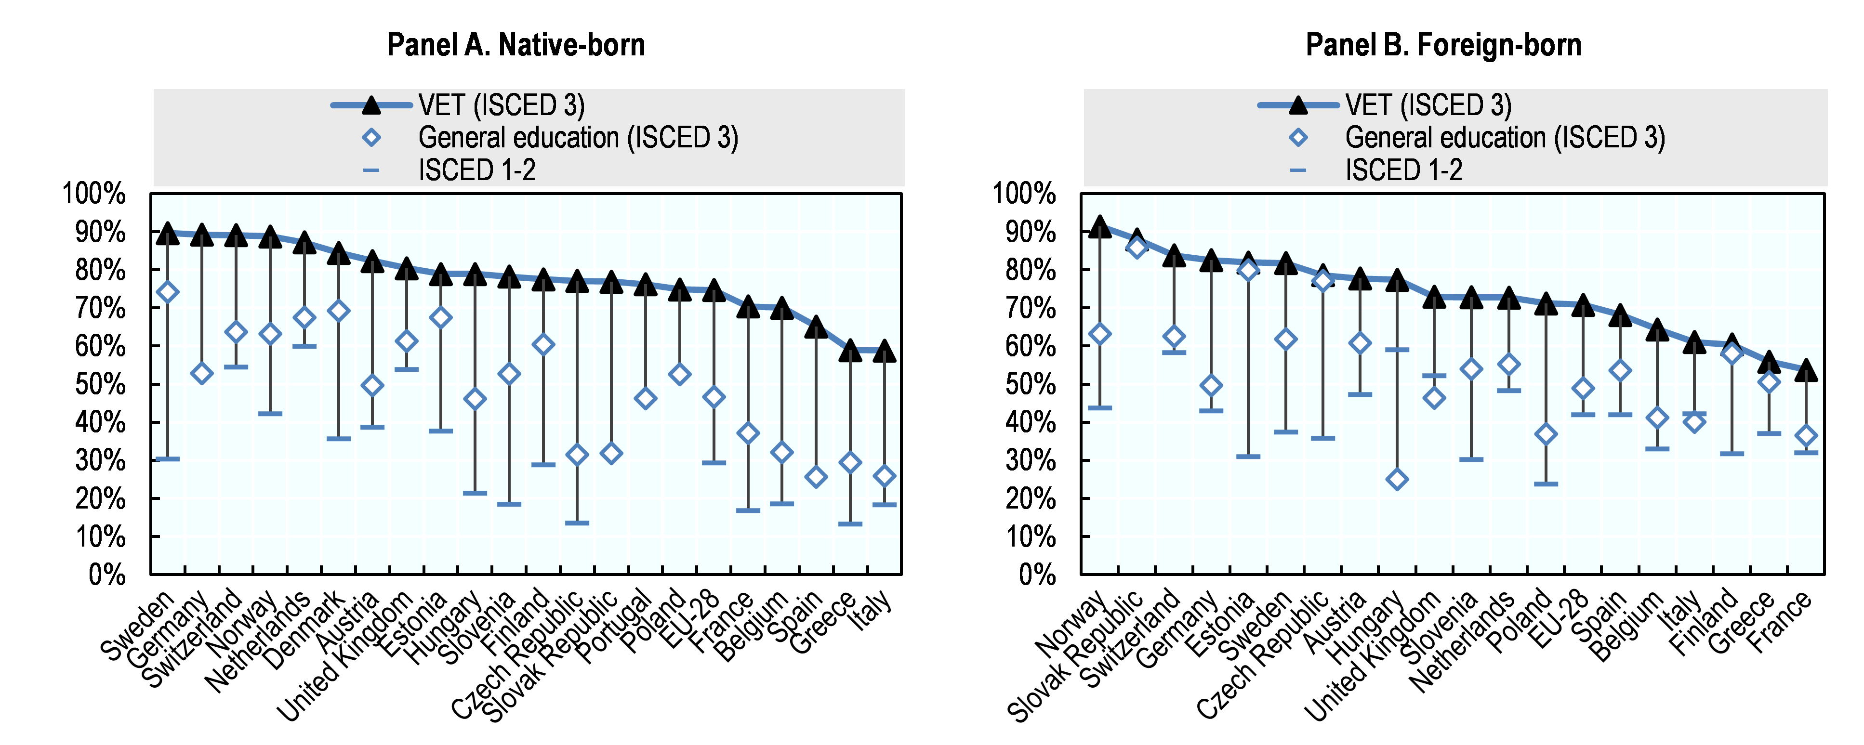
VET is a recognised solution in many OECD countries
Upper-secondary VET graduates show strong employment outcomes (ages 15-34), 2018

Slide 6
Sharing effective good practices across countries may help to strengthen the effort
Switzerland
  investment in migrant integration through VET
  recently-launched pre-apprenticeship programmes for newly arrived youth.
Sweden
  implementing a number of VET-related instruments to maximise the potential of migrants
  Vocational Packages in the upper-secondary transitional programmes and adult education programmes – mainly but not exclusively targeting newly arrived migrants.
Italy
  strengthening work-based VET, which is used to better integrate young humanitarian migrants in numerous EU-funded projects.
Germany
  strong efforts towards refugee integration through VET, with a focus on those who face particularly high barriers.

Slide 7
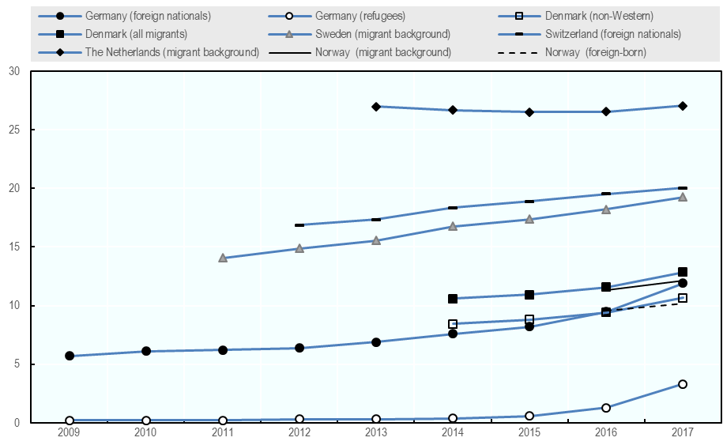
The share of migrant entrants into VET has increased in recent years

Slide 8
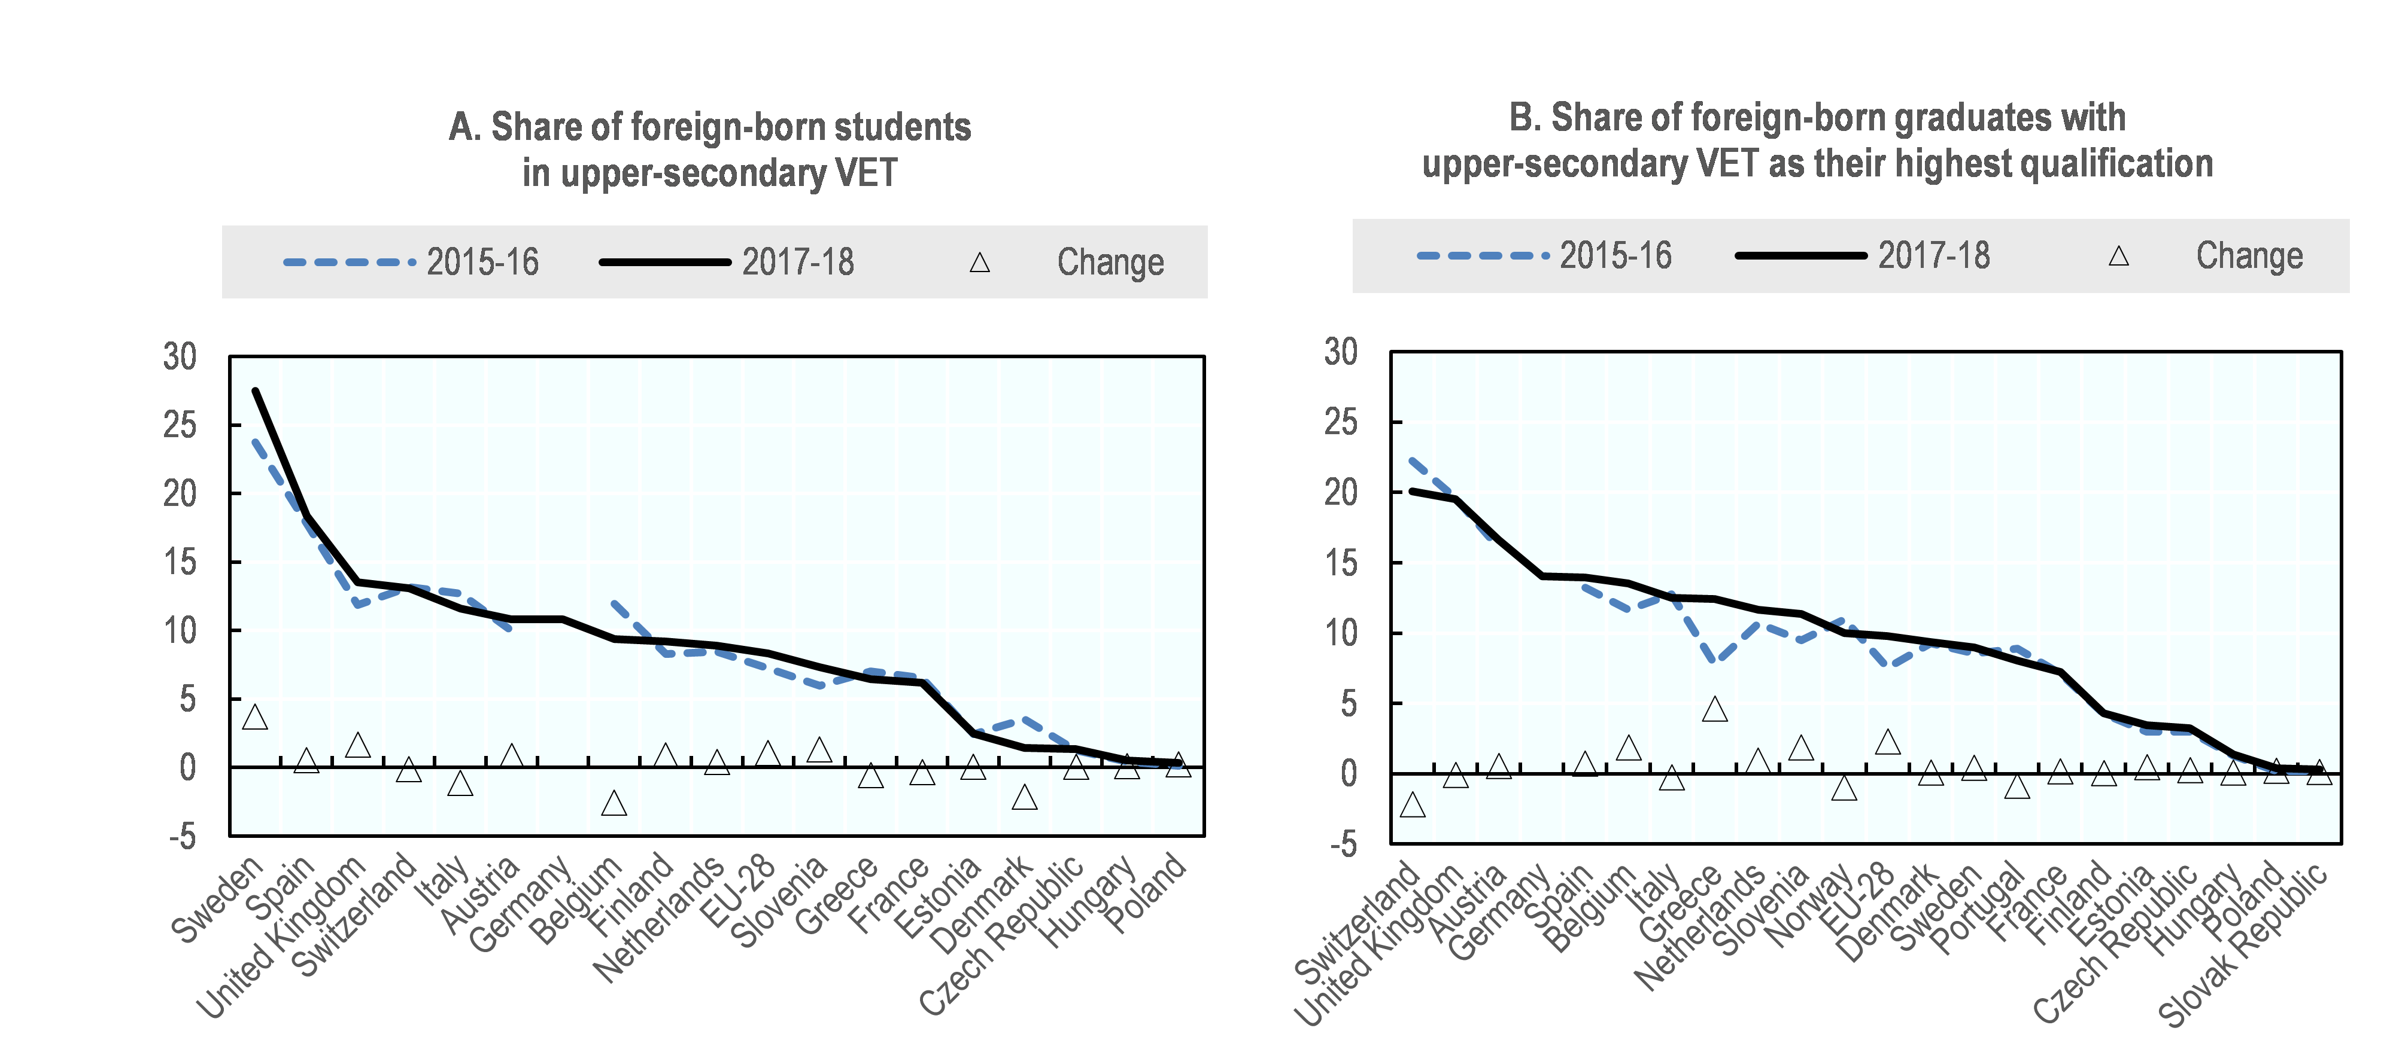
The share of migrants in and from VET has increased in recent years

Slide 9
Key messages: Build strong, flexible and inclusive VET system that works for all
  Identify what VET opportunities are available
  Be prepared to fully take advantage of the VET
  Overcome barriers to eligibility and entry
  Learn skills, successfully complete VET and connect to skilled employment
  Young migrants and refugees
Inform
Prepare
Enable access
Support
  Host countries
  Provide VET leading to long-term, quality and sustainable employment
  Adjust VET system to account for challenges facing migrants
  Prepare VET systems to support migrants
  Identify who is seeking VET and what can be offered

Slide 10
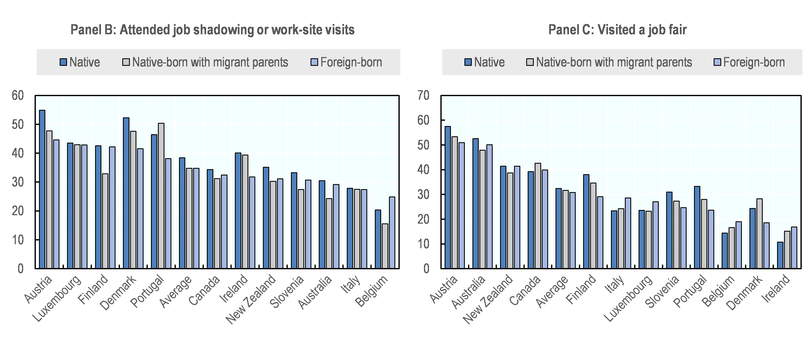
Migrant students tend to benefit less from career guidance provision
Attended job shadowing or work-site visits (%)
Visited a job fair (%)

Slide 11
Preparatory programmes facilitate entry or transition into upper-secondary VET
 | Preparatory programmes | Duration
Australia | Pre-apprenticeship | 6-12 months
Denmark | Integration Basic Education (Integrationsgrunduddannelsen, IGU) | 2 years
England (United Kingdom) | Traineeship | 6 weeks-6 months
Finland | Preparatory vocational education (VALMA or ammatilliseen peruskoulutukseen valmentava koulutus)* | 6-12 months
Germany | Transitional programmes (Übergangsbereich), among which: pre-vocational year (Berufsvorbereitungsjahr) and preparatory traineeships (Einstiegsqualifizierungen or EQ) | 6 months - 2 years
The Netherlands | MBO 1 (part of regular VET)
Sweden | Introductory programmes | 1-3 years
Switzerland | Transitional programmes and Pre-apprenticeship programmes | 6-12 months

Slide 12
Getting into VET is more challenging for migrants Admission rates of upper-secondary VET applications 2016-17

Slide 13
Wide variation of entry requirements to upper-secondary VET
Germany | Italy | Netherlands | Norway | Sweden | Switzerland
2 years
2 years
MBO 1
2-3 years
3-4 years
3-4 years
(EFZ)
3-4 years
2 years
(EBA)
3-4 years
(regional)
5 years
(national)
Work-based
Entry/transition point entailing the need to find an apprenticeship
Dual model
Entry/transition point that requires qualifications
School-based

Slide 14
Completion rates in VET are lower among students with migrant backgrounds (different cohort years)

Slide 15
Higher shares of migrant students perform paid work than native students in many OECD countries (PISA)

Slide 16
Examples of support for migrant students
Career guidance, accessible information
Preparatory programmes, pre-apprenticeships
Flexible mode of VET to facilitate easier access to VET
Intermediary bodies to help connect migrants to employers
Support from mentors, coaches and other support mechanisms both at schools and in workplaces
Prepare the teaching workforce and reinforce their ability to increasing shares of migrant students and their challenges

Slide 17
Migrant VET graduates are less likely to have gained work experience during upper-secondary VET
Share of upper-secondary VET graduates who had no work experience
during the course of upper-secondary VET, 2016

Slide 18
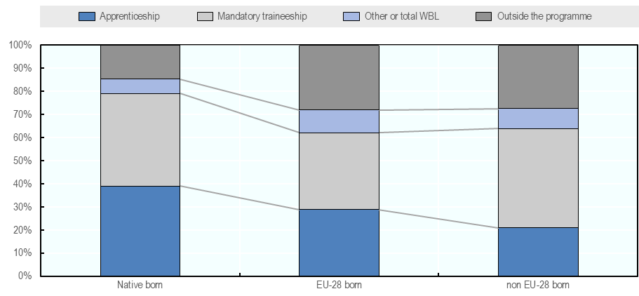
Migrant graduates are less likely to be engaged in work-based learning during VET

Slide 19
VET designed for lower performing students with support measures may facilitate completion for migrant students
Share (%) of students who completed upper-secondary VET with an expected qualification, 2012 cohort from Switzerland, 2017

Slide 20

Conclusion
To unlock the potential of migrants:
Build strong, flexible and inclusive VET systems that works for all

Slide 21
Cite this content as:
Jeon, S. (2019), Unlocking The Potential Of Migrants: Cross-country Analysis, OECD Reviews Of Vocational Education And Training, OECD Publishing, Paris, Https://Dx.Doi.Org/10.1787/045be9b0-en
See also:
Bergseng, B., E. Degler And S. Lüthi (2019 forthcoming), Unlocking The Potential Of Migrants In Germany, OECD Reviews Of Vocational Education And Training, OECD Publishing, Paris, Https://Dx.Doi.Org/10.1787/82ccc2a3-en.
Kuczera, M. and S. Jeon (2019), Vocational Education and Training in Sweden, OECD Reviews of Vocational Education and Training, OECD Publishing, Paris, https://dx.doi.org/10.1787/g2g9fac5-en.
Lüthi, S. (forthcoming), “Unlocking the potential of migrants through vocational education and training - Country note: Switzerland”, OECD Social, Employment and Migration Working Papers, OECD Publishing, Paris.

