Slide 1
CoVE Water pilot project Centre of Vocational Excellence Water
EUROPEAN VOCATIONAL SKILLS WEEK 2019 2019-10-17, Helsinki
Pieter Hoekstra
Projectmanager CIV Water
WaterCampus Leeuwarden
p.hoekstra@civwater.nl

Slide 2
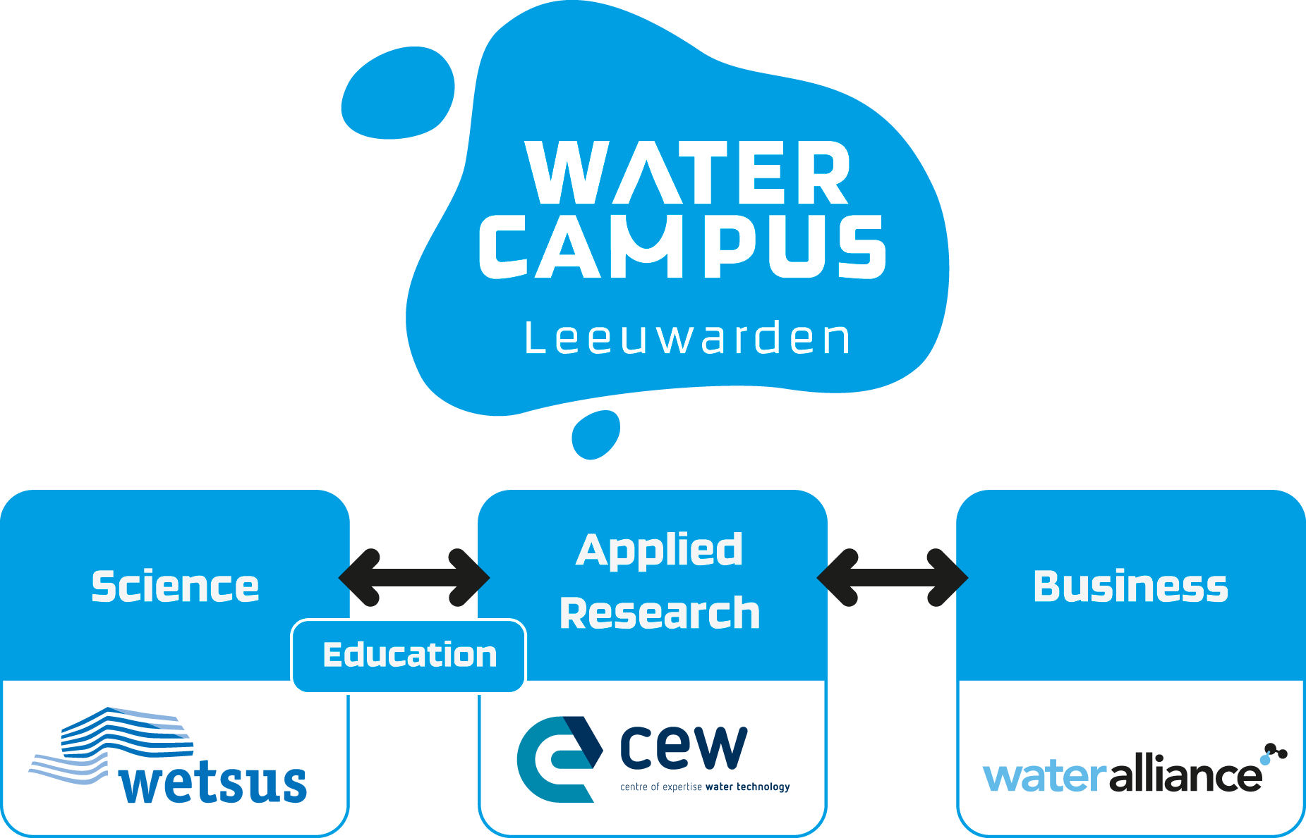
Innovation Ecosystem
2003
2012
2007
2013
Notes:
The different organisations are formed indepently. WaterCampus is the overall umbrella. Each organisation is a not for profit foundation.

Slide 3
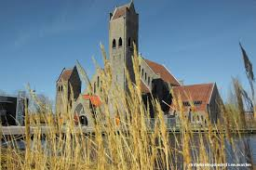
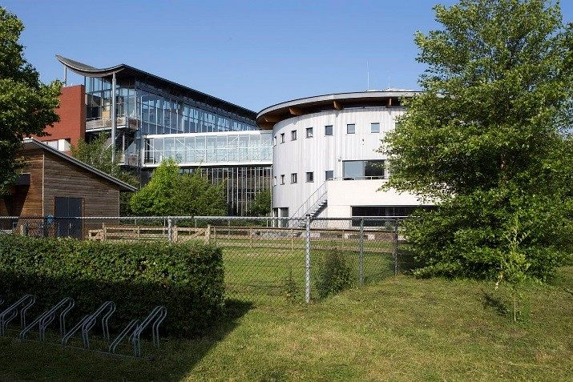
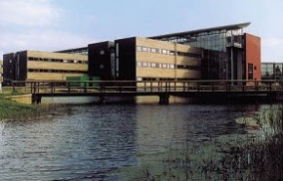
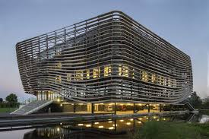

Slide 4
Learning Cycle
Notes:
Education at WaterCampus, always working with companies.
Wetsus, CEW and CIV-Water are all three public-private partnerships. Companies are very intensively involved and also fund part of the activities.
Education forms the backbone of the innovation ecosystem. Students from all levels are involved in research, innovation and demonstration projects.

Slide 5
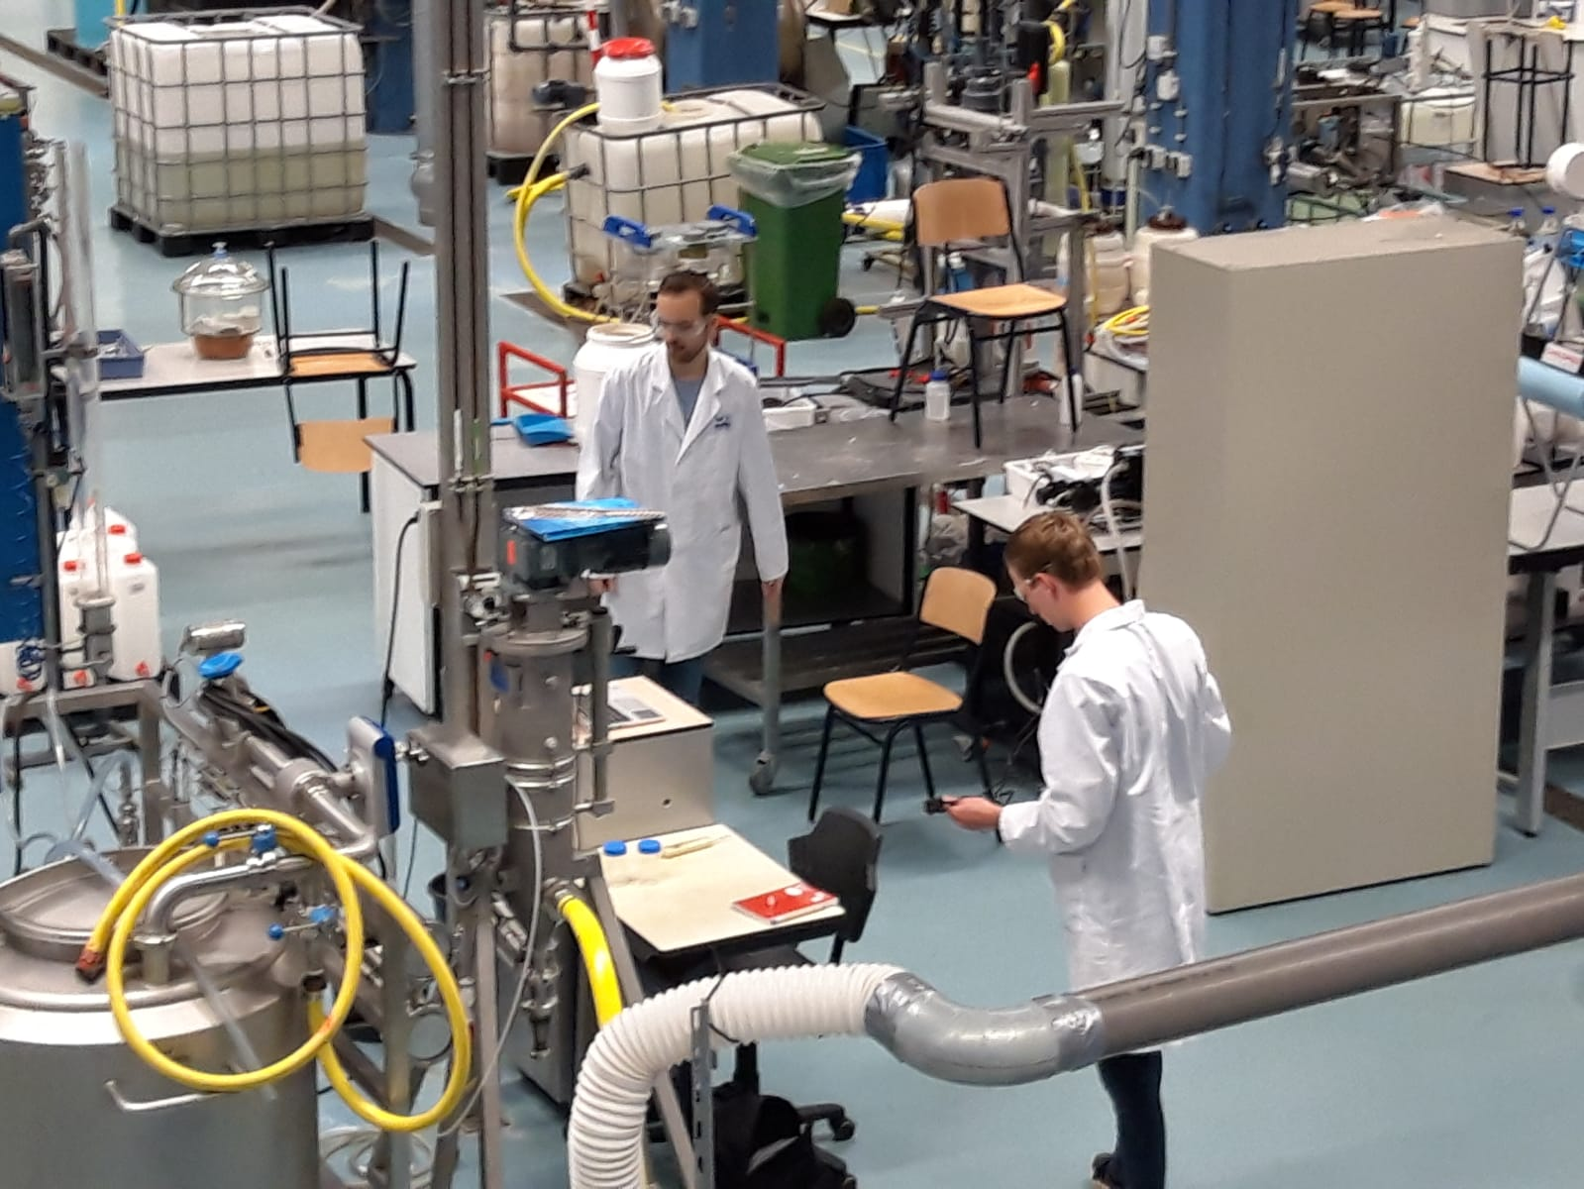
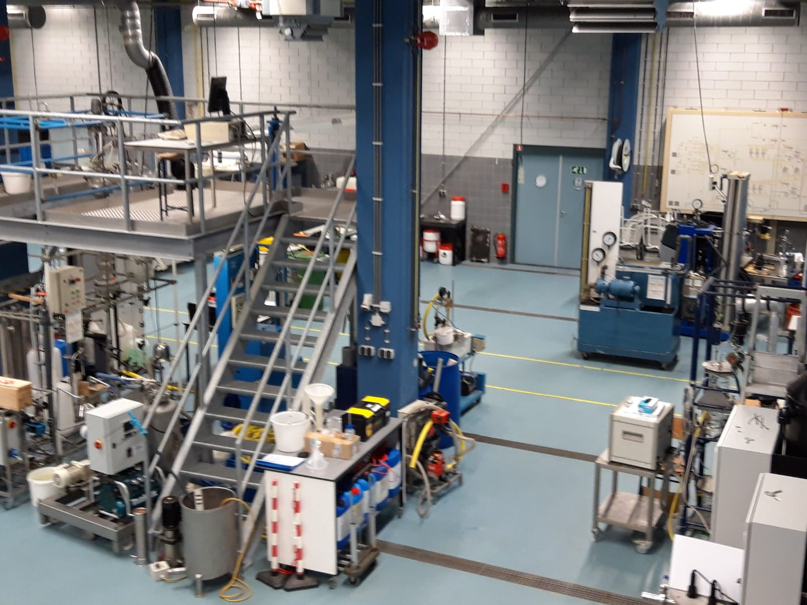
Water Application Centre (WAC)
VET & Applied Sciences
Notes:
In the Water Application Centre CIV-Water and CEW cooperate in research, innovation and demonstration projects.

Slide 6
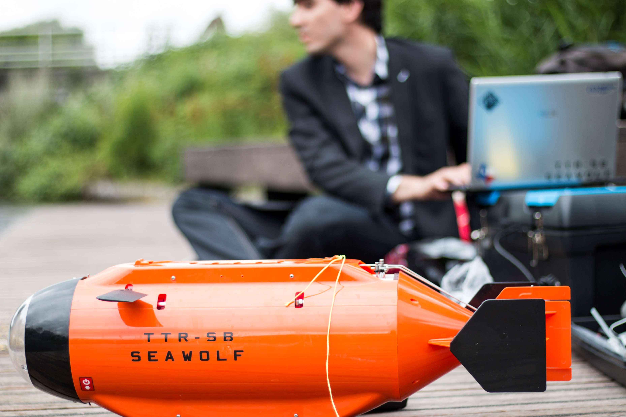
CIV Water: Underwaterdrone Pilot
New education material for VET & Applied Science
2 schools, 3 companies & 1 govermental organisation involved
VET & Applied Science students follow clases together on both levels
Taught by teachers from the participating schools & companies
Centre for innovative craftsmanship Water
Notes:
Example of a cooperation project between triple helix actors and school levels.

Slide 7
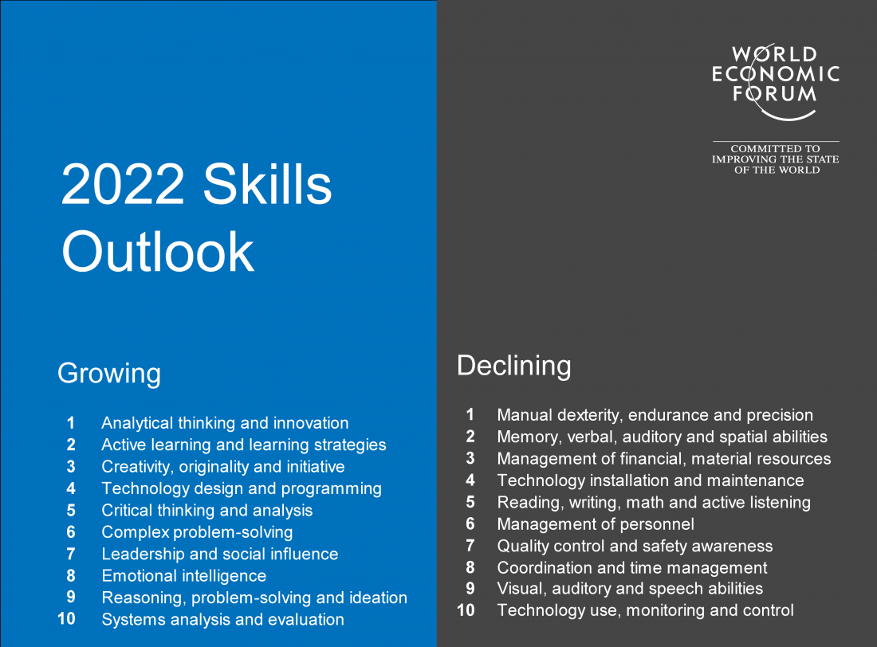
Skills Outlook 2022 (WEF)
Notes:
WaterCampus addresses the skills need which also World Economic Forum has highlighted.

Slide 8
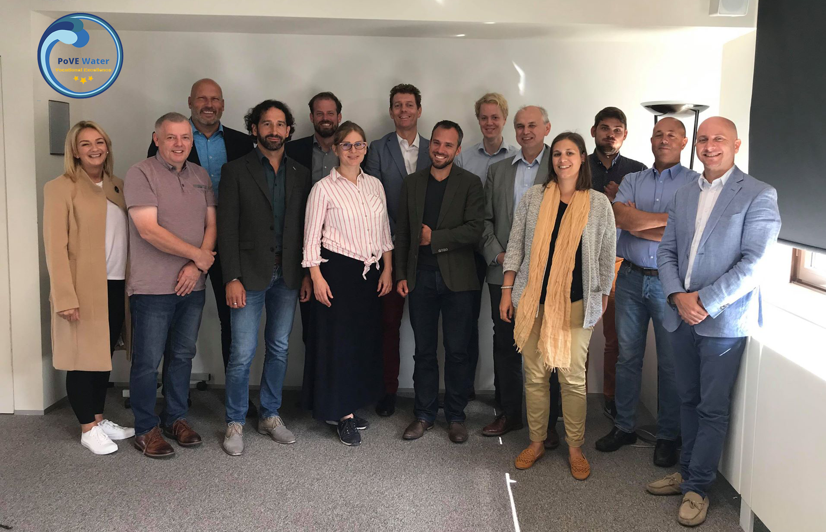
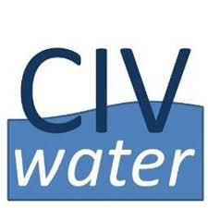
Centre of Vocational Excellence Water (CoVE Water) Pilot project
Notes:
CIV-Water is working with 12 other partners from 5 countries in the pilot project CoVE Water.

Slide 9
www.civwater.nl
www.wetsus.eu
www.watercampus.nl
www.topsectorwater.nl

