Slide 1

The Innovation Centre for Vocational Education and Training of Aragon
Teaching and Learning
Helsinki 17/10/2019

Slide 2

CIFPA
National Reference Centre for Trade Logistics and Transport Management
Teacher Training Centre
Innovation Centre

Slide 3



National Reference Centre Scope: national
Trade Logistics and Transport Management
Your future. Our impulse.

Slide 4


CIFPA-National Reference Centre Scope: national
Observation and analysis of the sector
Learning factory
LEAN Management and Logistics Equipment
Plan and put in place training activities
Upskilling and reskilling of workers, unemployed people, teachers and trainers
Fork-lift trucks
Elaborate formative itineraries
The Automated Logistics Chain
Professional standard certification
Heavy-vehicle simulators
Trade Logistics and Transport Management
Your future. Our impulse.

Slide 5
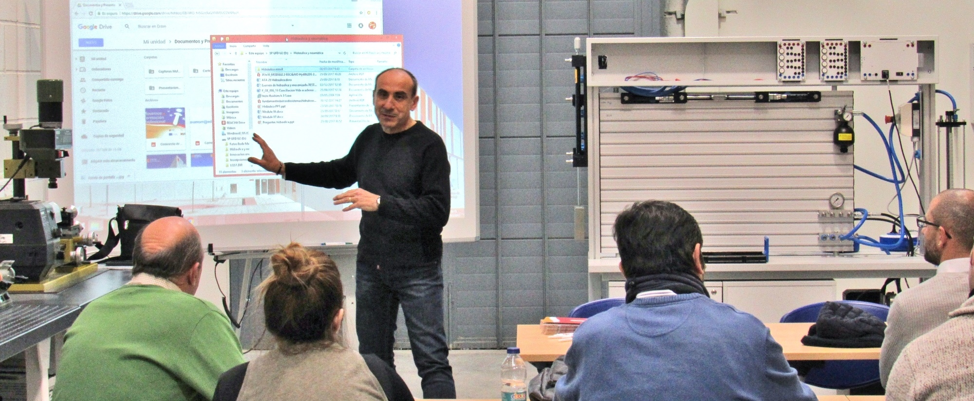

CIFPA- Training Centre Scope: regional
Your future. Our impulse.

Slide 6
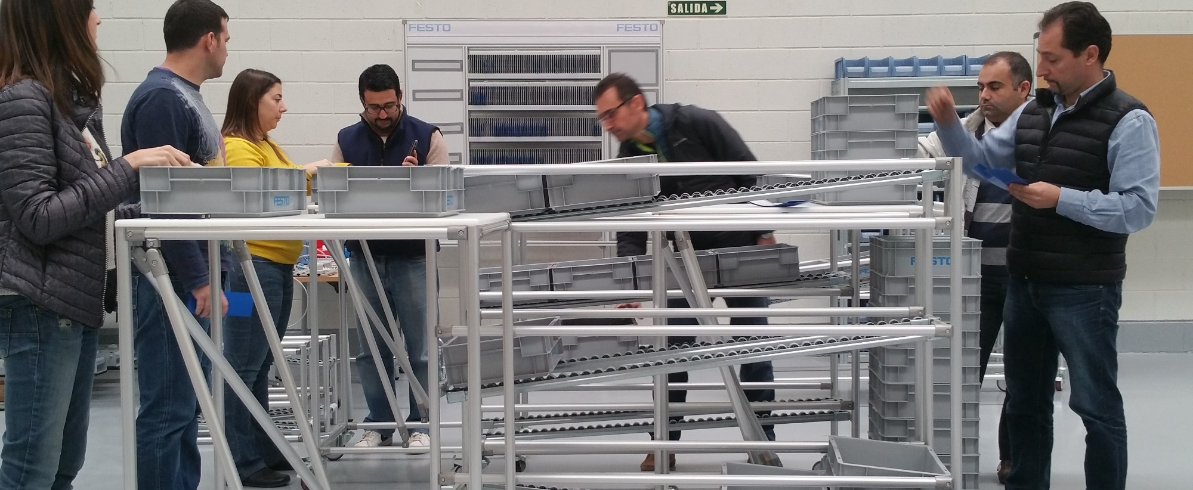
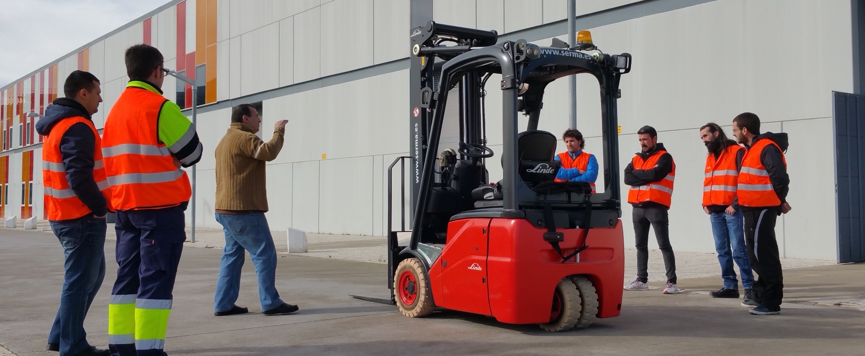
CIFPA- Training Centre Scope: regional
Lifelong learning
Training for businesses
Training for the unemployed and people with low qualification
Training for teachers and trainers
22 professional families
Physical and Sports Activities, Management and Administration, Agrarian, Graphic Arts, Trade and Marketing, Civil Work and Engineering, Electronics and Electricity, Water and Energy, Mechanical Manufacture, Tourism and Hospitality, Personl Immage, Sound and Immage, Food Industries, ICTs, Installation and Maintenance, Wood, Chemistry, Health, Safety and Environment, Socio-Cultural and Community Services, Textile, Transport and Vehicle Maintenance…
Your future. Our impulse.

Slide 7

CIFPA- Training Centre Scope: regional
Training needs detection
National Occupational Monitoring
Regional Business Tendency Monitoring
VET trainers/ in-company trainers
Business associations, job fairs, Open Working Days, collaboration with SMEs
Your future. Our impulse.

Slide 8
TRAINING COURSES OFFER:
Technical/Professional upskilling
Methodological innovation
Soft skills development.
Your future. Our impulse.

Slide 9
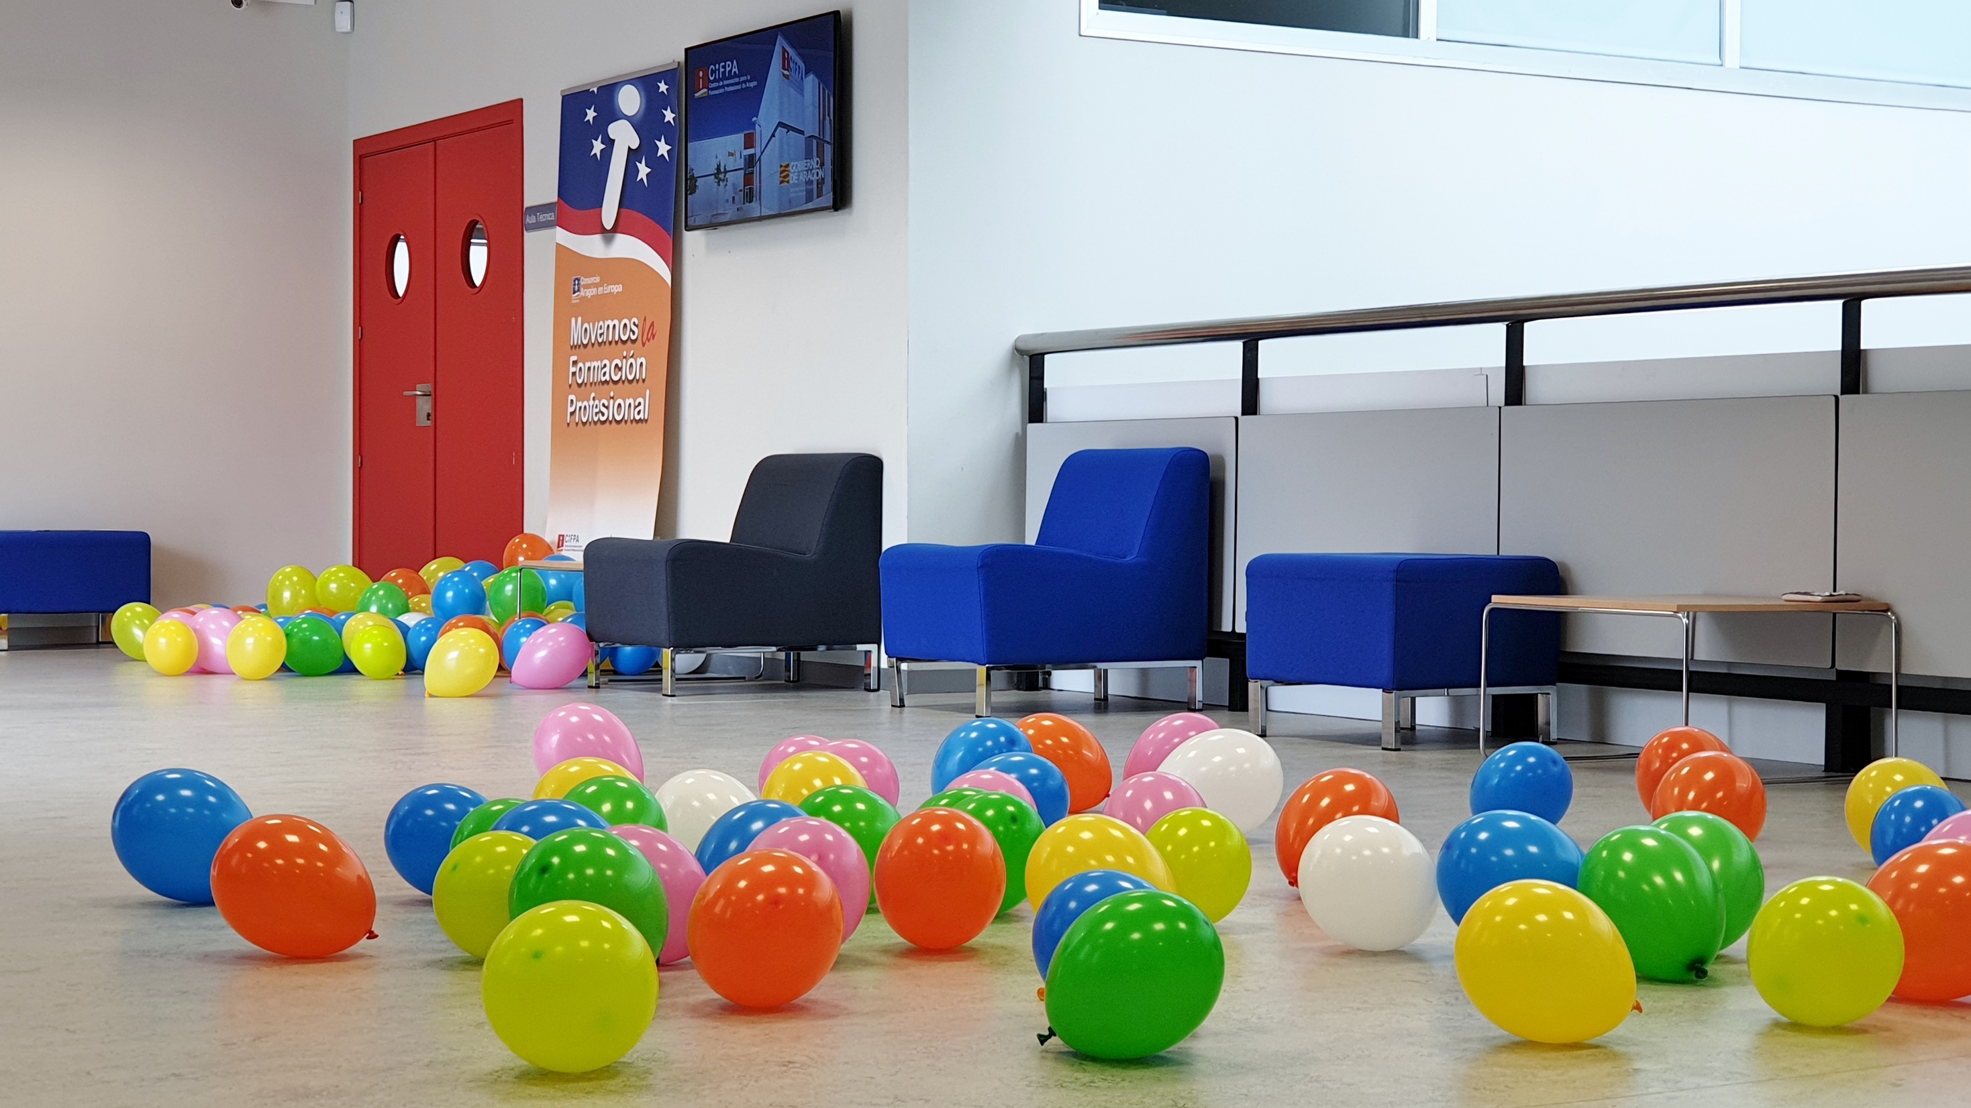
CIFPA-Innovation Centre Scope: regional/national
About 80 annual projects. Scope: All VET providers of Aragón
1. Industry 4:0
2. Bio-Economy
3. Methodological innovation
4. Virtual and augmented reality
Your future. Our impulse.

Slide 10
CIFPA- Innovation Centre. Scope: regional
Expert work group: Active Methodologies
http://bit.ly/2ONj8CE
https://bit.ly/2NvZhDv.
Gamification, PBL, CBL, learning through service…
Expert work group: Quality and excellence in VET
Implementation of EFQM model.
Expert work group: Drones as tools in VET
Improvement of professional competences through new technologies
Your future. Our impulse.

Slide 11
CREATING NETWORKS Scope: regional
Seminar for Directors of VET providers
Seminar for Career an Educational Guidance Counsellors
Seminar for DUAL training programmes trainers
Seminar for Erasmus+ coordinators
Open Working Days “Watch and act!” Dissemination events
Your future. Our impulse.

Slide 12
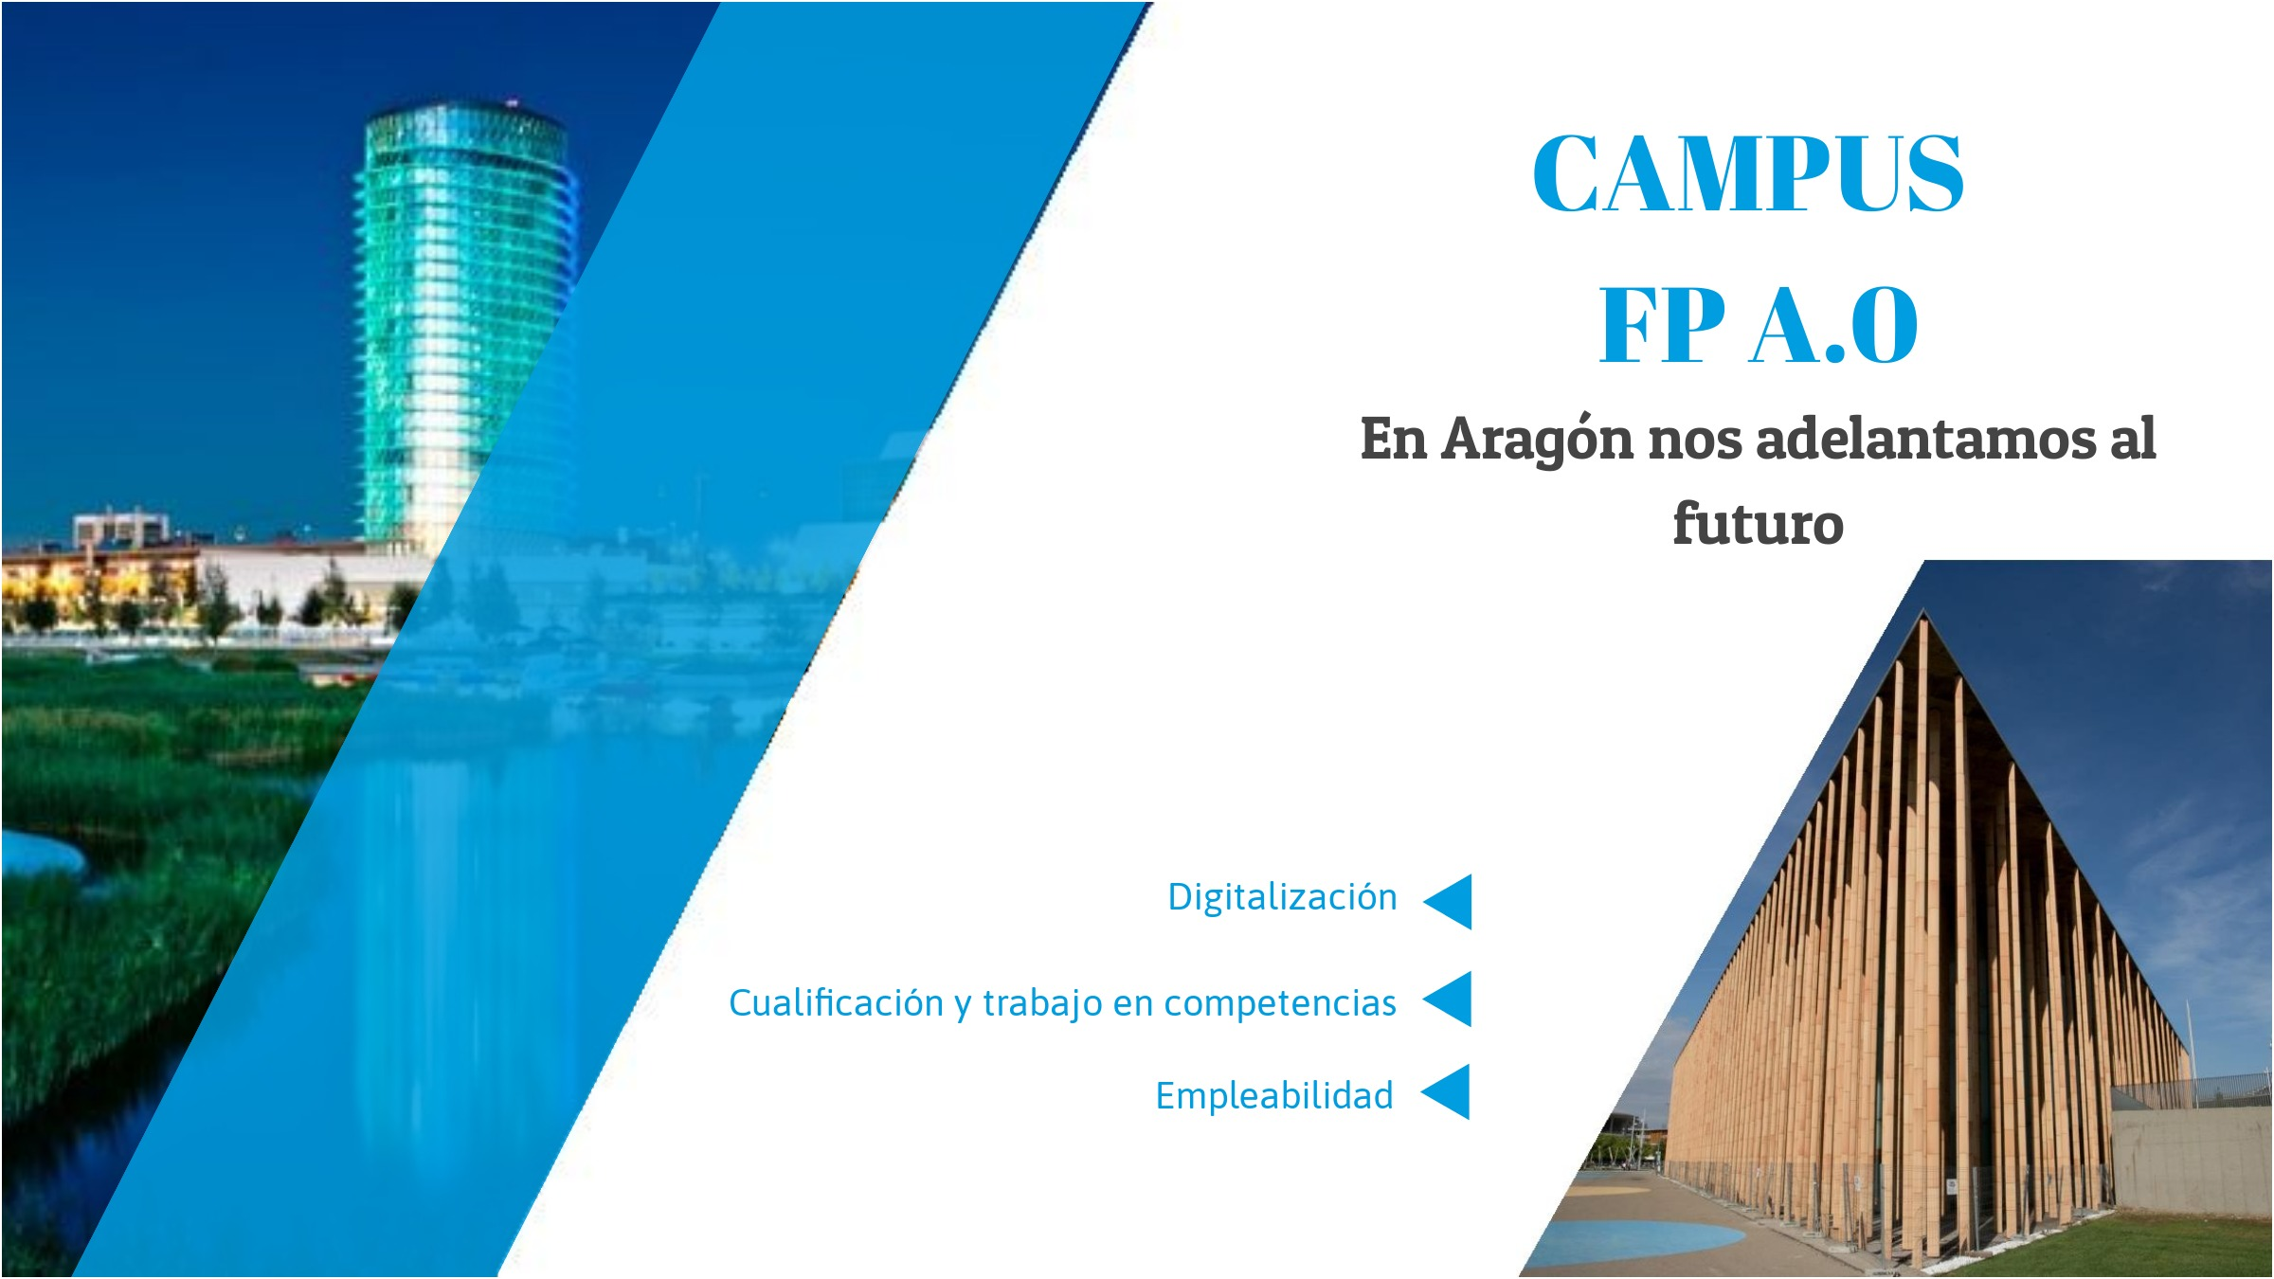

Slide 13
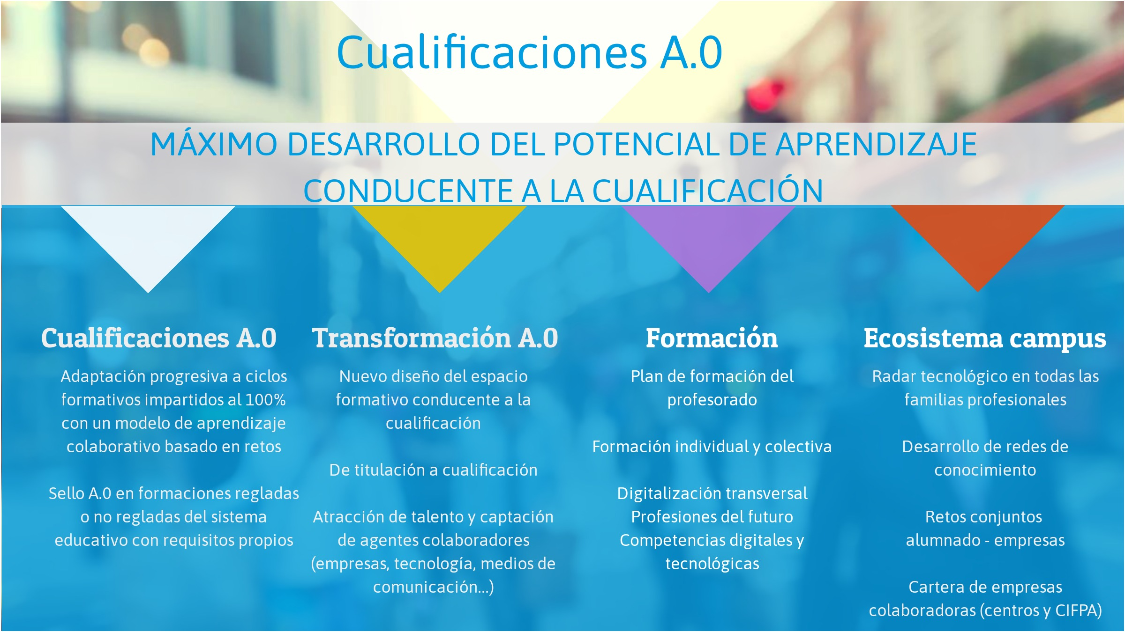

Slide 14
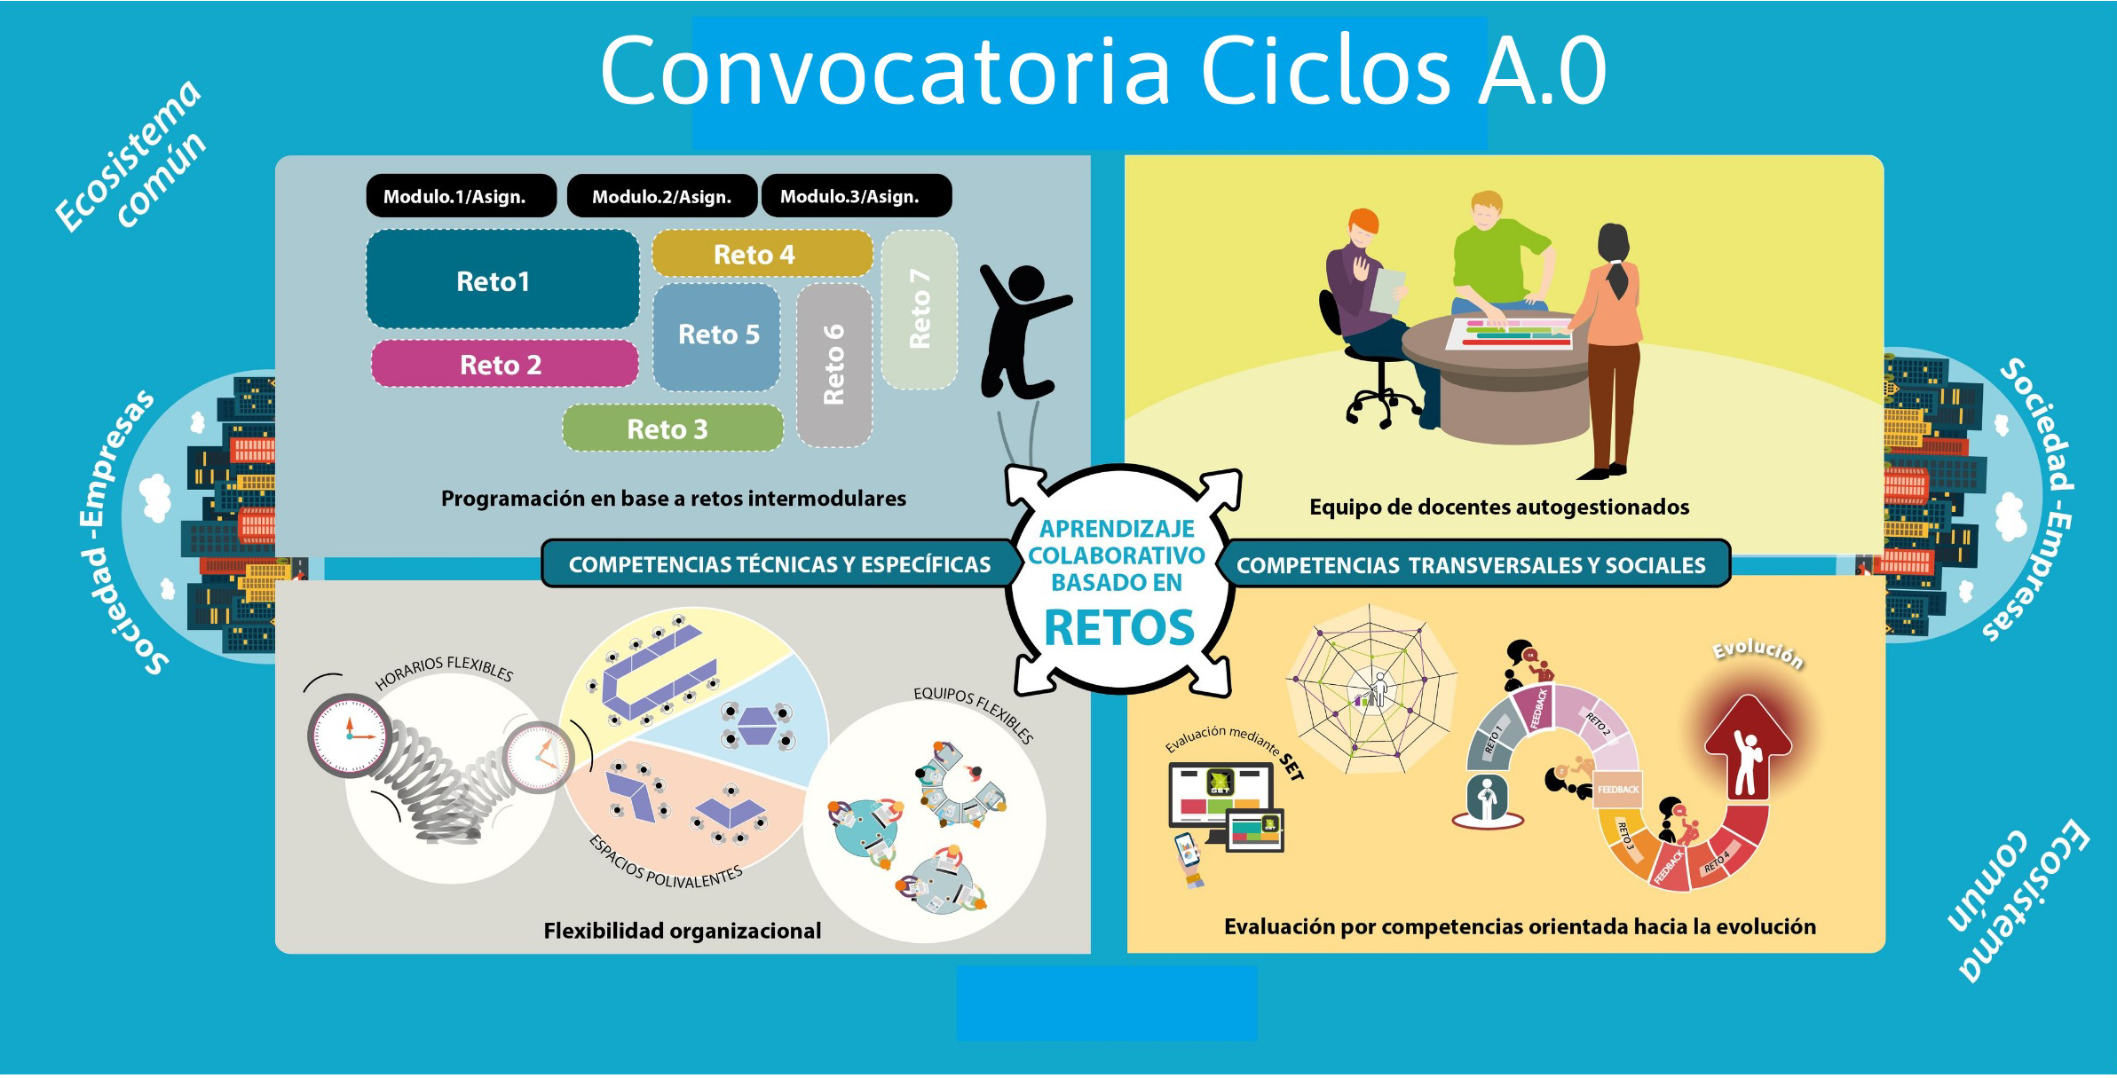

Slide 15
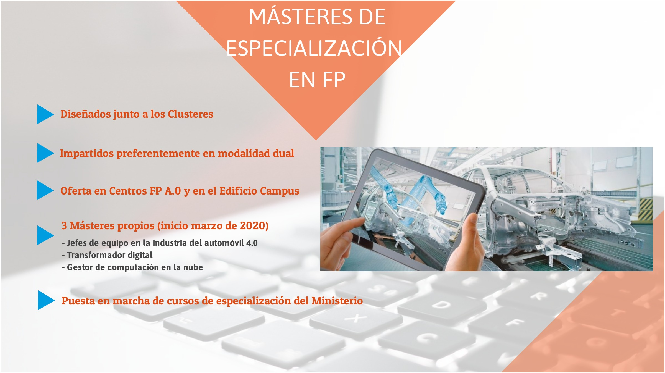

Slide 16
KEY CONCEPTS
FROM CERTIFICATION TO QUALIFICATION
DUAL TRAINING PROGRAMME
NETWORKS
FEEDBACK ANALYSIS
ALL STAKEHOLDERS ENGAGEMENT
FLEXIBILITY TRANSVERSALITY
ACTIVE METHODOLOGIES
SOFT SKILLS
UPDATED TRAINING OFFER

Slide 17
THANK YOU FOR
YOUR ATTENTION
Visit us: https://cifpa.aragon.es/
Contact us:
info@cifpa.aragon.es
Director:
Antonio Carrión Sacacia
director@cifpa.aragon.es

