Slide 1




The initiative on
“Centres of Vocational Excellence”
VET for ALL – Skills for Life conference
Session 1: Vocational excellence
Helsinki, Finland, 17 October 2019
Joao SANTOS
Jan VARCHOLA
European Commission,
Directorate General for Employment, Social Affairs and Inclusion
Unit E3 - Vocational training, Apprenticeships and Adult learning
joao.santos@ec.europa.eu linkedin.com/in/JoaoSantosEU @JoaoSantosEU

Slide 2
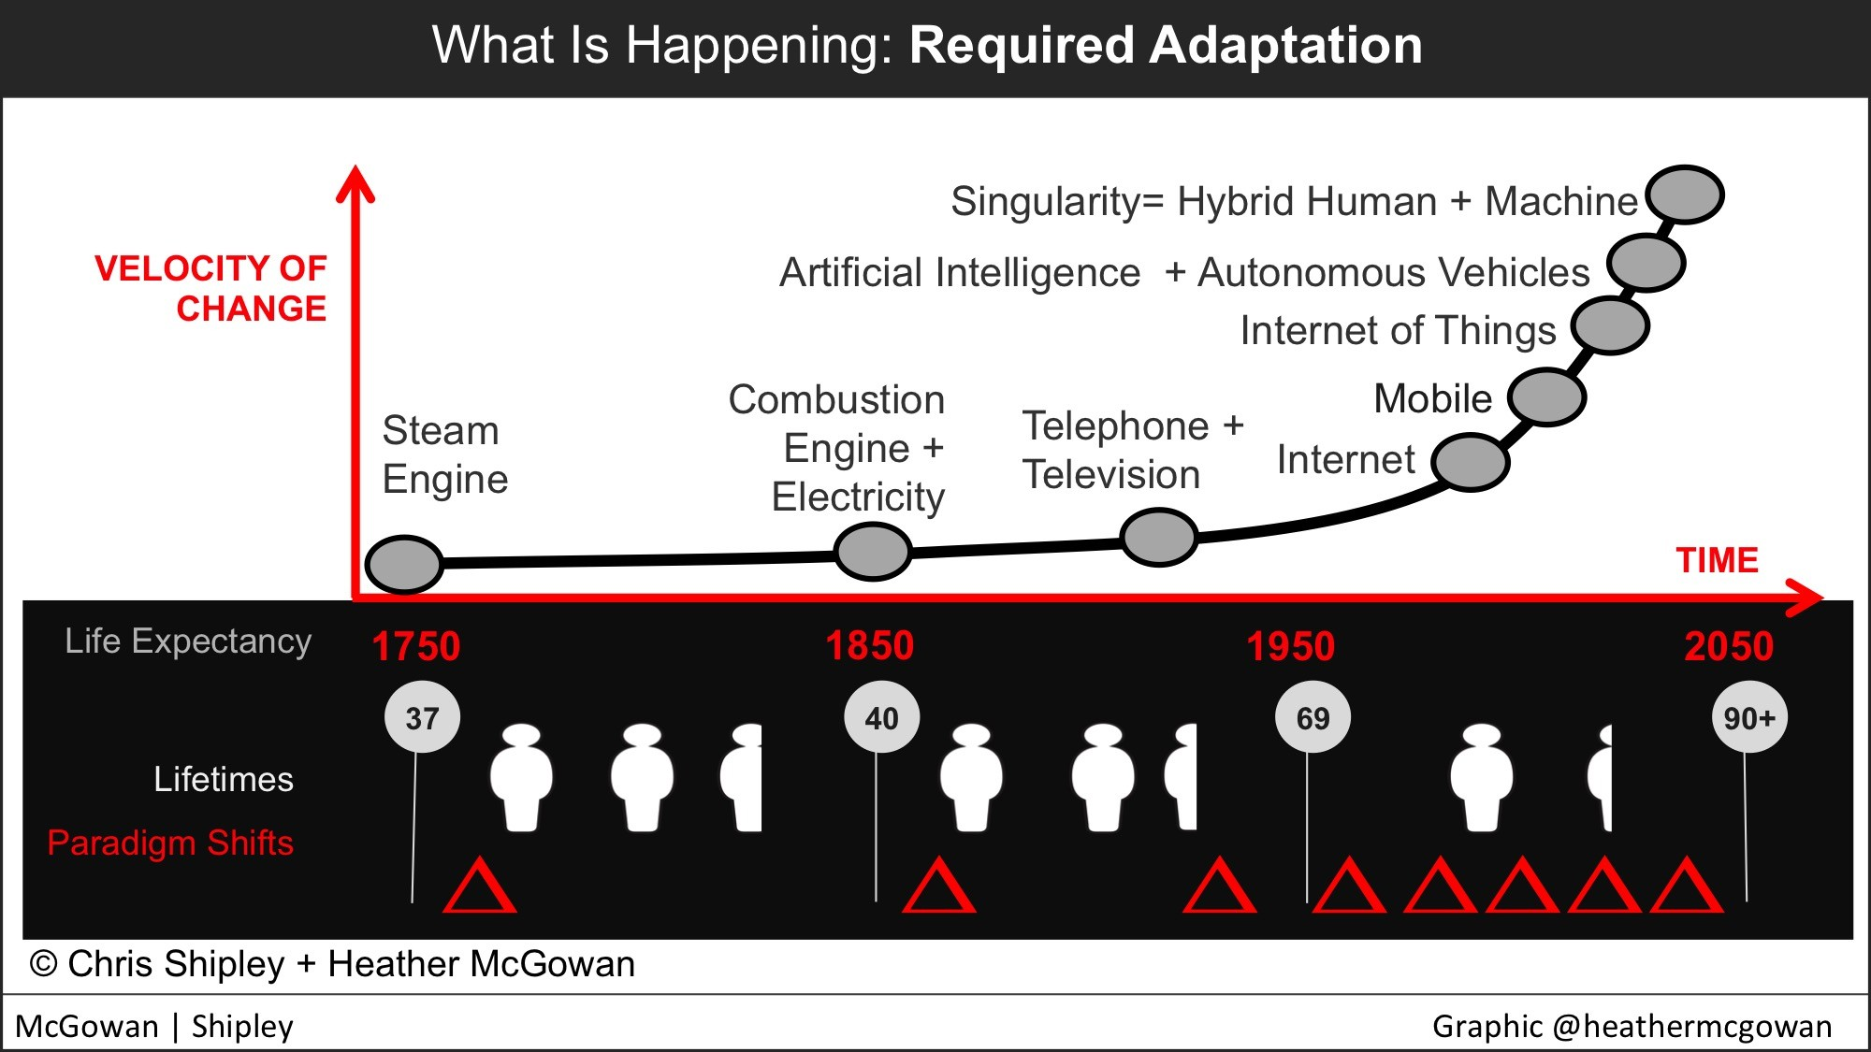
Generational paradigm shifts
over lifetime
@Heather McGowan, and
World Economic Forum
Notes:
For generations, new technologies – from the steam engine to the Internet and beyond – have fundamentally changed the nature of work and the economy. But it is happening faster now while we are living longer. Where our parents and grandparents might have experienced only one, or even no, significant change in their lifetimes, you have likely already experienced a dramatic technology-driven shift in your career, and your children will likely absorb a major shift every ten to fifteen years across theirs.
And let’s be very clear: there is nothing evolutionary or linear about this change; it’s exponential. Each step forward is double the past step and the further we get along in those steps, the greater the change becomes. The early Internet gave us access to information when we sat in front of a computer. Now, we can get to almost any information, use millions of applications, and tap into machines and sensors using the smart phones in our pockets from almost everywhere we are. Soon, virtually all products and systems around us will have some intelligence and some ability to tap into the Internet; we will become part of a coordinated external neural network. Autodesk Fellow Mickey McManus refers to this as the moment “when things wake up”. If every non-biological object around us has some intelligence connected to an external neural network, it is not hard to see that the algorithmic thinking of managing a known and routine processes can be almost entirely achieved with very little human intervention.

Slide 3

Understanding “Science” based and “Practice” based Innovation
The role of applying scientific findings and technologies in
Closed research and development environments is diminishing.
According to the Innovation in Europe survey, only 4% of innovations are based on academic research. The survey also shows that the most significant sources of innovation are customer contacts, company networks and the like. These produce 96% of innovations.
So, if scientific research is the initiator for only a fraction of innovations, there is reason thoroughly to consider the birth mechanisms of innovations and what methods would work best in their promotion. Innovations usually evolve from a practical need, and they are developed in a context that is far removed from the environment where scientific innovations are produced.
Vesa Harmaakorpi
Professor of Innovation Systems at Lappeenranta University of Technology, Lahti Area, Finland
Notes:
Gibbons et al. 1994
Mode 1: Science-based - Science, technology, innovation (STI)
knowledge production is traditional knowledge production based on single disciplines. It is homogeneous and primarily cognitive (STI).
Mode 2: Practice-based - Doing, using, interacting (DUI)
knowledge production, by contrast, is created in broader, heterogeneous interdisciplinary social and economic contexts within an applied setting (DUI).
https://www.tandfonline.com/doi/pdf/10.1080/09654313.2017.1327035 and https://www.sitra.fi/en/articles/vesa-harmaakorpi-finnish-innovation-policy-utilising-4-or-96-finnish-innovation/
Knowledge production Knowledge production in innovation has been categorized in various ways. For example, Gibbons et al. (1994) defined two processes of knowledge production: Mode 1 and Mode 2 (Table 1). Mode 1 reflects traditional research. Gibbons et al. (1994) reported a shift in knowledge activity from Mode 1 to Mode 2 knowledge creation. The role of scientific knowledge as a source of innovations is decreasing, but this trend does not diminish the significance of Mode 1 knowledge production. In broad-based innovation activities, Mode 2 is likely to play a much larger role, but tools to support it are not yet well developed, and until recently, Mode 2 had not been as highly valued as Mode 1. In Mode 2, success is defined as including the traditional criteria of scientific excellence, along with additional criteria, such as efficiency or usefulness. Such criteria are defined according to the contributions made by the work in solving interdisciplinary problems (Gibbons et al., 1994). Unfortunately, today’s measures and criteria of innovation rarely take these contributions into account, if at all. There is a clear need for new methods to identify and measure results as well as new ways to conceptualize innovation information and knowledge (Lundvall, 2007; Melkas, 2014)
A 2014 survey of literature on innovation found over 40 definitions. In an industrial survey of how the software industry defined innovation, the following definition given by Crossan and Apaydin was considered to be the most complete, which builds on the Organisation for Economic Co-operation and Development (OECD) manual's definition:^{[13]}
Innovation is production or adoption, assimilation, and exploitation of a value-added novelty in economic and social spheres; renewal and enlargement of products, services, and markets; development of new methods of production; and the establishment of new management systems. It is both a process and an outcome.
According to Kanter, innovation includes original invention and creative use and defines innovation as a generation, admission and realization of new ideas, products, services and processes.^{[14]}
Two main dimensions of innovation were degree of novelty (patent) (i.e. whether an innovation is new to the firm, new to the market, new to the industry, or new to the world) and kind of innovation (i.e. whether it is processor product-service system innovation).^{[13]} In recent organizational scholarship, researchers of workplaces have also distinguished innovation to be separate from creativity, by providing an updated definition of these two related but distinct constructs:
Workplace creativity concerns the cognitive and behavioral processes applied when attempting to generate novel ideas. Workplace innovation concerns the processes applied when attempting to implement new ideas. Specifically, innovation involves some combination of problem/opportunity identification, the introduction, adoption or modification of new ideas germane to organizational needs, the promotion of these ideas, and the practical implementation of these ideas.^{[15]}

Slide 4
VET pro-active in the
“Knowledge triangle”
Research and Development
New knowledge improves VET
curricula as well as
teaching and learning methods
Business opportunities push
for research and development
VET fostering Entrepreneurial attitudes and
STEAM skills
VET skills as an input for
research and development
New knowledge is a
source of innovation
Vocational Education and training
(including Higher VET)
Business/ Industry
VET skills as a key input for
Business innovation and competitiveness
Knowledge of market needs push for
relevant VET curricula and qualifications
Notes:
Vocational Education and training (VET) has an important role to play in contributing to the “knowledge triangle”, as well as to innovation and "smart specialisation" strategies that lead to sustainable growth and social cohesion. Some Member States already include VET as part of their innovation clusters and strategies. However, these are still rare exceptions.
The role of education and training systems in driving innovation has often been focused exclusively on higher education institutions with VET playing only a minor role, and quite often being largely neglected.
Some member states have launched successful initiatives aiming at Vocational excellence, but progress has been uneven throughout Europe, and in some cases rather slow.

Slide 5

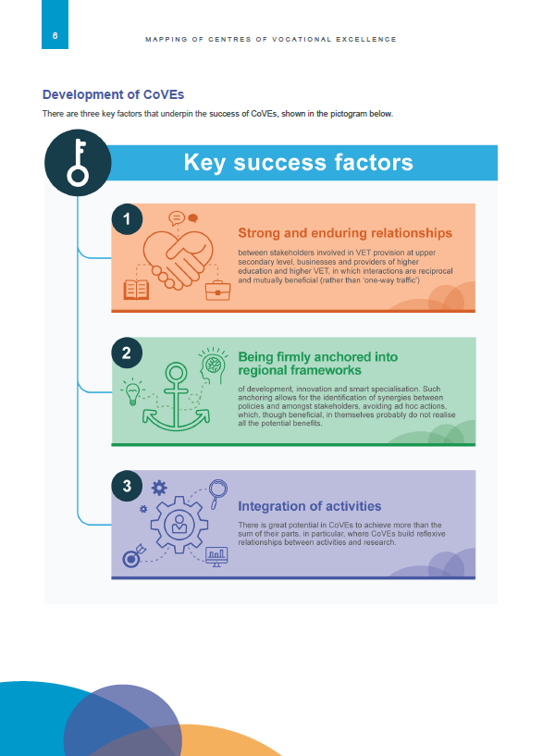
Notes:
Final report delivered by ECORYS in September 2019.
The over-arching aim of the mapping in all EU 28 Member States, EFTA and candidate countries is:
To identify examples of excellence in VET linked to wider strategies related to innovation and economic and social development
By the end of the exercise we also aim to have built an informed perspective on:
What is understood by VET Excellence in the context of the practice of regional social and economic development, innovation strategies, smart specialisation etc.; and
How Excellence in VET in this context is being pursued throughout Europe.
Geographical coverage:
EU Member States, EFTA, candidate countries, and other ETF partner countries

Slide 6
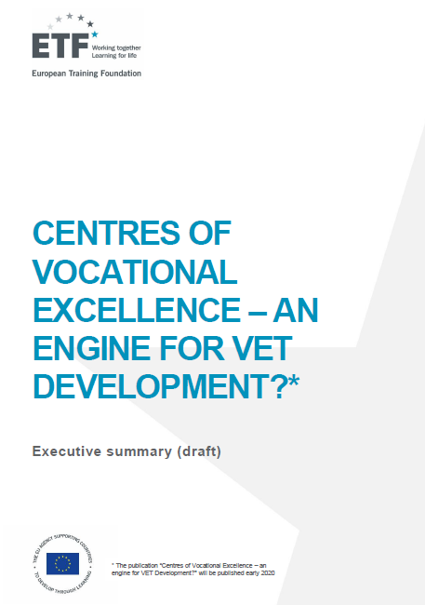
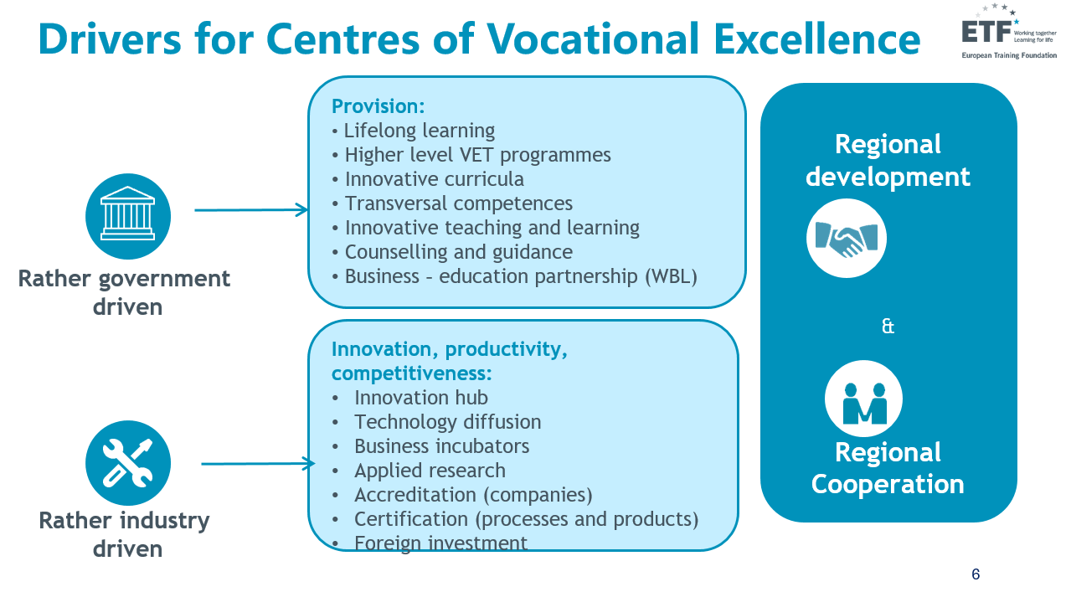
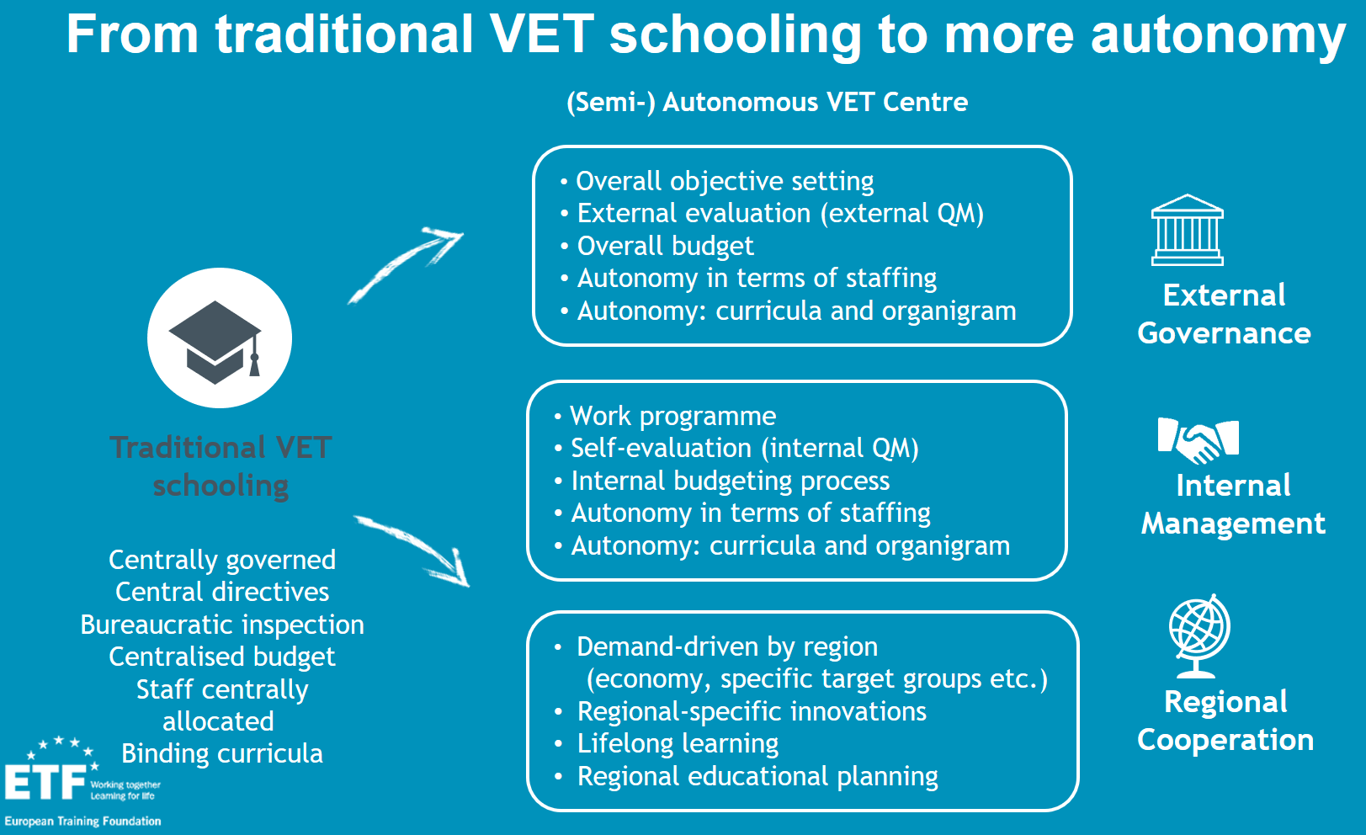

Slide 7
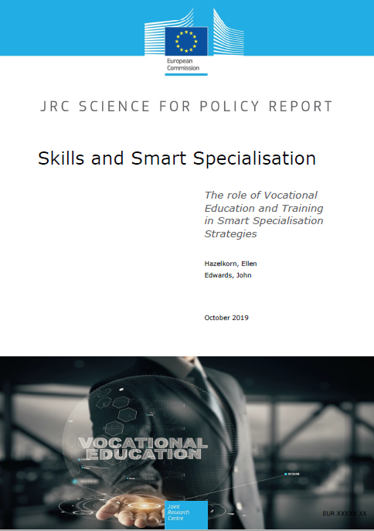

Slide 9
Centres of Vocational Excellence
Fostering local “Skills ecosystems”
Companies
See comparative
advantage to address
skill development and
business performance
for generating
innovation and growth
Bringing together:
Policy makers
Companies
Chambers
VET institutions
Universities of applied science
Research centres
Employment services/agencies
Regional development agencies
Professional or sector associations
Vocational Education and Training
Responsive delivery at all levels, that is valued by individuals and employers
Skills
eco-system
Policy setting
VET, employment and economic development policies support high skills strategy
Individuals
Invest in skills because
of rewarding jobs
and career
opportunities
Inspired on concept of “Skills ecosystems” proposed by David Finegold (1999) ‘Creating self-sustaining, high-skill ecosystems’, Oxford Review of Economics
Notes:
Inspired on concept of “Skills ecosystems”, as proposed by David Finegold (1999)
‘Creating self-sustaining, high-skill ecosystems’, Oxford Review of Economics

Slide 10

Centres of Vocational Excellence
Key success factors
Anchored into frameworks of regional development, innovation and smart specialisation - allows for the identification of synergies between policies and amongst stakeholders, avoiding ad-hoc actions
Integration of activities - CoVEs achieve more than sum of the parts
Strong and enduring partnerships - between the VET community, businesses and universities in which interactions are reciprocal and mutually beneficial
Notes:
Key to CoVE success include:
Strong and enduring relationships between the VET community, businesses and the university sector in which interactions are reciprocal and mutually beneficial (rather than ‘one-way traffic’)
Integration of activities. There is great potential in CoVEs to achieve more than sum of the parts, in particular, where CoVEs build reflexive relationships between activities and research.
Being firmly anchored into the frameworks of regional development, innovation and smart specialisation. Such anchoring allows for the identification of synergies between policies and amongst stakeholders, avoiding ad hoc actions, which, though beneficial in themselves probably do not realise all the potential benefits.

Slide 11
Centres of Vocational Excellence The initiative
Foster Vocational Excellence at two levels
Local / Regional / National
International
Through Centres of Vocational Excellence (CoVE)
Operating in a given local context, embedding them closely in the local innovation and skills ecosystems, working with businesses, chambers, tertiary education, research institutions, public authorities, etc.
Through Platforms of CoVE's to establish world-class reference points for VET by bringing together partners that share a common interest in:
Specific sectors/trades - such as aeronautics, e-mobility, green technologies, healthcare, textiles…
Societal challenges - such as integration of migrants, Digitalisation, AI, SDG, upskilling and reskilling…
Notes:
Foster Vocational Excellence at two levels:
National: through Centres of Vocational Excellence operating in a given local context, embedding them closely in the local innovation ecosystems, working with businesses, chambers, tertiary education, research institutions, public authorities, etc.
Transnational: through Platforms of Centres of Vocational Excellence to establish world-class reference points for vocational training by bringing together CoVE`s that share a common interest in:
Specific sectors/ trades - such as aeronautics, e-mobility, green technologies, healthcare, etc., or
Innovative approaches to tackle societal challenges – such as integration of migrants, Digitalisation, Sustainable Development Goals, upskilling people with low qualification levels, etc.

Slide 12



CoVE’s key activities
clustered in three groups
Activities clustered in three groups:
Teaching and learning
Cooperation and partnerships
Governance and funding
Notes:
Examples may be doing the above through at least one and preferably several of the following activities:
Teaching and learning
Providing people with labour market relevant skills, in a lifelong learning continuum approach. Combining offers of initial VET qualifications, with offers of continuing training (for upskilling and reskilling), that are informed by skills anticipation.
Providing guidance services, as well as validation of prior learning.
Developing innovative curricula and pedagogies that focus both on technical skills and transversal competences, while making use of European tools (e.g. SELFIE) and competence frameworks (e.g. DigComp, EntreComp, etc.).
Developing innovative teaching and training methodologies, including interdisciplinary learning, and fully exploiting digital technologies (e.g. MOOC's, simulators, etc.).
Investing in the continuing professional development of teachers and trainers, for both pedagogical as well as technical skills.
Developing project based learning that bring interdisciplinary approaches and VET learners from different fields of study (e.g. design, marketing, engineering) to solve real work problems/challenges.
Developing modular and learner-centred trans-national Joint VET curricula (and/or qualifications) thus facilitating the mobility of learners and staff, as well as the recognition at regional and/or national levels.
Providing higher level VET programmes and developing flexible pathways between VET and higher education institutions.
Establishing strong quality assurance mechanisms, effective feedback loops and graduate tracking systems that enable the timely adaptation of curricula to evolving labour market needs.
Cooperation and partnerships
Contributing to creation and dissemination of new knowledge in partnership with other stakeholders, e.g. through joint R&D with universities, R&D units in companies, research bodies, etc.
Establishing business-education partnerships for apprenticeships, internships, sharing of equipment, exchanges of staff and teachers between companies and VET centres, etc.
Working together with local SME's and acting as innovation hubs and technology diffusion centres by sharing equipment and creating incentives for staff to engage in applied research and development projects with the involvement of the VET learners, and by providing SMEs with technical support, tools, methodologies and training to improve their apprenticeship offer and up-skilling/re-skilling offer for adults.
Acting as or supporting innovation hubs and technology diffusion centres, while sharing equipment and creating incentives for staff to work together with local SME's in applied research and development projects, with the involvement of VET learners.
Providing or supporting business incubators for VET learners to develop their entrepreneurship skills and initiatives.
Developing internationalisation strategies to foster trans-national mobility of VET learners as well as teachers and trainers. This could also include preparatory work to facilitate mobility such as teaching programmes or courses on EU studies to better understand Europe's integration process and its place in a globalised world (e.g. inspired on the Jean Monnet actions).
Developing "International VET campus/academies" for learners in primary, secondary, and VET schools, teachers and trainers, Leaders in VET institutions, as well as for people considering future vocational study options. These could be focused on specific occupational fields, products or services.
Participating in national and international Skills competitions, aimed at raising the attractiveness and excellence in VET.
Launching and actively participating in campaigns and activities aimed at raising the attractiveness of VET and awareness to the life and job opportunities provided by VET qualifications. These initiatives could attract more people (including learners in primary and secondary schools) to specific professions, and contribute to the European Vocational Skills Week.
Governance and funding
Ensuring effective governance at all levels involving relevant stakeholders, particularly companies, chambers, national and regional authorities and social partners.
Actively engaged in the overall national Skills governance systems and linked with employment and social policies at local, regional, national and European level;
Integrated into economic and innovation strategies and systems at local, regional, national and European levels to proactively co-shape innovation and growth.
Developing sustainable financial models that combine public and private funding, as well as income generating activities.
Supporting the attraction of foreign investment projects by ensuring timely provision of skills for companies investing locally
Making full use of EU financial instruments and Funds to support infrastructure investments to modernise VET centres with advanced equipment (including simulators, and high-tech equipment). Including developing active citizenship skills that equip people to contribute to a sustainable and inclusive society (e.g. through a good understanding and contribution to the UN 17 Sustainable development goals (SDG’s)

Slide 13













Typical activities of CoVE's
Pro-active partner in local development
Regional development,
Smart Specialisation,
Knowledge triangle
Providing both Initial and continuing VET
at all EQF Levels
Governance
(social partners, national and local governments VET providers, development agencies…)
Innovative curricula, & Teaching & training methodologies
(PBL, Interdisciplinary...)
Cost-sharing, sustainable funding, and effective use of EU funding
Higher VET, and Flexible pathways with Schools and Universities
Vocational Excellence
Technology diffusion and Innovation Hubs
Quality assurance
feedback loop,
learner tracking
Incubators supporting
entrepreneurial initiatives
Validation and Guidance
Partnerships for: Skills anticipation, Apprenticeships,
T&T exchanges…
Notes:
Centres of Vocational Excellence (CoVE), should be understood in a wide context that adapts to the diversity of VET systems in the various member states. In some countries they can be led by a Vocational institution (e.g. in the Netherlands) providing a large portfolio of services in close relation with other organisations, while in other countries (e.g. Germany and Austria) they could be led by the Chambers that have a key (and legal) coordinating role in implementing VET policies and services.
Whether CoVE´s are concentrated around regional VET institutions or a cluster of regional entities led by chambers (two extreme cases), they are expected to go far beyond the simple provision of a quality vocational qualification.
Examples may be doing the above through at least one and preferably several of the following activities:
Providing people with labour market relevant skills, in a lifelong learning continuum approach. Combining offers of initial VET qualifications, with offers of continuing training (for upskilling and reskilling).
Providing higher level VET programmes; developing pathways to higher level programmes in conjunction with higher education institutions
Establishing business-education partnerships for; apprenticeships, internships, sharing of equipment, exchanges of staff and teachers between companies and VET centres, etc.
Working together with local SME's and acting as innovation hubs and technology diffusion centres by sharing equipment and creating incentives for staff to engage in applied research and development projects with the involvement of the VET learners, and by providing SMEs with technical support, tools, methodologies and training to improve their apprenticeship offer and up-skilling/re-skilling offer for adults.
Developing Joint VET curricula together with other VET providers and companies in various countries bringing the very best know-how from each partner and facilitating recognition
Developing internationalisation strategies to foster trans-national mobility of VET learners as well as teachers and trainers, with or without Erasmus+ support. This could also include preparatory work to facilitate mobility such as teaching programmes or courses on EU studies to better understand Europe's integration process and its place in a globalised world (e.g. inspired on the Jean Monnet actions).
Developing innovative teaching and training methodologies, including those based on digital technologies (e.g. MOOC's, simulators, etc.), and new curricula
Developing innovative curricula and pedagogies focused not just on technical skills but also transversal competences, e.g. entrepreneurship, digital skills, etc.
Investing in the continuing professional development of teachers and trainers, for both pedagogical skills as well as technical skills
Developing project-based learning that brings inter-disciplinary approaches and VET learners from different fields of study (e.g. design, marketing, engineering) to solve real work problems/challenges
Providing guidance services, as well as validation of prior learning
Providing business incubators for VET learners to develop their entrepreneurship skills and projects.
Acting as or supporting innovation hubs and technology diffusion centres, which might support companies of any size, while sharing equipment and creating incentives for staff to work together with local SME's in applied research and development projects, with the involvement of the VET learners
Supporting the attraction of foreign investment projects by ensuring timely provision of skills for companies investing locally
Developing "International VET campus/academies" for learners, teachers and trainers, leaders in VET institutions, as well as for people considering future vocational study options. These could be focused on specific occupational fields, or products.
Participating in national and international Skills competitions, aimed at raising the attractiveness and excellence in VET
Contributing to creation and dissemination of new knowledge in partnership with other stakeholders, e.g. through joint R&D with universities, R&D units in companies, research bodies, etc.
Making full use of EU financial instruments and Funds to support infrastructure investments to modernise VET centres with advanced equipment (including simulators, and high-tech equipment).
Developing sustainable financial models that combine public funding, and income generating activities for the Centres of Vocational Excellence

Slide 14
Centres of Vocational Excellence
Overview of 2019 selected projects
Title | Talentjourney | Excellent Advanced Manufacturing 4.0 | Digital Innovation Hub for Cloud Based Services | Open Design School | Platform of Vocational Excellence Water
Sector | IoT in Smart manufacturing | Advanced Manufacturing | Cloud computing | Cultural and creative industries | Water sector
Countries | 5 | 4 | 5 | 9 | 6
EU Grant | 953.550 € | 799.332 € | 999.882 € | 874.093 € | 998.022 €
Coordinator | Solski (SI) | Tknika (ES) | Helsinki Business college (FI) | Basilicata Foundation (IT) | Firesland college (NL)
Partners | 13 | 8 | 10 | 9 | 11
5 projects selected. Duration 2 years. Total grants: €4.624.879

Slide 15
Centres of Vocational Excellence
E+ KA3 - The 2020 Pilot projects
https://eacea.ec.europa.eu/erasmus-plus/funding/ka3-centers-of-vocational-excellence_en
KA3 Specific call (open to partners from outside E+ programme countries)
Support for “Platforms of Centres of Vocational Excellence (CoVE)”
Support for 5 Pilot projects running for 4 years, based on innovative cooperation methods, for the establishment of Platforms of CoVE’s
Strategic approach to development of skills-ecosystems at local level and in line with local growth and innovation strategies
At least 4 programme countries, at least 8 full partners, with at least 1 company or industry representative, and 1 VET provider in each country
Can be focused on any EQF level but must also include levels 3, 4 or 5
Budget €20.000.000, with maximum EU grant €4,000,000 per project
Publication in October 2019. Deadline for applications February 2020.
Notes:
To bring you up to date with the developments regarding the first call for pilot projects on the initiative on “Centres of Vocational Excellence”:
In 2019, we could not launch a specific call for the CoVE initiative, and therefore we modified the regular Sector Skills Alliance call to include a Lot for the launch of a small set of pilot projects that closely resemble the concept we are developing for the CoVE.
This was not the ideal way of supporting the comprehensive approach we want for the CoVE's, which include both a sectoral dimension (supported by SSA), as well as a thematic dimension (not possible under SSA).
However, we were very positively encouraged by the demand for this first limited call, which was initially designed to support only 4 projects with a total budget of €4 million, but attracted 15 applications (almost 4 times more than expected) with a budget of €13 million.
Applications came from 11 countries, and included partners from all EU countries (except HU and LU), and also from one candidate country. In total, we have 177 organizations involved in these applications, with an average of 12 partners per project.
Partners are mostly VET centres (both upper secondary, as well as tertiary level Universities of applied sciences), Centres for adult training, regional development agencies, SMEs, Chambers and Social partners.
The analysis of these applications will be very useful for finalising the concept of the initiative and designing future calls.
For the AWP2020, we plan to have a dedicated KA3 call for the CoVE, which will support the full concept as outlined in the concept note that we are currently finalising with the close involvement of VET stakeholders. Discussions have taken place within the DGVT, ACVT as well as meetings with VET providers and Chambers.

Slide 16
Time | Session title | Speakers
09:00 | Welcome and introduction | Joao Santos, European Commission Georgios Zisimos, European Training Foundation
09:20 | Key note | Shyamal Majumdar, UNESCO-UNEVOC
09:30 | Approaches to VET excellence | Moderator: Andrew McCoshan, Ecorys : Anna Kopeykina Fernández, on Teaching and learning in The Regional Centre for Innovation for Vocational Training of Aragón (CIFPA), Spain) Joachim Rapp, on Cooperation and partnerships, through Handwerkskammer Freiburg, Gewerbe Akademie, Germany Fredrik Zeybrand, on Governance and funding in The Göteborg Region Association of Local Authorities, Sweden)
10:15 | Panel discussion on the focus and priorities of CoVE projects | Moderator: Michele Grombeer, EACEA: Jouni Hytönen, on Digital Innovation Hub for Cloud Based Services Iñigo Araiztegui, on Excellent advanced manufacturing 4.0 Pieter Hoekstra, on the Pilot Platform of Vocational Excellence Water Adrijana Hodak, on Talentjourney the Platform for CDS VET Excellence
11:00 | Coffee break
11:15 | Work in focus groups Beyond EU funding: Tools and support services | All participants contribute to discussions. Chairs: Georgios Zisimos (ETF), Lore Schmid (Cedefop), John Edwards (JRC), Malgorzata Kozak (EAC), Michele Grombeer (EACEA), Liebe, Jens (UNESCO-UNEVOC,) Jan Varchola (EMPL), Stylianos Mavromoustakos (EfVET), Adrijana Hodak (Talentjourney), Pieter Hoekstra (CIV Water) Rapporteurs: Appointed on spot for each table.
12:15 | Reporting | Rapporteurs present conclusions from the focus groups discussions
12:30 | End | Joao Santos, European Commission

Slide 17
Session 1: Vocational excellence
Focus groups, 11:15 – 12:15
What is “Vocational Excellence”?
Is there a trade-off between excellence and inclusion?
What are the critical success factors and activities that characterise Vocational Excellence?
What support services, tools and instruments should be made available at EU level to support the development of Vocational Excellence throughout Europe?

Slide 18


