Slide 1
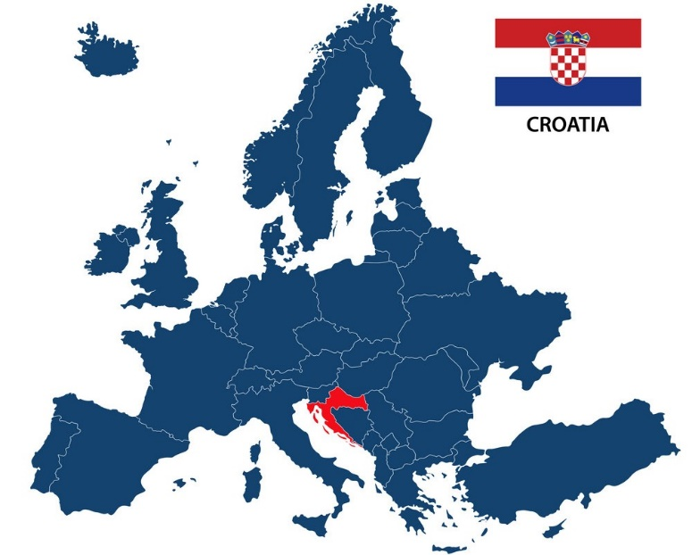
EU Presidency – Croatia 2020

Slide 2
Context
Institutional changes following the European Parliament elections, new European Commission, Brexit
New strategic period: post-2020
1st Croatian EU Presidency
RO-FI-HR trio
Bruxelles-based Presidency

Slide 3

Possible HR PRES priorities in education
European teachers and trainers for the future
Reforms in education and the European Semester
Post-2020 framework for European cooperation in education and training (ET2030); developing the European Education Area
Mobility and brain circulation; Erasmus+ Regulation

Slide 4
HR PRES events (provisional calendar)
Bruxelles:
EYCS Council - Education (20 February, 18 May)
Croatia:
DG HE (23 – 24 March, Šibenik)
DG VET (23 – 24 March, Šibenik)
DG Schools (26 – 27 March, Šibenik)
Conference Teachers and Trainers for the Future (24 – 25 March, Šibenik)
HLG ET (22 – 23 April, Zagreb)
EDUC (18 - 19 June, Dubrovnik)
SGIB (15 – 16 April, Zagreb)
BFUG Board (6 – 7 February, Zagreb)
BFUG (4 – 5 May, Split)

Slide 5
Contacts
Croatia:
Ana Tecilazić Goršić, EU PRES Deputy Coordinator for Education, EDUC Vice-Chair
Ministry of Science and Education
Donje Svetice 38, HR – 10000 Zagreb, Croatia
E-mail: ana.tecilazicgorsic@mzo.hr
Tel: +385 4594 367
Mob: +385 99 265 7046
Bruxelles:
Daria Arlavi, Education Counsellor, EDUC Chair
Permanent Representation of the Republic of Croatia to the EU
Avenue des Arts 50, Bruxelles
E-mail: daria.arlavi@mvep.hr
Mob: +32 (0) 492 913 247
Tel: +32 (0)2 507 54 74
Barbi Svetec, First Secretary (Education)
Permanent Representation of the Republic of Croatia to the EU
Avenue des Arts 50, Bruxelles
E-mail: barbi.svetec@mvep.hr
Mob: +32 (0) 490 668 231

Slide 6
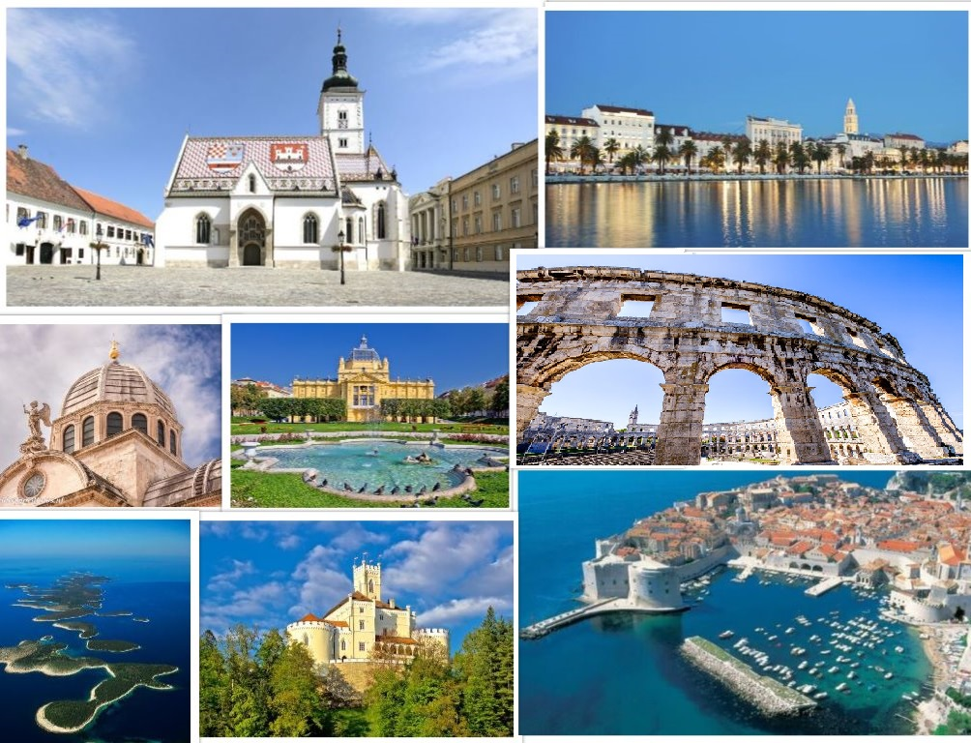
Looking forward to welcoming you in Croatia!

