Slide 1
VET4ALL – Skills for Life Services 4.0: innovation for workforce upskilling and reskilling 17 October 2019 – 09:00-12h30

Slide 2
Introduction to the session
How to use the app voting tool
No app? => evsw.plazz.net
Moderation: Lidia Salvatore, CEDEFOP expert
Notes:
BACKUP: SLIDO, #EVSWservices

Slide 3
Introduction to the session
How many times did you change jobs in your life?
Notes:
BACKUP: SLIDO, #EVSWservices

Slide 4
Introduction to the session
What is the key skill that most helped you to operate these transitions and adapt to new jobs?
Notes:
BACKUP: SLIDO, #EVSWservices

Slide 5
Introduction to the session
Of all the skills you have acquired in your life, how much did you learn at work (and not at school)?
Notes:
BACKUP: SLIDO, #EVSWservices

Slide 6
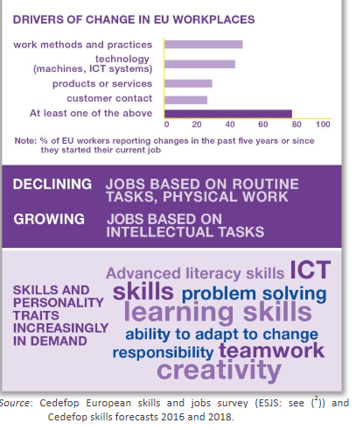
Notes:
Focus on growing demand: jobs based on intellectual tasks (medium/high skills) and crucial need train people with low skills/qualifications
Focus on transversal/transferable skills needed by employers, ability to adapt
2019 CEDEFOP Briefing note - The skills employers want!
https://www.cedefop.europa.eu/en/publications-and-resources/publications/9137

Slide 7
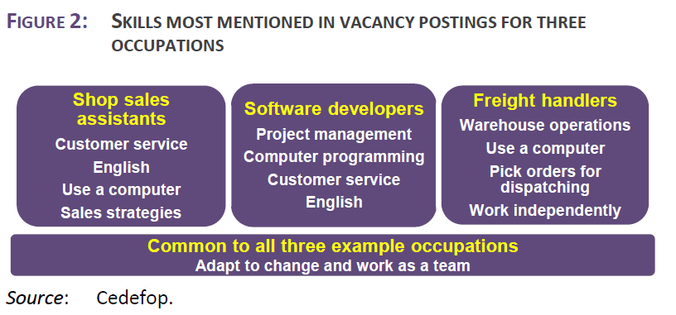
Introduction to the session
Notes:
Illustration of need for transferable skills: IT skills, English proficiency, customer service…
Will be even better illustrated with the story of Inge (experience@work) from Belgium later on today
2019 CEDEFOP Briefing note - The skills employers want!
https://www.cedefop.europa.eu/en/publications-and-resources/publications/9137

Slide 8
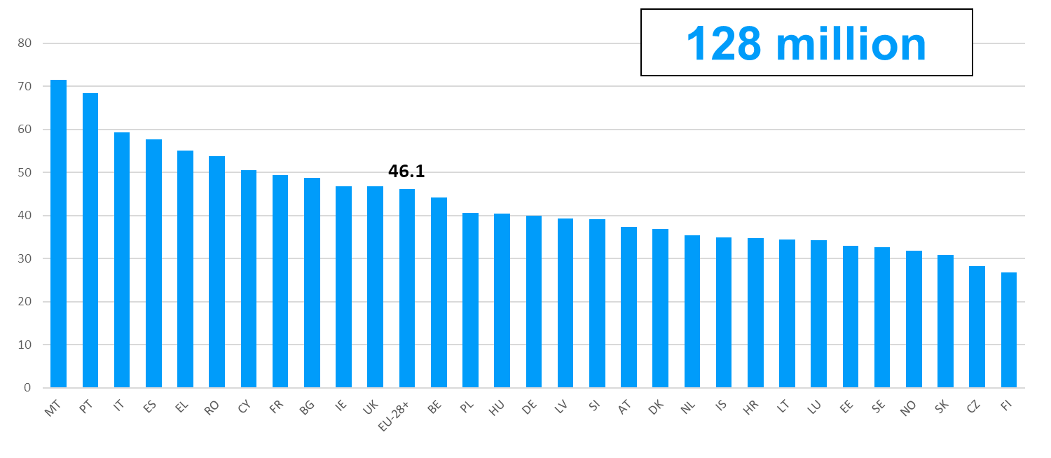
Introduction to the session
Estimated adult population with potential for upskilling by country (%), EU-28+ (*)
(*) EU-28+ = EU-28 plus Iceland and Norway.
Source: Cedefop calculation based on LFS 2016, CSIS 2015, OECD PIAAC 2012, 2015.
Notes:
Cedefop’s latest figure on the estimated adult population with potential for upskilling in the EU-28+ (128 million, 46.1% of the adult population of the area)

Slide 9
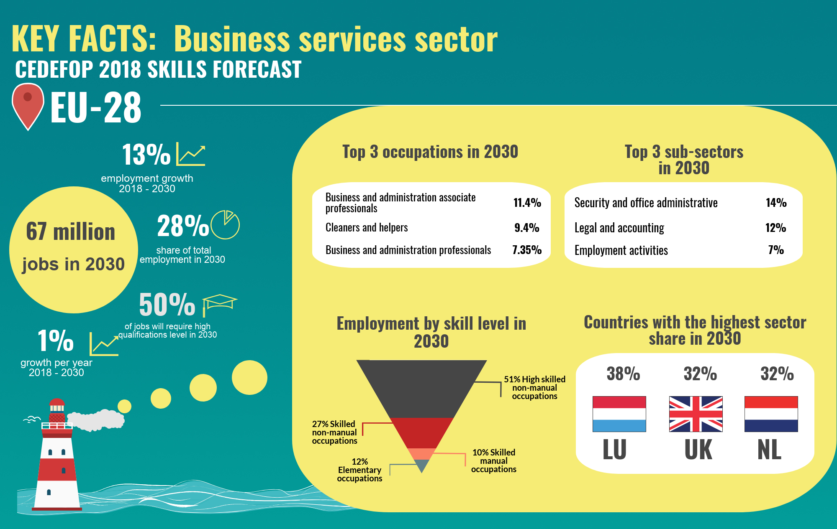
Introduction to the session

Slide 10
Introduction to the session
15 job transitions in a lifetime
Need to become agile lifelong learners
Only 41% of employees train
Dana-Carmen Bachmann, Head of Unit “VET, Apprenticeships and Adult Learning”, DG Employment, Social Affairs and Inclusion, European Commission
Notes:
DANA TAKES THE FLOOR
Working environments undergoing profound mutations in their organisation, forms and scale, with tremendous consequences on people’s careers and learning paths
How to ensure people remain employable is a crucial challenge, especially since there is no longer a ‘job for life’: people can expect to go through up to 15 job transitions in their lifetime
Since the labour market is so volatile, people’s skills are more and more likely to be or become outdated in a near future and it’s important that adults become agile lifelong learners, easily adaptable to new jobs and working conditions
We know education and training have a positive effect on workers’ capital and total factor productivity, leading ultimately to economic growth; estimates show that reducing the share of low-qualified adults by half by 2025 would lead to an annual economic net benefit of around €200 billion across the EU (CEDEFOP).
And yet
workers at most risk of job loss or displacement are the ones who train the least
By 2022 54% of employees will require upskilling (World Economic Forum, Future of Jobs report, 2018)
Cedefop’s latest figure on the estimated adult population with potential for upskilling in the EU-28+ (128 million, 46.1% of the adult population of the area)
40% of employers cannot find people with the right skills to fill their vacancies (European Commission, Employment and Social Developments in Europe 2015, Publications Office of the European Union, 2016)
only 40.8% of employees are provided with training opportunities by their employers (CVTS)

Slide 11
Introduction to the session
Specific challenges in the service sector
Pressure on health systems
Platform economy…
Notes:
Additionally the service sector has question marks of its own when looking at the future.
Ageing populations are posing a challenge to health and care related occupations.
Artificial intelligence and automation will not only affect low-skilled and routine work but also many high-skilled tasks in the service sector, e.g. in health care, transport, finance and insurance, legal services, market research or education.
Workers will need to acquire new and improved skills to be able to cope with automated systems, and offer services in the fast-developing labour market and the platform economy.
Yet in 2015, in the sector of wholesale and retail trade, transport, accommodation and food service activities for instance, only 37% of employees participated in a continuing VET course

Slide 12
Introduction to the session
“Everyone has the right to quality and inclusive education, training and life-long learning in order to maintain and acquire skills that enable them to participate fully in society and manage successfully transitions in the labour market”
Notes:
The European Commission and CEDEFOP are very much aware that modernising vocational education and training is the way forward to respond quickly to new emerging skill and competence needs, but also to help ensure that nobody is left behind.
The first principle of the European Pillar of Social rights, adopted in 2017, states that “everyone has the right to quality and inclusive education, training and life-long learning in order to maintain and acquire skills that enable them to participate fully in society and manage successfully transitions in the labour market”.

Slide 13
Introduction to the session
Everyone has the right to timely and tailor-made assistance to improve employment or self-employment prospects. This includes the right to receive support for job search, training and re-qualification.
Notes:
The European Commission and CEDEFOP are very much aware that modernising vocational education and training is the way forward to respond quickly to new emerging skill and competence needs, but also to help ensure that nobody is left behind.
The first principle of the European Pillar of Social rights, adopted in 2017, states that “everyone has the right to quality and inclusive education, training and life-long learning in order to maintain and acquire skills that enable them to participate fully in society and manage successfully transitions in the labour market”.

Slide 14
Introduction to the session
Skills Agenda
Upskilling Pathways: new opportunities for adults
European Qualifications Framework
Digital Skills and Jobs Coalition
Blueprint for Sectoral Cooperation on Skills
EU Skills Profile Toolkit for Third-Country Nationals
Vocational education and training (VET)
Key Competences
Europass
Graduate tracking
Analysing and sharing of best practice on brain flows
Notes:
We have been of course working for many years to modernize adult learning and VET systems, notably with the European Agenda for Adult Learning and the Copenhagen process; but I would like to focus today on our latest initiatives.
Within the current political mandate the Commission with the support of CEDEFOP has worked on the Skills Agenda (2016), a coordinated approach to skills to
improve the quality and relevance of training and other ways of acquiring skills
make skills more visible and comparable
improve information and understanding of trends and patterns in demands for skills and jobs (skills intelligence)
The 10 actions of the Skills Agenda: see slide, among which a few examples
Upskilling pathways: providing low-skilled adults with tailored, quality opportunities to assess the skills they already possess, undertake training and validate the newly acquired learning outcomes
Revision of the European Qualifications Framework: support better understanding of qualifications and make better use of all available skills in the European labour market.
EU Skills Profile Tool for Third-Country Nationals to support early identification of skills of asylum seekers, refugees and other migrants
Key competences: A review of the Recommendation on Key Competences for Lifelong Learning focused on promoting entrepreneurial and innovation-oriented mind-sets and skills.
Europass: ensure that the Europass framework can offer people better and easier-to-use tools to present their skills and obtain useful real-time information on skills needs and trends
The Skills Agenda notably gave birth to this European Vocational Skills Week.

Slide 15
Introduction to the session
Mission letter from Commission President
I want you to develop an action plan to implement the Pillar
You should reinforce the Youth Guarantee
You will lead the work on implementing and updating our skills agenda, focusing on identifying and filling skills shortages and supporting reskilling as part of the just transition. You should explore the idea of individual learning accounts for people of working age, enabling adults to accumulate training entitlements and use them for quality-assured training.
Nicolas Schmit, Commissioner-designate for Jobs
Notes:
Political guidelines for the next European Commission show that skills remain a long-term policy priority.
They underline that “the best investment in our future is the investment in our people” and that skills and education drive Europe’s competitiveness and innovation.
They call for an action plan to fully implement the European Pillar of Social Rights and achieve a cultural change to deliver on lifelong learning
The new Commissioner for Jobs, Nicolas Shmit, has been tasked by President-elect Ursula von der Leyen to lead the work on implementing and updating our Skills agenda, focusing on identifying and filling skills shortages and supporting reskilling as part of the just transition.

Slide 16
Introduction to the session
Discussion questions for today
How can continuing vocational education and training be used as an empowering tool for people’s employability?
How can we build effective upskilling and reskilling systems that include workplace and work-based learning?
Notes:
This session therefore aims at exploring creative solutions to upskill or reskill our workforce in the service sector and empower them to navigate new horizons thanks to continuing vocational education and training.
The session will shed light in particular on the use of work-based and workplace learning, as it is
An accessible and attractive way for adults to maintain and update their skills
An efficient way for employers to improve staff retention and competitiveness
A way to support social and economic integration of vulnerable groups
See also the report on the tables next to the entrance on « Promoting adult learning in the workplace » (product of our working group of Ministries on adult learning)
Given that the most vulnerable of our citizens will face greater risks on ever-changing labour markets, a particular emphasis will also be put on social inclusion in the discussion to reinforce their resilience and adaptability – so that excellence goes hand in hand with social inclusion in our VET systems and “VET4all” is not a hollow shell.
The aim of this session is to:
Inform on recent and ongoing relevant EU level research
Promote peer exchange on main challenges
Present successful country and sub-sector approaches on future-oriented solutions
On the basis of this food for thought, brainstorm on key recommendations, which will be presented during the closing of the Week.
Discussion questions:
How can continuing vocational education and training be used as an empowering tool for people’s employability?
How can we build effective upskilling and reskilling systems that include workplace and work-based learning?
DANA GIVES THE FLOOR BACK TO LIDIA

Slide 17
Introduction to the session
9:25 | Upskilling adults in Services 4.0: stories from Europe
10:25 | Coffee break
10:45 | Brainstorming
12:00 | Reporting to plenary and conclusion
12:30 | End of session
#DiscoverYourTalent
#EUVocationalSkills
@EU_Social
Notes:
Go through the programme of the morning
Housekeeping announcements
Don’t forget to use our hashtags to Tweet during this session
We hope you had fun yesterday night meeting our VET ambassadors and discussing VET, but don’t forget that « Open Minds » activities are running still today and tonight in the first and second floor
EU exhibitions to discover what we do for VET
Space where you can build partnerships for your project ideas
Wall of ideas to express what the Week inspires you

Slide 18
Introduction to the session
Discussion questions for today
How can continuing vocational education and training be used as an empowering tool for people’s employability?
How can we build effective upskilling and reskilling systems that include workplace and work-based learning?
Notes:
This session therefore aims at exploring creative solutions to upskill or reskill our workforce in the service sector and empower them to navigate new horizons thanks to continuing vocational education and training.
The session will shed light in particular on the use of work-based and workplace learning, as it is
An accessible and attractive way for adults to maintain and update their skills
An efficient way for employers to improve staff retention and competitiveness
A way to support social and economic integration of vulnerable groups
See also the report on the tables next to the entrance on « Promoting adult learning in the workplace » (product of our working group of Ministries on adult learning)
Given that the most vulnerable of our citizens will face greater risks on ever-changing labour markets, a particular emphasis will also be put on social inclusion in the discussion to reinforce their resilience and adaptability – so that excellence goes hand in hand with social inclusion in our VET systems and “VET4all” is not a hollow shell.
The aim of this session is to:
Inform on recent and ongoing relevant EU level research
Promote peer exchange on main challenges
Present successful country and sub-sector approaches on future-oriented solutions
On the basis of this food for thought, brainstorm on key recommendations, which will be presented during the closing of the Week.
Discussion questions:
How can continuing vocational education and training be used as an empowering tool for people’s employability?
How can we build effective upskilling and reskilling systems that include workplace and work-based learning?
DANA GIVES THE FLOOR BACK TO LIDIA

Slide 19
Introduction to the session
9:25 | Upskilling adults in Services 4.0: stories from Europe
10:25 | Coffee break
10:45 | Brainstorming
12:00 | Reporting to plenary and conclusion
12:30 | End of session
#DiscoverYourTalent
#EUVocationalSkills
@EU_Social
Notes:
Go through the programme of the morning
Housekeeping announcements
Don’t forget to use our hashtags to Tweet during this session
We hope you had fun yesterday night meeting our VET ambassadors and discussing VET, but don’t forget that « Open Minds » activities are running still today and tonight in the first and second floor
EU exhibitions to discover what we do for VET
Space where you can build partnerships for your project ideas
Wall of ideas to express what the Week inspires you

Slide 20
Upskilling adults in Services 4.0
Stories from Europe
Making a change: a skills strategy for the tourism sector | Silvia Barbone, coordinator of the Blueprint Alliance for Tourism
From bankers to nurses: skills anticipation and talent mobility in Belgium | Inge Janssens, Director « experience@work »
The learner’s angle: Marie-Sophie’s career transition | Marie-Sophie Seba, Cook at “Le Phare du Kanaal”
Notes:
Go through the programme of the morning
Housekeeping announcements
Don’t forget to use our hashtags to Tweet during this session
We hope you had fun yesterday night meeting our VET ambassadors and discussing VET, but don’t forget that « Open Minds » activities are running still today and tonight in the first and second floor
EU exhibitions to discover what we do for VET
Space where you can build partnerships for your project ideas
Wall of ideas to express what the Week inspires you

Slide 21
Coffee break

Slide 22
Vote for topics!
Barriers to workplace learning
Promoting a learning culture at work
Transversal skills and life transitions – 2 tables
Workplace learning: a path to empowerment and inclusion
Basic skills at the workplace

Slide 23
Brainstorming
Go to the table where the topic you like the most will be discussed (one topic may be discussed in several tables if popular)
Appoint a moderator/rapporteur among yourselves
Read the supporting material on your table

Slide 24
Brainstorming
Follow these steps
discuss the specific question associated to your topic
discuss what this topic means to your own reality
come up with 1 concrete idea to reply the specific question or to improve the situation linked to your topic (either by acting yourself or by making a recommendation to someone else)
Rapporteur to write this key message in the app (max 300 characters, write also the topic of your table)

Slide 25
Reporting to plenary and conclusion

