Slide 1
Cedefop study on key competences in initial VET: digital policies and their implementation
Dmitrijs Kuļšs and Iraklis Pliakis
15 October 2019, Helsinki

Slide 2
Cedefop’s work on key competences
Background information about the 2019 study
Main findings with a focus on digital

Slide 3
Analysing policy
Developing lifelong learning
Identifying skill needs
Understanding qualifications
Is there a Cedefop activity that does not touch upon key competences?

Slide 4
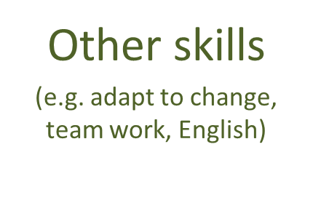
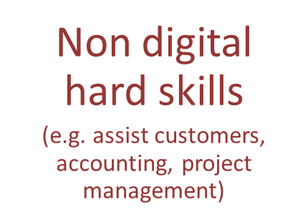
Skills in jobs - the big picture
Based on 73 million online vacancies

Slide 5
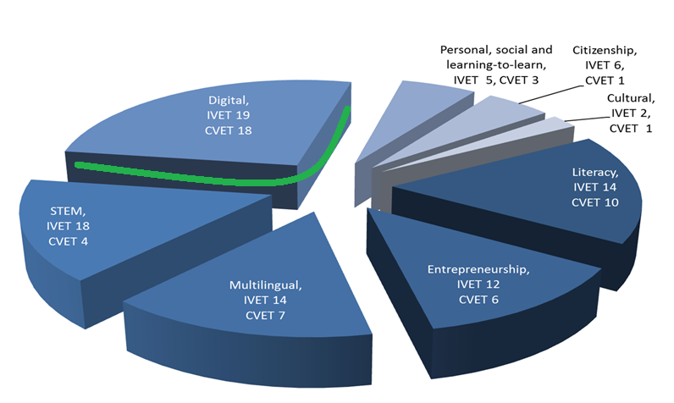
Monitoring progress towards Riga priorities

Slide 7
Background
For VET learners to adapt to new life situations and career shifts, manage change, take initiative and risk, innovate, and engage in further learning, purely occupation-specific skills are not enough; they also require key competences.

Slide 8
Background
Ensuring that key competences are adequately integrated in initial VET curricula is one of the aims of the Bruges communiqué which defined the strategic objectives for VET until 2020.
Riga conclusions (2015) continue seeking more effective opportunities to acquire or develop these competences through VET.

Slide 9
Objectives
Advance knowledge of existing policies on selected key competences in initial VET in the EU+ countries
Increase stakeholder participation in the debate on key competences in VET
Inform discussions on benefits for initial VET at national level, also based on policies of other EU+ countries

Slide 10
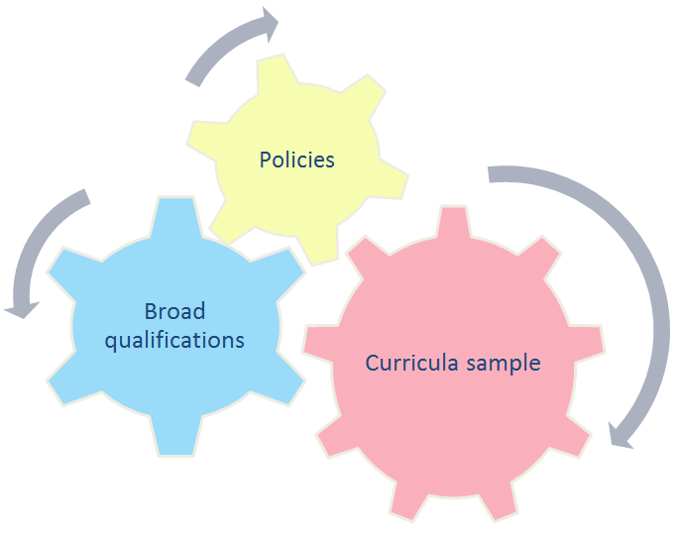
Scope
Digital, literacy and multilingual
Upper secondary initial VET
35 VET systems (EU, Norway and Iceland)
Reference period: 2011-18
Analysis of policies, ‘broad qualifications’, curricula sample and
case studies of policies
that had faced
challenges

Slide 11
Research questions
How have policies promoted key competences in initial VET since 2011?
How are the selected key competences embedded in initial VET?
To what extent has promoting key competences in VET been effective and efficient at national/EU level?

Slide 12
How have policies promoted digital competence in initial VET since 2011?

Slide 13
Key messages: policies
Policies aim to promote and often embed digital competence
Most policies do not focus only on digital competence
60% of policies promoting digital competence have a wider scope than IVET
1
2
3

Slide 14
Promoting vs embedding digital competence
Policies promoting digital competence
Policies embedding key competences
(67%)
Policies mentioning digital competence, aiming to raise awareness, but without including specific actions
Policies describing specific actions aiming to increase the extent to which digital competence is included in IVET

Slide 15
Key messages: policies
Policies aim to promote and often embed digital competence
Most policies do not focus only on digital competence
60% of policies promoting digital competence have a wider scope than IVET
1
2
3

Slide 16
Policies promoting literacy, multilingual & digital competences
Promoting literacy competences
In total: 53 policies
Promoting multilingual competences
In total: 41 policies
Promoting digital competence
In total: 64 policies
The study identified 79 policies promoting literacy, multilingual and/or digital competences (2011-18).
8
20
10
4
31
3
3

Slide 17
Policies promoting a single key competence
92% of policies exclusively promoting digital competence also aim to embed it.

Slide 18
Key messages: policies
Policies aim to promote and often embed digital competence
Most policies do not focus only on digital competence
60% of policies promoting digital competence have a wider scope than IVET
1
2
3

Slide 19
Most policies aim to embed digital competence in programme delivery
9 policies aim to embed digital competence in all thematic areas;
10 focus on one thematic area

Slide 20
How is digital competence embedded in initial VET?

Slide 21
Key messages: curricula sample
Do we all mean the same when we refer to digital competence?
Programmes fully reflecting EU definition

Slide 22
Key messages: curricula sample
Mode of delivery
Digital competence is more often integrated in other subjects
Teaching approach
Digital competence is most frequently delivered in an instructor/teacher centred approach, but also in a learning-by-doing approach
Assessment methods
Digital competence is most often assessed as a part of the subject that it is integrated in

Slide 23
Key messages: curricula sample
Key competence vs occupation-specific competence

Slide 24
To what extent has promoting digital competence in VET been effective and efficient at national/EU level?

Slide 25
Has promoting digital competence been effective and efficient?
A uniform assessment of policies’ effectiveness and efficiency is challenging
Two-thirds of policies (2011-15) have completed the planned activities
Policies promoting key competences mainly lead to follow-up actions
Policies embedding key competences contribute to changes in IVET

Slide 26
Main challenges for policy implementation
Policies have too broad scope
Vague and abstract objectives
Lack of clearly operationalised implementation plans
Lack of human resources and support at VET provider level

Slide 27
Discussion of the findings and next steps
ET2020 working group on digital education in Brussels on 15 February 2019
DGVT meeting in Alba Iulia on 18 March 2019
Workshop on key competences in initial VET: digital, literacy and multilingual in Thessaloniki on 19-20 September 2019
Publication of the study findings by Cedefop early 2020
Continue consultations about the future research on key competences in VET

