Slide 1
Centres of Vocational Excellence, the ETF experience
European Vocational Skills Week
VET for All - Skills for Life
17th October 2019 – Helsinki
By Georgios Zisimos @Gzisimos

Slide 2
The ETF is an agency of the European Union, helping EU neighbouring countries to reform their own education and training systems, in line with the EU’s external relations policies.

Slide 3
WHERE WE WORK

Slide 4
What are we Discussing
What is the urgency?
Perceptions of Vocational Excellence
Developmental dimension of Vocational Excellence
ETF Future Plans
Mapping of Centres of Vocational Excellence
Setting Up CoVEs

Slide 5
What is Vocational Excellence? (The EC view)
VET Excellence ensures high quality skills and competences that lead to quality employment and career-long opportunities, which meet the needs of an innovative, inclusive and sustainable economy
The concept of vocational excellence that is proposed, is characterised by a learner centred holistic approach in which VET:
Is an integrative part of skills ecosystems, contributing to regional development, innovation, and smart specialisation strategies
Is part of knowledge triangles, working closely with other education and training sectors, the scientific community, and business
Enables learners to acquire vocational and key competences through high-quality provision that is underpinned by quality assurance, builds innovative forms of partnerships with the world of work, and is supported by the continuous professional development of teaching and training staff, innovative pedagogies, mobility and internationalisation strategies.

Slide 6
What is the aim of this initiative?
The aim of this initiative is to foster Vocational Excellence at two levels:
National: through Centres of Vocational Excellence (CoVE) operating in a given local context, embedding them closely in the local innovation ecosystems, and connecting them at European level
Transnational: through Platforms of Centres of Vocational Excellence to establish world-class reference points for vocational training by bringing together CoVE`s that share a common interest in specific sectors/ trades (e.g. aeronautics, e-mobility, green technologies, ICT, healthcare, etc.) or innovative approaches to tackle societal challenges (e.g. integration of migrants, Digitalisation, Artificial Intelligence, Sustainable Development Goals, upskilling people with low qualification levels, etc.).

Slide 7
What are the essential features of centres of vocational excellence?
Centres of Vocational Excellence (CoVE), should be understood in a wide context that adapts to the diversity of VET systems in the various member states. In some countries they can be led by a Vocational institution (e.g. in the Netherlands) providing a large portfolio of services in close relation with other organisations, while in other countries (e.g. Germany and Austria) they could be led by the Chambers that have a key (and legal) coordinating role in implementing VET policies and services.

Slide 9
Diverse nomenclature for centres of excellence
Russia – “Centres of Competency” or “Centres of Occupational excellence and workers”
Ukraine – “Centres for professional excellence”
Moldova – “partnerships for quality and relevance”
Azerbaijan – “VET competence centres”
Belarus – “Centres of excellence”
Kosovo* – “Akademie”
Algeria – Partnership for Excellence (Partenariat pour l'excellence)
* This designation is without prejudice to positions on status, and is in line with UNSCR 1244/1999 and the ICJ Opinion on the Kosovo Declaration of Independence.

Slide 10
the most common elements
ETF partner countries are mainly middle-income or in economic transition
Development, introduction or presence of innovative teaching and training methodologies
Development, introduction or presence of innovative curricula and pedagogies
Investing in the continuing professional development of teachers and trainers
Establishing business-education partnerships
continuum
Providing people with labour market relevant skills in a lifelong learning

Slide 11
the least common elements
ETF partner countries are mainly middle-income or in economic transition
Development, introduction or presence of “International VET campus/academies”
Development, introduction or presence of business incubators for VET learners
Contributing to creation and dissemination of new knowledge
Acting as or supporting innovation hubs and technology diffusion centres
Making use of EU financial instruments and Funds

Slide 12
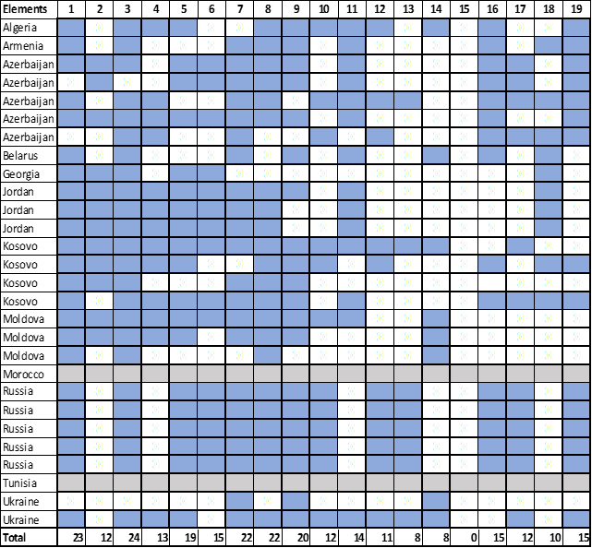
Elements per project
1. Providing people with labour market relevant skills
2. Providing higher level VET programmes;
3. Establishing business-education partnerships for; apprenticeships,
4. Working together with local SME's by sharing equipment
5. Development, introduction or presence of Joint VET curricula
6. Development, introduction or presence of internationalization
7. Development, or presence of innovative teaching methodologies
8. Development, introduction or presence of innovative curricula
9. Investing in the continuing professional development of teachers
10. Development, introduction or presence of project-based learning
11. Providing guidance services, as well as validation of prior learning
12. Development, introduction or presence of business incubators
13. Acting as or supporting innovation hubs
14. Supporting the attraction of foreign investment projects
15. Development, or presence of "International VET academies"
16. Participating in national and international Skills competitions
Contributing to creation and dissemination of new knowledge
18. Making use of EU financial instruments and Funds
19. Developing sustainable financial models

Slide 13
ETF paper on CoVEs:
What does it bring?
Sources gathering started in 2015 (request to ETF from EE PCs).
Added value to EC & ETF Mappings (+) providing comprehensive picture on the fragmented, multifaceted & high in policy agendas discussions on CoVEs worldwide .
Supported & Complemented the elaboration of different analysis presented in the ETF document (e.g. typology for set-ups , role of donors, ETF PCs mapping, transmission of excellence etc.)
Strong focus on and use of VET history, VET institutions, Role of VET in Employment, Digital revolution, EU acquis communautaire, International approaches and examples, donor experiences, academic developments (etc.)
Identified gaps on the need for further research (e.g. survey in policy processes & system change, study cases, lack of evaluation and monitoring practices -performance assessments-, VET & Innovation etc.).

Slide 14
Snapshot on Background:
Key Issues supporting Rationales & Policy Options For Setting- up CoVEs
Improving the efficiency and performance of networks of VET institutions, & invest in infrastructure, equipment.
Improving VET quality provision; Q.A systems; using labour market intelligence to effectively match skills.
Addressing effective and wide-spread work-based learning (WBL) practices;
Halting declining or stagnating enrolment rates in VET institutions (demography of VET);
Improving effectiveness of VET multi level governance & increasing VET school autonomy;
. Addressing gaps in the recruitment of quality teaching staff (e.g. masters of practical training);

Slide 15
Key Issues supporting Rationales & Policy Options For Setting- up CoVEs
Reforming the (insufficient) public financing of VET and the inefficient funding schemes for pooling public VET funds, while creating opportunities for multichannel financing and cost-sharing mechanisms (use of tax systems);
Reforming the status and pathways of vocational education systems within LLL perspective (e.g. CVET qualifications at level 5 to HE etc.);
Introducing a culture of continuous improvement and innovation into the VET community;
Tackling the underuse of vocational guidance and other counselling tools/measures to help in increasing the recognition and employability of VET graduates in the labour market;
Supporting political consensus around complex processes of rationalising and optimising VET networks;
. Increasing the role of economic sectors, regions and local ecosystems for skills development to boost VET (local) partnerships.
Developing new methodological tools and resources: this requires the creation of network institutions to transfer accumulated knowledge to other VET institutions and whole community.

Slide 16
Drivers for Centres of Vocational Excellence
Provision:
Lifelong learning
Higher level VET programmes
Innovative curricula
Transversal competences
Innovative teaching and learning
Counselling and guidance
Business – education partnership (WBL)
Regional
development
&
Regional
Cooperation
Rather Government
driven
Innovation, productivity, competitiveness:
Innovation hub
Technology diffusion
Business incubators
Applied research
Accreditation (companies)
Certification (processes and products)
Foreign investment
Rather Industry
driven

Slide 17
From traditional VET schooling to more autonomy
(Semi-) Autonomous VET Centre
Overall objective setting
External evaluation (external QM)
Overall budget
Autonomy in terms of staffing
Autonomy: curricula and organigram
External Governance
Work programme
Self-evaluation (internal QM)
Internal budgeting process
Autonomy in terms of staffing
Autonomy: curricula and organigram
Traditional VET schooling
Internal
Management
Centrally governed
Central directives
Bureaucratic inspection
Centralised budget
Staff centrally allocated
Binding curricula
Demand-driven by region (economy, specific target groups etc.)
Regional-specific innovations
Lifelong learning
Regional educational planning
Regional Cooperation

Slide 18
CoVEs
Centre of Vocational Excellence
WHAT ?
HOW ?
Green technology
Digitization
Agriculture
Adult training
Innovative teaching
etc.
Governance
Autonomy
Collaboration
Leadership
Financing
etc.
Why are you doing what you do? And where, e.g. Europe, Africa, Asia?
Do you focus your support rather on the what or on the how?
What are the success factors?
How can international networks help?

Slide 19
SCOPE FOR COLLABORATION
Projects, such as the joint development of new materials or the application of new methodologies;
Observation and learning from innovative or modern practice in other schools.
Collaborating to engage and work with business and other non-educational actors.
Sharing resources, e.g. staff,
leadership, laboratories and
instructional materials
Collective provision of some services, such as professional development, procurement, data storage, careers advice, labour market data collection
Coordination and rationalisation of the training offer in order to optimise it and increase efficiency.
Notes:
By supporting human capital development in the context of its external relations policy, the European Union contributes to economic development in these countries by providing the skills necessary to foster productivity and employment and supports social cohesion by promoting civic participation.
In the context of the efforts of these countries to reform their economic and social structures, the development of human capital is essential for attaining long-term stability and prosperity and in particular for achieving socio-economic equilibrium.
European Council Regulation

