Slide 1
Update on VET Stocktaking Study
7th meeting of the VET WG on Digitalisation and Innovation
Helsinki, 15 October, 2019.

Slide 2
Centres of Vocational Excellence Report – PUBLISHED!
Go to https://ec.europa.eu/social/main.jsp?catId=738&langId=en&pubId=8250&furtherPubs=yes
to have a look….

Slide 3
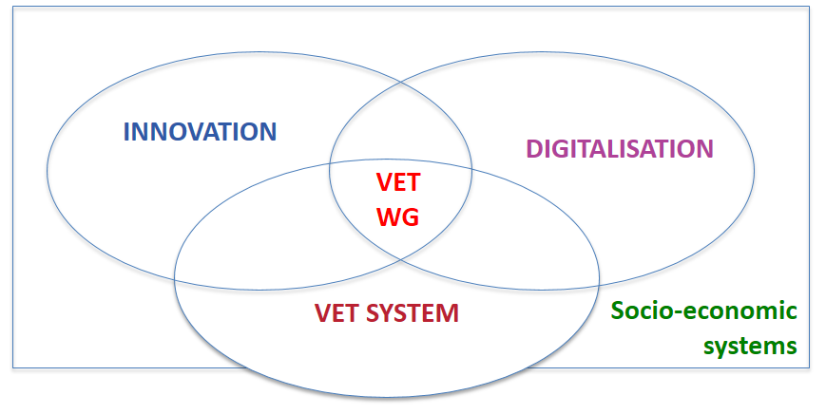
Comments incorporated
From WHERE?
Participants at June Webinar;
Comments from 14 countries on stocktaking tasks;
The ETF and VETNET.
About WHAT?
General comments on the draft report, and;
Concrete and relevant VET examples to enrich the text.
STILL….
1. More examples needed!
2. Expanding funding section..
3. Drafting mobility section…
Notes:
- Still, we need more examples from the WG particularly related to funding and mobility.

Slide 4
Changes to the stocktaking report
Main takeaways: improved working definition; better identification of pedagogical innovations and digital learning technologies used in VET across Europe; ideas for expanding funding and mobility sections.
Relevant examples from WG:
Text boxes throughout the report
Novel sections:
Focal areas for driving quality and excellence in VET; CoVEs, Higher VET;
European level funding for innovation and digitalization.

Slide 5
Issues addressed at June webinar
OLD DEFINITION
Innovation is (…) the implementation of a new or significantly improved product (goods or services, such as textbooks) or process (such as ICT in e-learning), a new marketing method (such as different pricing methods for courses), or a new organisational method in business practice, workplace organisation or external relations (for example using a new app or software to communicate with parents
NEW DEFINITION
Innovation is the use of new or significantly re-designed teaching and learning tools, methods or environments (such as digital learning tools, MOOCs or virtual reality) or new organisational methods (for example using a new app or software to interact with employers) aimed at improving the quality of VET and/or supporting innovation for environmental sustainability and social and economic goals.
“Make examples more focused on VET”
“Include purpose of innovation”
FOCUS OF MOBILITY TOPIC
How mobility supports skills improvements (technical, key competences) which, in turn, supports innovation, including through trans-national sharing of ideas
… and the opportunities to achieve better blending of digital and physical mobility, e.g. in light of climate emergency

Slide 6
Next steps
Draft text of key messages of chapters to be circulated before December PLA Budapest: Request for initial feedback/discussion
Examples to be received by end December 2019
January WG meeting: small group work to elaborate key messages, conclusions and recommendations; session on communications
March webinar: Discuss key messages, conclusions and recommendations elaborated since January meeting

