Slide 1
Let’s Do
It

Slide 2
Craig Robertson
CEO
TAFE Directors Australia
Chair
World Federation of Colleges and Polytechnics

Slide 3
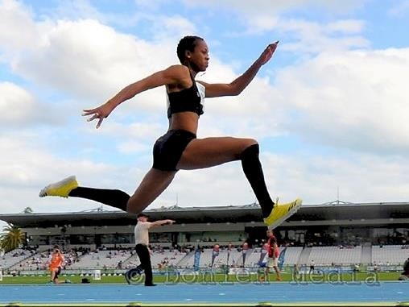
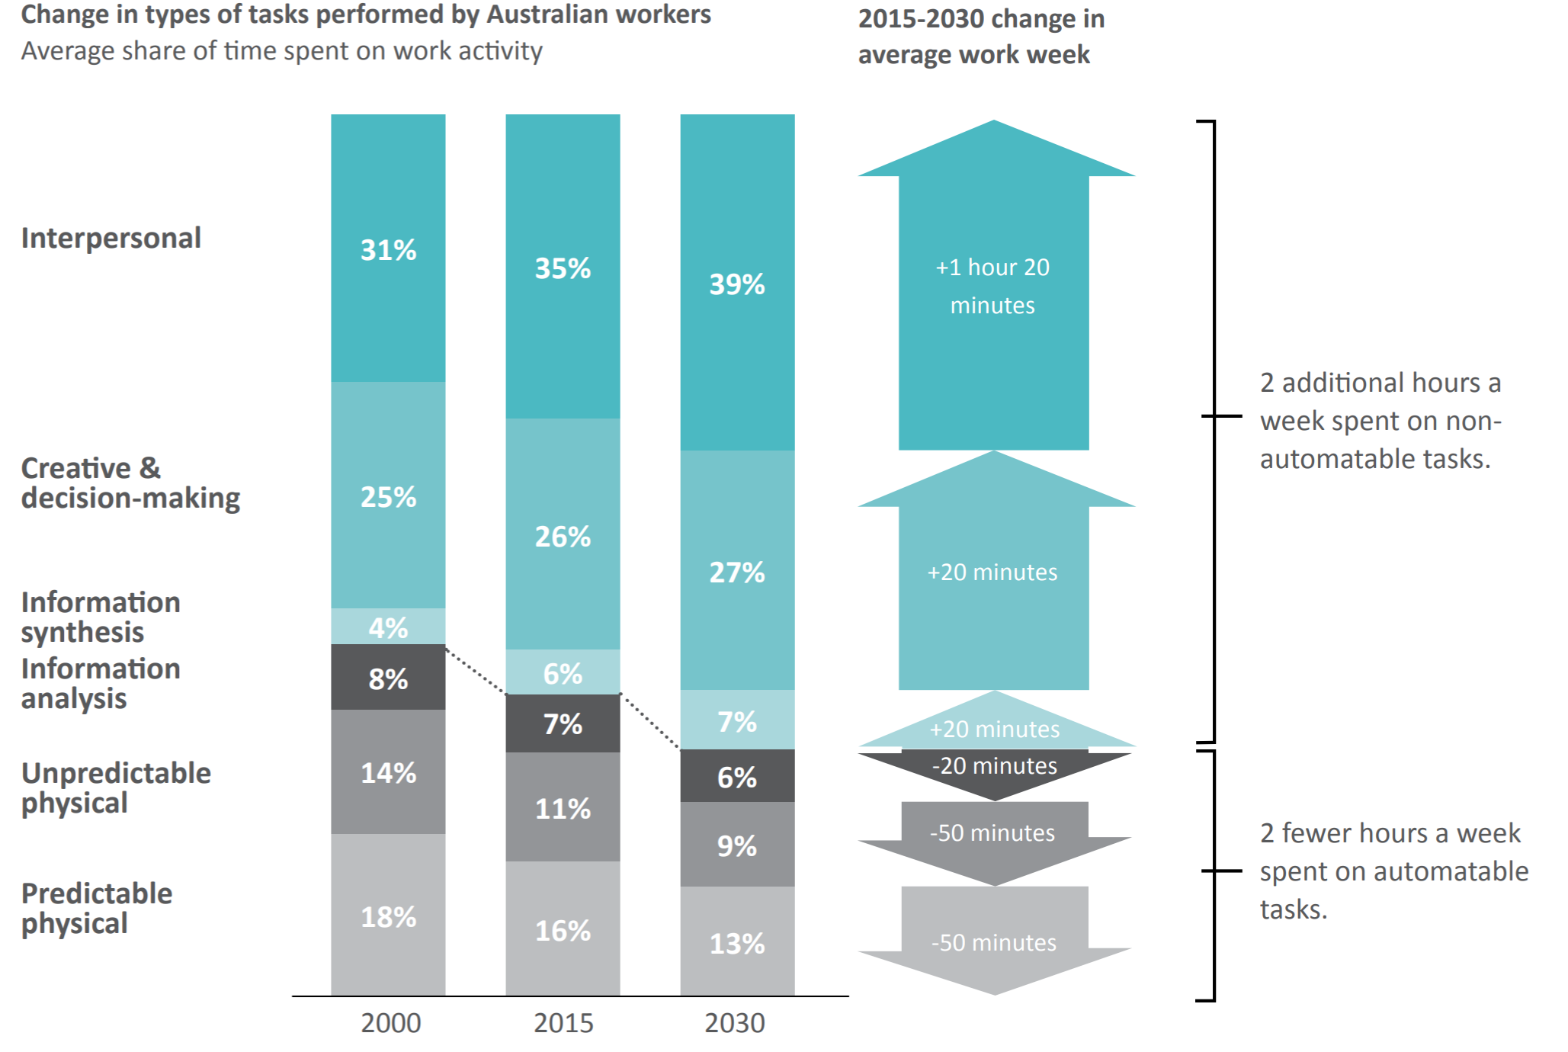
Know-What
alphaBeta, Strategy x economics, The Automation Advantage, 2019

Slide 4
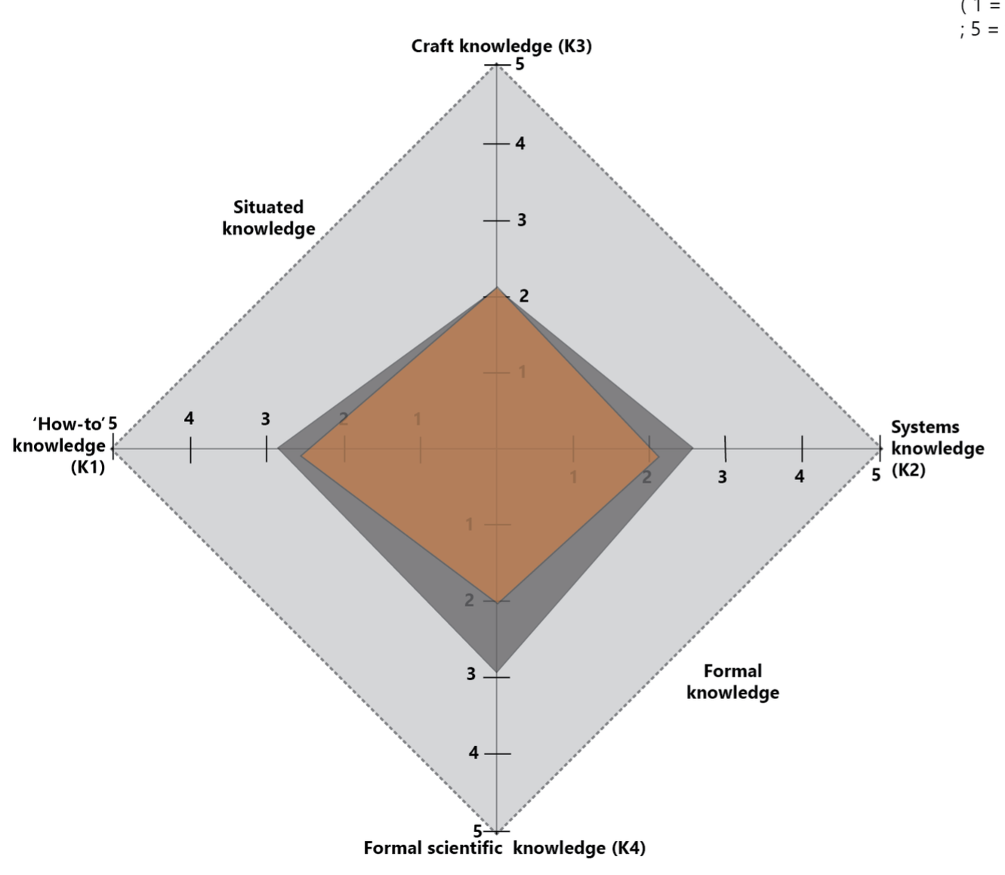
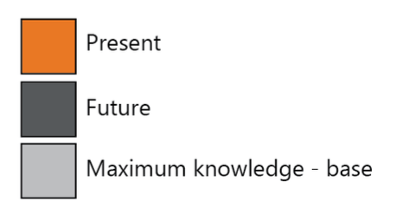
Know-Why
Boat Building
Jean Gamble From Labour market to labour process: finding a basis for curriculum in TVET, 2016

Slide 5
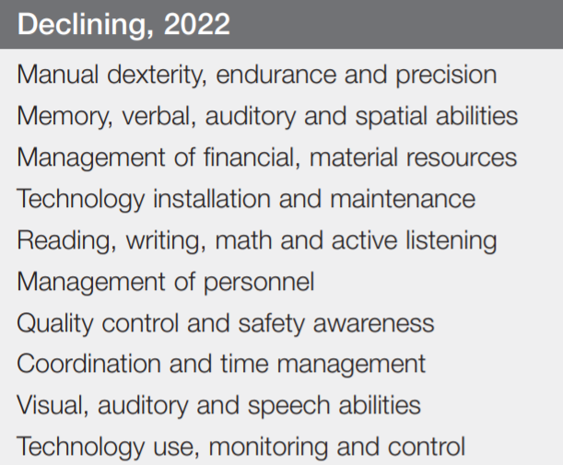
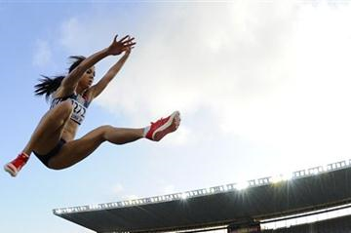
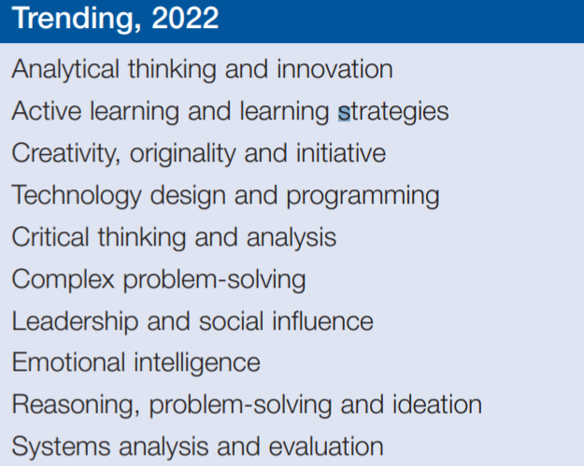
Know-How
World Economic Forum – The Future of Jobs Report, 2018

Slide 6
Let’s
bring it
together

Slide 8
Thank you

